Slide 1
Paid Family and Medical Leave: Some lessons from research
Randy Albelda, Professor of Economics
Senior Fellow at Center for Social Policy and
Graduate Program Director of MA in Applied Economics
University of Massachusetts Boston

Slide 2
Paid Family and Medical Leave: Research support/Supporting research
Brief overview of PFML
Making the policy case
“Leaping into the 20th century”
Cost of not having paid FML and having paid FML
Reducing income, gender, and racial inequalities
Leveling employer playing field
Policy obstacles
New territory for non-TDI states
Administrative structure
Usage
Fine-tuning a program
Program parameters that are costly, reach workers currently without PFML, and can be supported by workers with paid FML
Program tradeoffs

Slide 3
Family and Medical Leave
A temporary, but extended leave from work for
Own serious health condition or pregnancy-related health reasons (medical leave)
To care for a family member with a serious health condition or to bond with a new-born or adopted child.
Family and medical leave in the US
FMLA (Family and Medical Leave Act) since 1993
12 weeks of unpaid job-protected leave for documented family or medical reason for some employees.
Must have worked 1250 hours in the previous year for an employer that employs 50 or more workers within a 75 mile radius.
41% of workers do not meet these requirements (Klerman, Daley and Pozniak 2012 – DOL sponsored survey)

Slide 4
Paid leave
The US is an outlier when it comes to both.
Of 22 high-income countries, the US is the only one that does not have guaranteed leave for an illness that lasts 50 days (Heymann et al. 2012).
The US is one of three in the world that does not provide paid maternity leave.
Five states (and PR) have had TDI programs that cover own health and pregnancy-related leaves for over 50 years. See http://www.abetterbalance.org/web/images/stories/Documents/general/TDIchart.pdf for details.
Four of these states (CA, NJ, RI and NY) now also have paid leave for bonding and family care leaves. See http://www.nationalpartnership.org/research-library/work-family/paid-leave/state-paid-family-leave-laws.pdf for details.

Slide 5
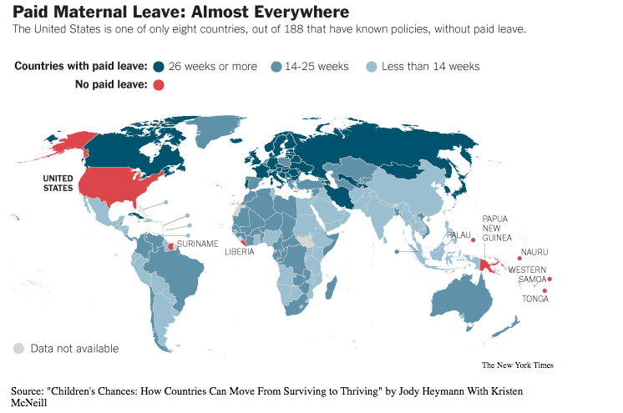
Source: NYT:http://www.nytimes.com/imagepages/2013/02/17/opinion/17coontz2-map.html

Slide 6
Making the policy case for paid family and medical leave
Employers and employers ARLEADY do it. It is a fact of everyday work life.
People get sick; parents have babies and adopt children; and parents, spouses, children, and other relatives need family caregivers when serious ill.
Costs are born by individuals now. With a social insurance program they become shared costs over time and they are not very much per worker/employee.
Paid FML reduces inequality.
Least likely to get paid leave now are workers of color and low-wage workers.
Women are more likely to take a leave.
Paid FML levels the field for small businesses – the least likely to be able provide paid FML.
Individual cost is very high, but shared one is not.

Slide 7
Policy (vs. political) obstacles
There are 5 TDI states, offering own health leaves for almost 70 years and pregnancy leaves since the 1970s.
Four of those now have family leaves too – extending their system in place (NY is revising as well).
The other 45 states and DC have to start from scratch.
Uncertainly about usage and costs.
We currently know what TDI states do with 26-52 weeks of TDI and 4-6 weeks of family leave.
We know what national leave taking behavior is like (DOL survey).
But, new programs proposed use different parameters and have different cultures about leave taking.

Slide 8
ACM (Albelda and Clayton-Matthews)/IWPR Paid Family and Medical Leave Simulator
Program costs.
Incidence of need and eligibility.
Program participation (take-up rates).
Distribution of use and benefits by demographic and economic characteristics of the population.
Provide estimates for a range of programs that differ by eligibility characteristics and benefits.
Provide a model that can be used by other states or administrative jurisdictions.

Slide 9
Massachusetts
The “sliding scale” program benefit replaces 90% of weekly wages up to $377 (30% of the statewide average weekly wage) and then 33% of weekly wages for any amount up to that, with a maximum benefit of $650 (which is less than half of the average weekly wage and about 90% of the weekly median wage).

Slide 10
Coverage
Of the 3.1 million covered workers (self-employed and federal and local workers are excluded), we estimate 12% currently (no program) take 508,000 leaves, with or without wage replacement.
With this program and additional 11,000 workers take leave (with 13,000 additional leaves).
We estimate 152,000 workers would use the program annually (just under 30% of all leavers, 5% of covered LF).
Of paid leaves: 66% for own health; 15% for pregnancy and 16% for bonding; 3% for ill relative.
Currently, without a program, 72.4% percent of leaves have some wage-replacement. With the program that increases to 80.8% for all leaves and 84.9% for leaves 3 weeks or longer.

Slide 11
Cost
Total annual cost: $491 million
Average annual total cost per worker: $159
Average weekly cost: $3.06
Payroll premium (uncapped): 0.325%
Payroll premium (capped at $113,400):0.375%
Average annual cost for median wage earner ($772/week) is $150 at capped premium

Slide 12
Fine-tuning a program: cost, coverage, and buy-in
Cost considerations
Cost-driving policy parameters
Maximum leave lengths
Maximum wage replacement
Replacement rate
Coverage considerations
Coverage of workers least likely to be covered now
Employment or earnings eligibility requirements
Sliding scale replacement rate
Employer size exceptions
Buy-in considerations
Employers and employees with paid FML now
Maximum leave length
Maximum wage replacement
Replacement rate

Slide 13
Fine-tuning a program: tradeoffs
Policy Parameter Trade-offs
 | Reduce Costs | Increase Coverage | Increase Buy-in | Compromise?
Length of leave | Low | Sufficiently high | Sufficiently high | Sufficiently high
Wage replacement level | Low | Medium | High | Medium
Wage replacement rate | Low | High | Sufficiently high | Sliding scale to sufficiently high rate
Employees covered | All | All | ? | All

