Slide 1
How To Cut Rx Costs
Pharmacy Outreach Program
The University of Rhode Island
College of Pharmacy
1-800-215-9001
www.uri.edu/pharmacy/outreach

Slide 2
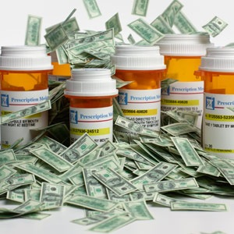
Statistics
Estimates for 2013
$271.1 billion in prescription costs (US)
Almost 3.9 billion prescriptions filled at pharmacies
People ages 65+ consume more prescription and OTC medicines than any other age group
Notes:
Stats updated Feb 2015
http://www.cms.gov/Research-Statistics-Data-and-Systems/Statistics-Trends-and-Reports/NationalHealthExpendData/Downloads/highlights.pdf -stat on cost of medications
http://www.statehealthfacts.org/profileind.jsp?sub=66&rgn=1&cat=5 -stat on # of rx filled
http://kff.org/other/state-indicator/retail-rx-drugs-by-age/ - age stat

Slide 3
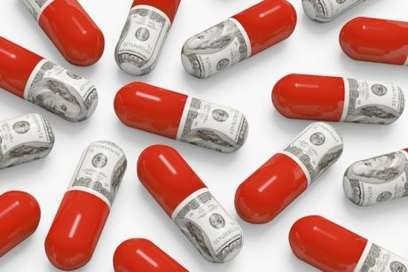
Does anyone know why medications are so expensive?

Slide 4
Why Are Meds So Expensive?
Research & Development
Usually takes over 10 years for one drug
Not every drug reaches the market
Clinical trials!
Cost of production and manufacturing
Advertising
$3.1 billion each year (2012)
Demand
Drugs not in high demand often cost more
Notes:
Research=
Not every drug that is investigated makes it to market.
Clinical trials ensure efficacy and safety but cost money
Some drugs that are not in high demand often cost more. Less people to share the burden of cost.
Some drugs are more expensive to manufacture than others i.e. Enbrel…
http://www.ncsl.org/default.aspx?tabid=14461
http://prescriptiondrugs.procon.org/

Slide 5
Cost vs. Demand
Cost (in dollars)
Number of people taking medication
Notes:
Uncertain of source?

Slide 6
Practical Ways to Save Money
Be your own advocate!
Communicate with your doctor and ask questions
Ask your Pharmacist!
Best resource for prescription related information
Some pharmacies have coupon cards on hand
Research different assistance programs
Don’t be embarrassed to tell your doctor you can’t afford your medications
Notes:
Some pharmacies have coupons on hand.
Many drug companies offer coupons or rebates on their website (get someone to look for you)

Slide 7
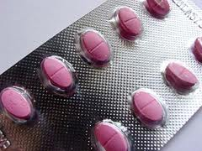
Practical Ways to Save Money
Request formulary medications only
Formulary: list of drugs covered by insurance
Bring your drug formulary list to the doctor
Ask your doctor about less expensive therapeutic alternatives
Ask your doctor for samples or coupons
Samples may not have directions on them, be sure to check with doctor about how to take them!
Let pharmacy know to check for interactions!
Notes:
By law in RI meds have to be substituted to the generic unless specified by the patient or the doctor

Slide 8
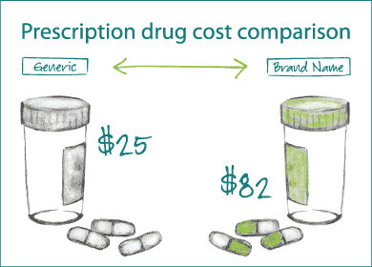
Who knows what a generic drug is?

Slide 9
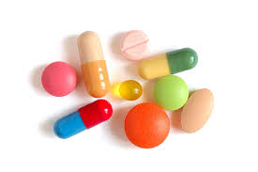
Generic vs. Brand Drugs
Generic drugs are copies of brand drugs
Generic drugs are just as safe as brand drugs and work the same!!
Both have the same:
Manufacturing procedures
Safety profiles
Equally regulated by the FDA
Use generic medications whenever possible!
By R.I. law, generics are automatically substituted for brand name medications unless specified by Dr. or patient

Slide 10
New Generic Drugs for 2014-2015
 | Brand | Generic
2014 | Diovan 320mg ($727.36/90tabs) | valsartan ($569.10/90 tabs)
 | Actonel | risedronate
2015 | Abilify 2-15 mg ($1,070.36/30 tabs) | aripiprazole
 | Namenda | memantine
2016 | Crestor | rosuvastatin
Notes:
2014
Actonel 150 mg ($298.24/1 tab) → risedronate ($233.39)
Diovan 320 mg ($727.36/90 tabs) → valsartan ($569.10)
Evista 60 mg ($792.00/100 tabs) →raloxifene ($712.80)
2015
Abilify 2-15 mg ($1,070.36/30 tabs) → aripiprazole
Namenda 5-10 mg ($374.99/60 tabs) → memantine
Avodart 0.5 mg ($128.99/30 caps) → dutasteride
2016
Crestor ($740.77/90 days) → rosuvastatin
Namenda is BID
Corporate pharmacy services. https://www.corporatepharmacy.com/page/upcoming_generic_drugs. accessed October 14 2014.
Lexi-Comp Complete. Hudson, Ohio: Lexi-Comp inc.;2008; Prices updated Feb 2015
Abilify 4-20-15
Namenda 7-11-15
Avodart 4th quarter 2015

Slide 11
Practical Ways to Save Money
Mail Order
Some insurance plans allow you to receive a 3 month supply of your maintenance medications for the price of a one month co-pay via mail order
Convenient for some
Let pharmacist know if you get
some medications through mail
order!

Slide 12
Practical Ways to Save Money
Live a healthy lifestyle
Decreased need for meds → $ saved!
Take your medications exactly as prescribed
Side effects = leading cause of hospitalization in older adults
Store medications properly
In the fridge (when needed)
Not in the bathroom
Not in the car

Slide 13
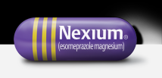
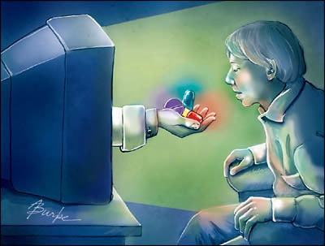
Practical Ways to Save Money
Don’t let direct-to-consumer advertising influence you!
Example: “The new purple pill” - Nexium® (esomeprazole)
Prilosec® (omeprazole) may do the same job for cheaper and has a generic
Always ask you doctor or pharmacist questions about what you hear in advertisements!
Notes:
Explain the term “direct-to-consumer”
These medications used to be prescription-only, but are now available OTC (Prilosec has a generic, Nexium doesn’t yet)

Slide 14
Internet Pharmacies
Many of them are not properly licensed & regulated!!
Only use sites that have the VIPPS seal of approval from the NABP
VIPPS = Verified Internet Pharmacy Practice Site
Notes:
Vipps – verified internet pharmacy practice sites
NABP – national association boards of pharmacy

Slide 15
Importing Medications From Abroad
Many issues with meds from other countries (including Canada!)
Almost always illegal
The medications have not met FDA standards
Safety & effectiveness are not reliable
Expired, contaminated, counterfeit
Can’t get refunded if there is a problem with the meds
Notes:
There are sites that are legal, but they must be registered with the state as a non-resident pharmacy provider
Other countries do not have standards as high as the united states.

Slide 16
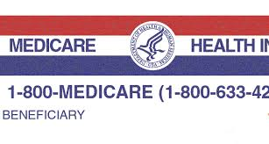
MEDICARE
Medicare provides health insurance for people:
Aged 65 years or older
Age less than 65 years with certain disabilities
All people with End-Stage Renal Disease (ESRD)
All people with Lou Gehrig’s Disease (ALS)
Notes:
Receiving SSDI for 24 months = “certain disabilities)
Amyotrophic lateral sclerosis (ALS)

Slide 17
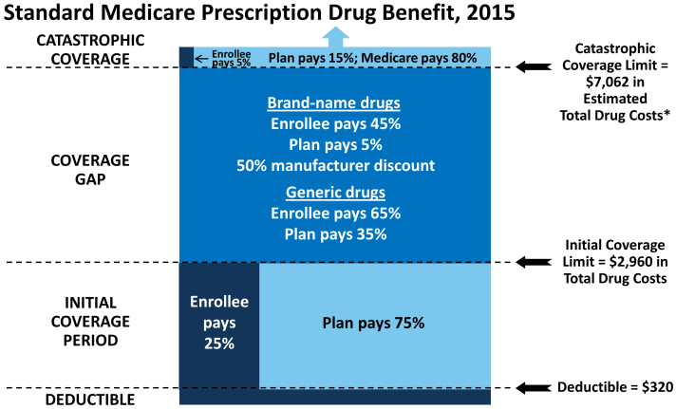
MEDICARE Part D
The manufacturer discount counts as out-of-pocket spending!
(Out-of-pocket spending $4,700)
Notes:
http://kff.org/medicare/fact-sheet/the-medicare-prescription-drug-benefit-fact-sheet/
Needs to be updated yearly

Slide 18
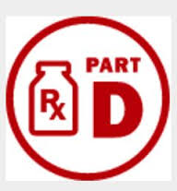
MEDICARE Part D
In 2015, enrollees will pay 45% of the total cost of BRAND NAME medications in the gap
Will only pay a max of 65% on GENERIC medications in the gap
Additional savings each year through 2020
In 2020 the coverage gap will be closed

Slide 19
Programs to Help With Drug Costs
SHIP - Senior Health Insurance Program
Volunteers provide seniors with:
Information
Counseling
Assistance in making decisions about Medicare, supplemental insurance, managed care, etc.
Free!
http://www.dea.ri.gov/insurance/
Notes:
Look up
http://www.dea.ri.gov/insurance/
Division of elderly affairs

Slide 20
Question:
Does anyone here have RIPAE?
"RI Pharmaceutical Assistance to the Elderly”
Notes:
Rhode Island Pharmaceutical Assistance to the Elderly

Slide 21
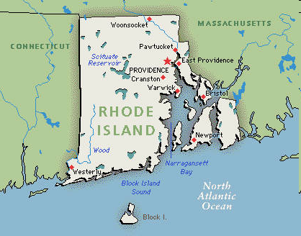
Programs to Help With Drug Costs
RIPAE
State program which helps older adults pay for their medications
Does not replace Medicare!
RIPAE is only be available for those enrolled in a Medicare part D plan
Must send in copy of enrollment
letter or card
Notes:
Look up RIPAE
Coverage is creditable if the actuarial value of the coverage equals or exceeds the actuarial value of standard prescription drug coverage under Medicare Part D, as demonstrated through the use of generally accepted actuarial principles and in accordance with CMS actuarial guidelines – RIPAE is not a “replacement” for Medicare, need both

Slide 22
Programs to Help With Drug Costs
RIPAE
Provides extra benefit for those who don’t qualify for Extra Help from Medicare
Only covers generic drugs!
Unless no generic available or doctor specifies brand
Applies to all expenses that person is 100% responsible for
Deductible
Coverage gap (“Donut Hole”)
Certain drugs not covered under your Part D Plan
Visit RIPAE for a list of covered meds

Slide 23
Programs to Help With Drug Costs
RIPAE
To be eligible must be:
Over 65 years, or aged 55-64 receiving disability (SSI)
Coverage level based on income
$0 to $22,432
$0 to $28,042
$22,432 to $28,159
$27,574 to $35,211
$28,159 to $49,372
$34,623 to $56,320
$0 to $48,547 $0 to $56,320
Notes:
Supplemental security income
Send in by dec 15th so no break in coverage
http://www.dea.ri.gov/programs/prescription_assist.php – may need to update income amounts (there are text boxes)

Slide 24
Programs to Help With Other Costs
Medigap Plans
Supplemental coverage insurance that you can purchase
Reduces copays from parts A & B
Not prescriptions
Offered by many organizations
Most popular is AARP
Will help with costs not covered by Medicare (copays, deductibles)
Notes:
Ways to reduce cost
American Association of Retired Persons

Slide 25
Programs to Help With Drug Costs
For Veterans and their spouses
You may be eligible for these programs:
TRICARE for Life
TRICARE Senior Pharmacy Program
You may also be eligible to receive meds from VA pharmacy clinics
Notes:
Tricare for Life uses Medicare as primary payer, then Tricare pays some of the leftover price to reduce cost
The pharmacy program requires you to to fill select maintenance medications via TRICARE Pharmacy Home Delivery or use a military pharmacy instead of using retail pharmacies
The program does not apply to medications for acute conditions taken for a limited time, such as antibiotics or pain medications or any generic medications. At this time, it also does not apply to generic drugs.
At a network pharmacy, brand-name drugs cost $60 (90-day supply). The same prescription costs only $16 (90-day supply) from home delivery.
http://www.military.com/benefits/tricare/retiree/tricare-senior-pharmacy.html

Slide 26
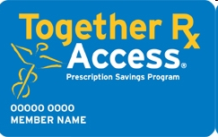
Programs to Help With Drug Costs
Medication Discount Cards
20-40% discount on certain brand name medications offered by manufacturers
15% savings on generic medications offered by some pharmacies
*Only for people who do not have prescription drug coverage
Not for those that qualify for Medicaid or Medicare
Notes:
Abbot, astrazeneca, aventis, bristol-myers squibb, glaxosmithkline, janssen, novartis, orthomcneil

Slide 27
Programs to Help With Drug Costs
Partnership for Prescription Assistance
Help with more than 2,500 brand-name and generic medications
Free or low cost
Make sure you know the names of your medications
Call 1-888-4PPA-NOW
Visit: www.pparx.org
Trained specialists will answer your questions and help you apply—it is a free service!

Slide 28
Programs to Help With Drug Costs
www.internetdrugcoupons.com
Manufacturer discounts for brand name drugs
Some specify Med Part D or Medicaid patients are ineligible
AAA discount!
Average 24% savings (not for use with other insurance)
Senior Citizen discount
Most pharmacies offer a 10% discount on cash prescriptions for seniors
Notes:
Abbot, astrazeneca, aventis, bristol-myers squibb, glaxosmithkline, janssen, novartis, orthomcneil

Slide 29
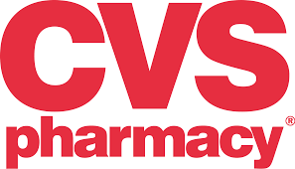
Pharmacy Savings Programs
Most major chain pharmacies and many smaller independent pharmacies may price match—ask!
Walmart, Target, CVS, Rite Aid, Walgreens, Stop & Shop, Kmart
All have prescription savings plans
Some require an enrollment fee
Only specific generics covered
Some allow a 3 month supply
Even greater savings
More convenient
Notes:
New 30 days for $30 atorvastatin, clopidogrel at Walmart… regular and NPH insulin for $25/vial
For diabetes testing supplies, pharmacies have their own generic meter – if you have to pay out of pocket for these things test strips are usually significantly cheaper

Slide 30
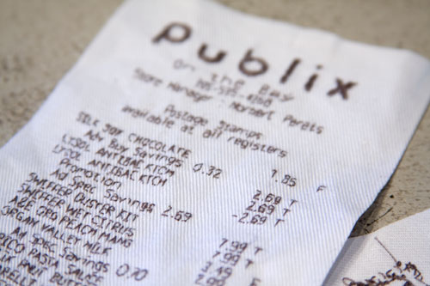
Practical Ways to Save Money
Housing and Urban Development (HUD) Residents
Save the receipts from your daily OTC items
Vitamins, creams, Depends…
Turn receipts in to housing office with a note from your doctor saying that it is necessary for you to use these items
Receipts count toward your annual rent deductions!
Notes:
Section 8 housing

Slide 31
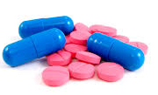
Summary and Key Points
Be your own advocate!
Look at each medication you are taking & evaluate its cost
Communicate with your Doctor and your Pharmacist
Research which programs can benefit you
Be an informed consumer & patient
Take your medications exactly as your physician prescribes

Slide 32
Programs to Help With Drug Costs
Pharmacy Outreach Program
Acts as a resource for medication assistance programs, both State and National
Answers common medication questions
Generic vs. brand name drugs
Drug formularies
Therapeutic substitutions
Medication Information Line
Toll free number: 1-800-215-9001

Slide 33
Thank You!!
Pharmacy Outreach Program
The University of Rhode Island
College of Pharmacy
1-800-215-9001
www.uri.edu/pharmacy/outreach

