Slide 1
PROJECT MANAGEMENT THROUGH THE PRISM OF REEPORT
Carol Harvey, Assistant Director, NJAES
2013 Fall NEMO Meeting
October 7. 2013

Slide 2
TODAY’S DISCUSSION
INITIAL SURVEY ON REEPORT
7 respondents, mostly site administrators
Several system issues raised
HOW WE WILL USE REEPORT TODAY?
A framework for identifying various research project management/reporting issues.
To discuss some strategies for dealing with some REEport challenges.
Identify specific topics for future meetings.
USER TRAINING AND RESOURCES

Slide 3
PROJECT INITIATION
BEFORE YOU CAN INITIATE A PROJECT IN REEPORT, YOU HAVE TO DEVELOP A PROJECT.
Project development processes vary by institution.
Is this a good topic for a future NEMO session?

Slide 4
PROJECT INITIATION IN REEPORT
COVER PAGE
PARTICIPATION
GOAL/OBJECTIVES
EXPECTED OUTCOMES
PRODUCTS
TARGET AUDIENCES
METHODS
NON-TECHNICAL SUMMARY
PROJECT CLASSIFICATION
PROPOSAL
ASSURANCE STATEMENTS

Slide 5
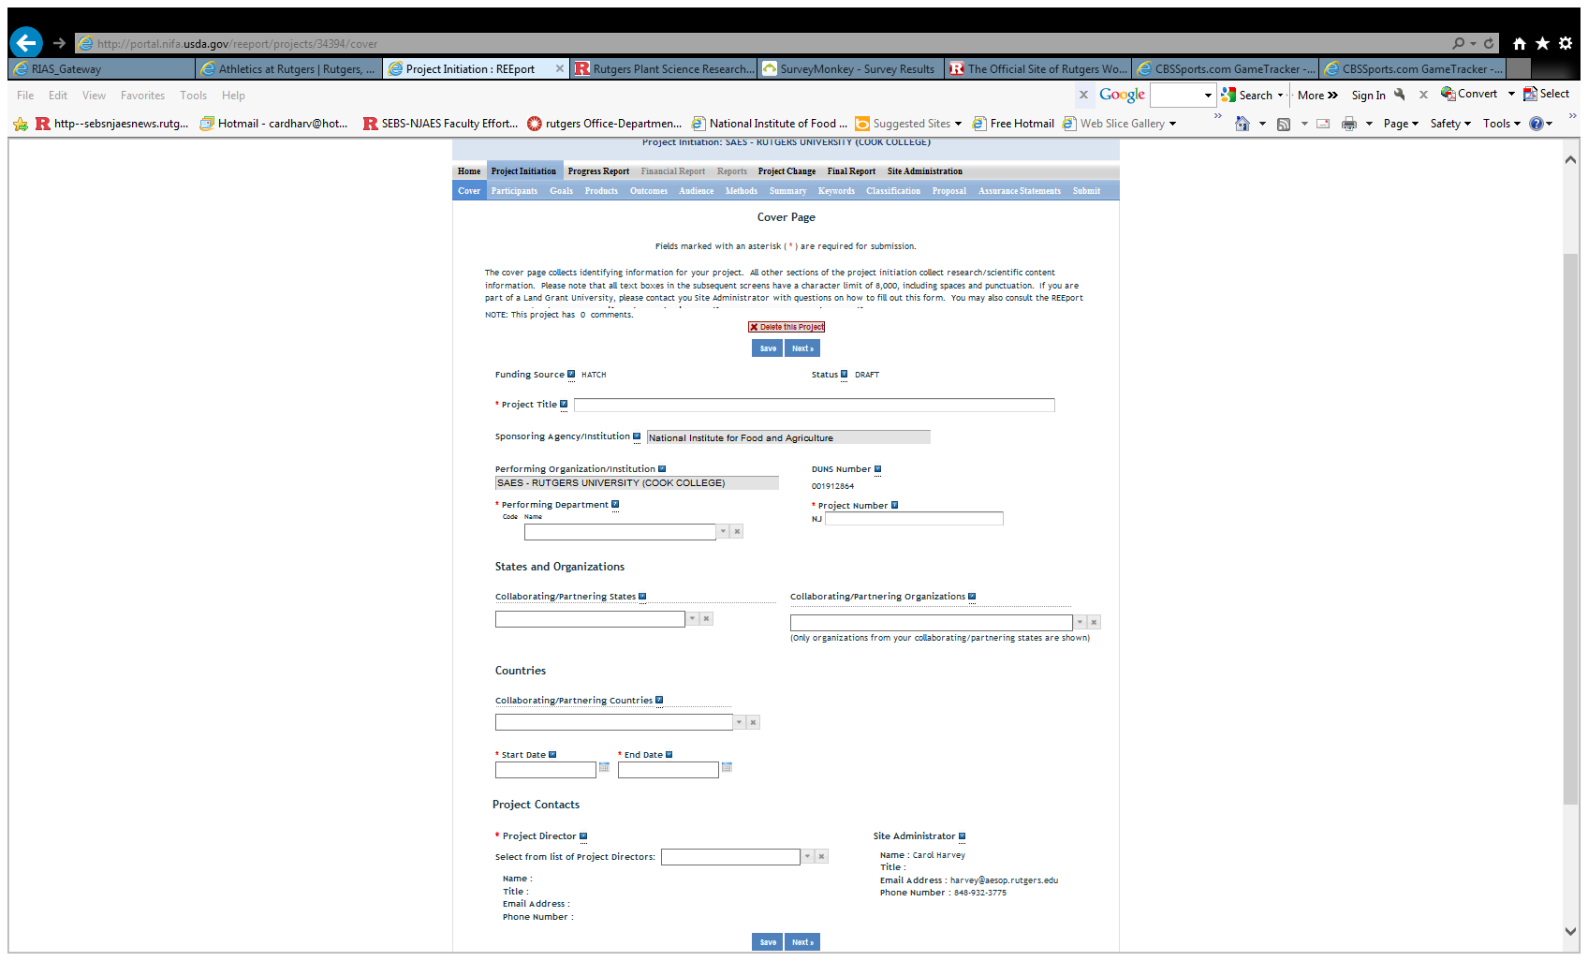

Slide 6
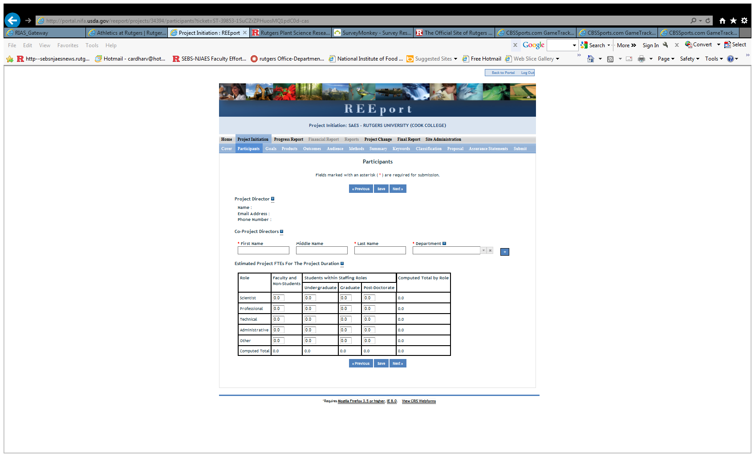

Slide 7
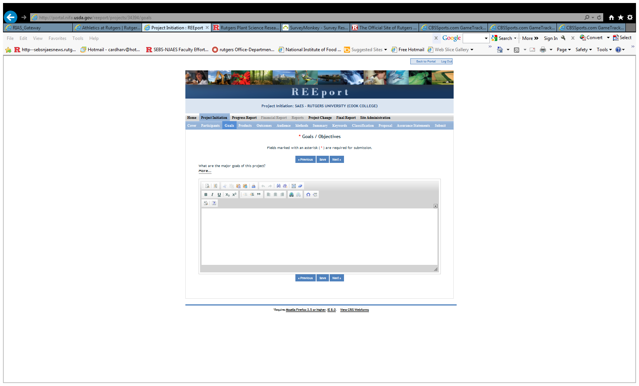

Slide 8
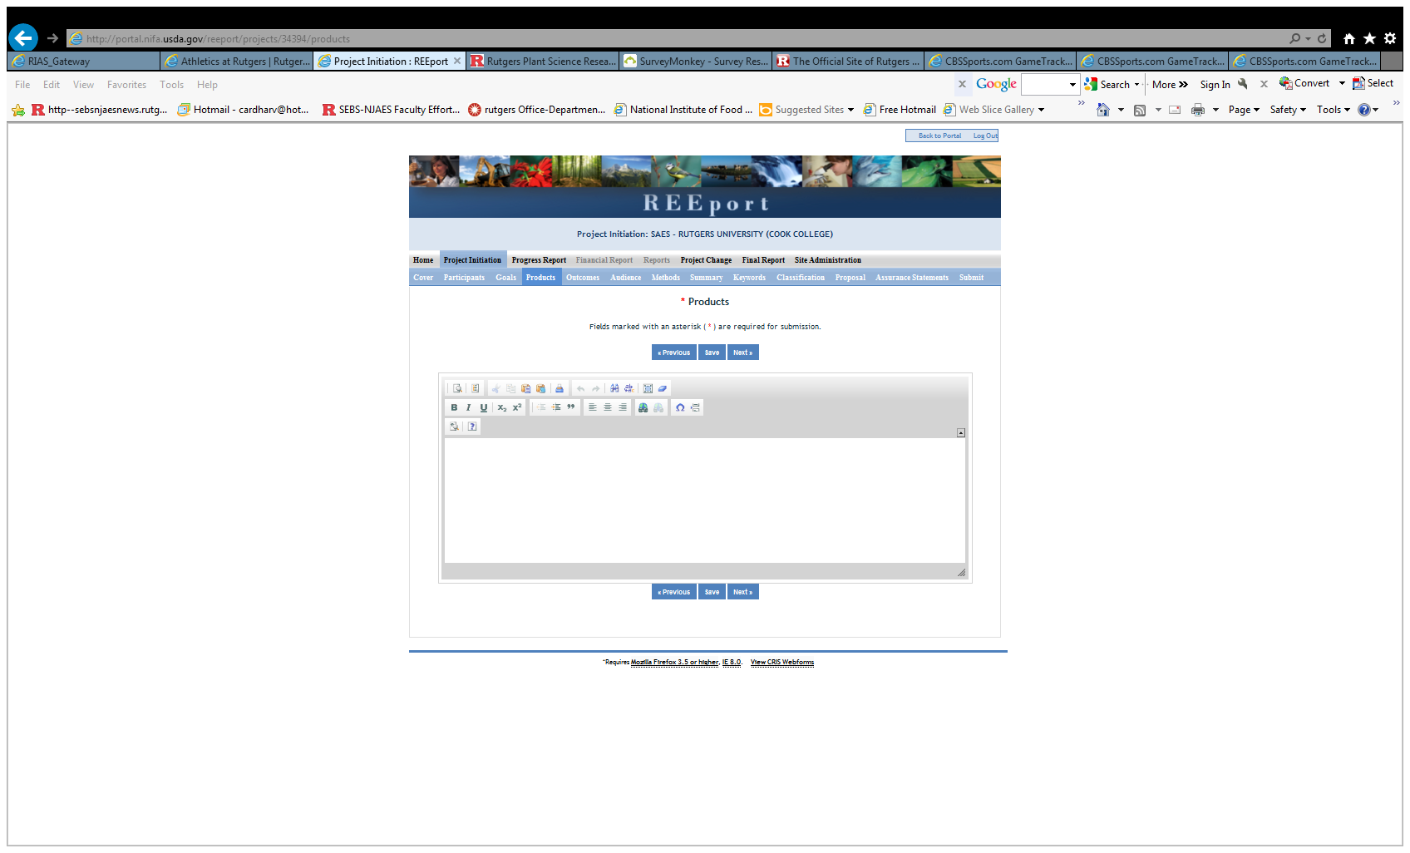

Slide 9
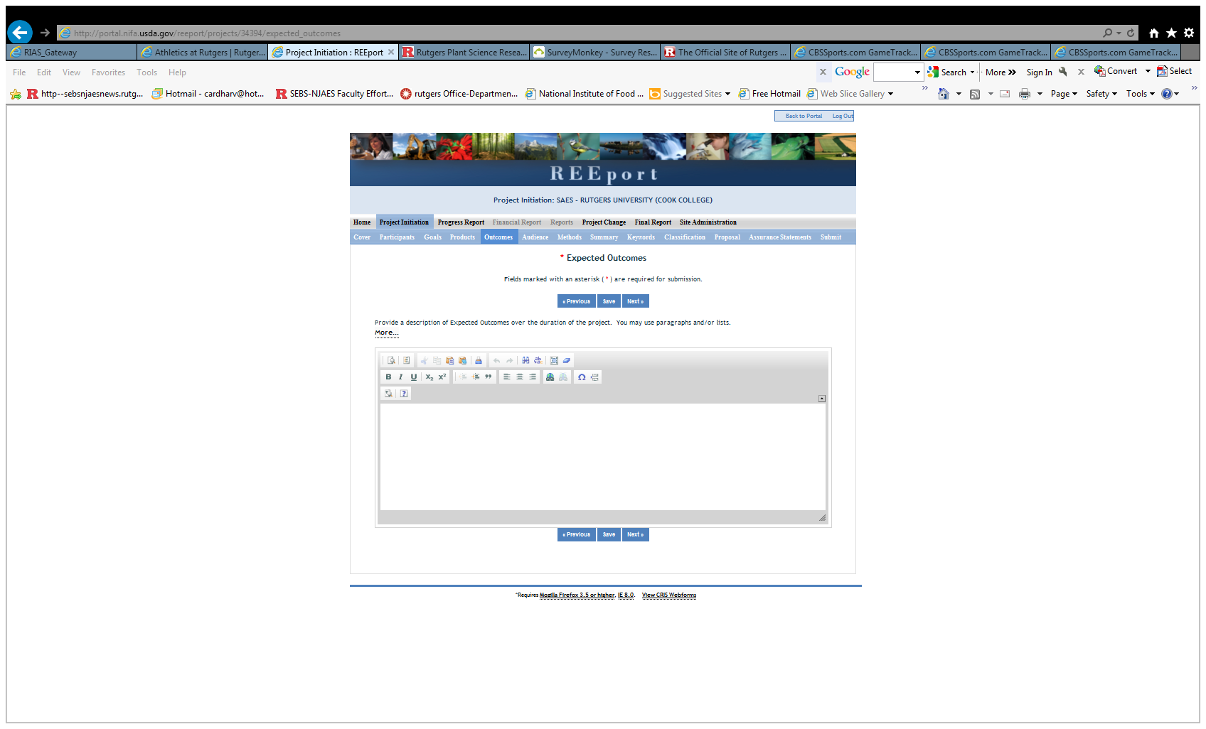

Slide 13
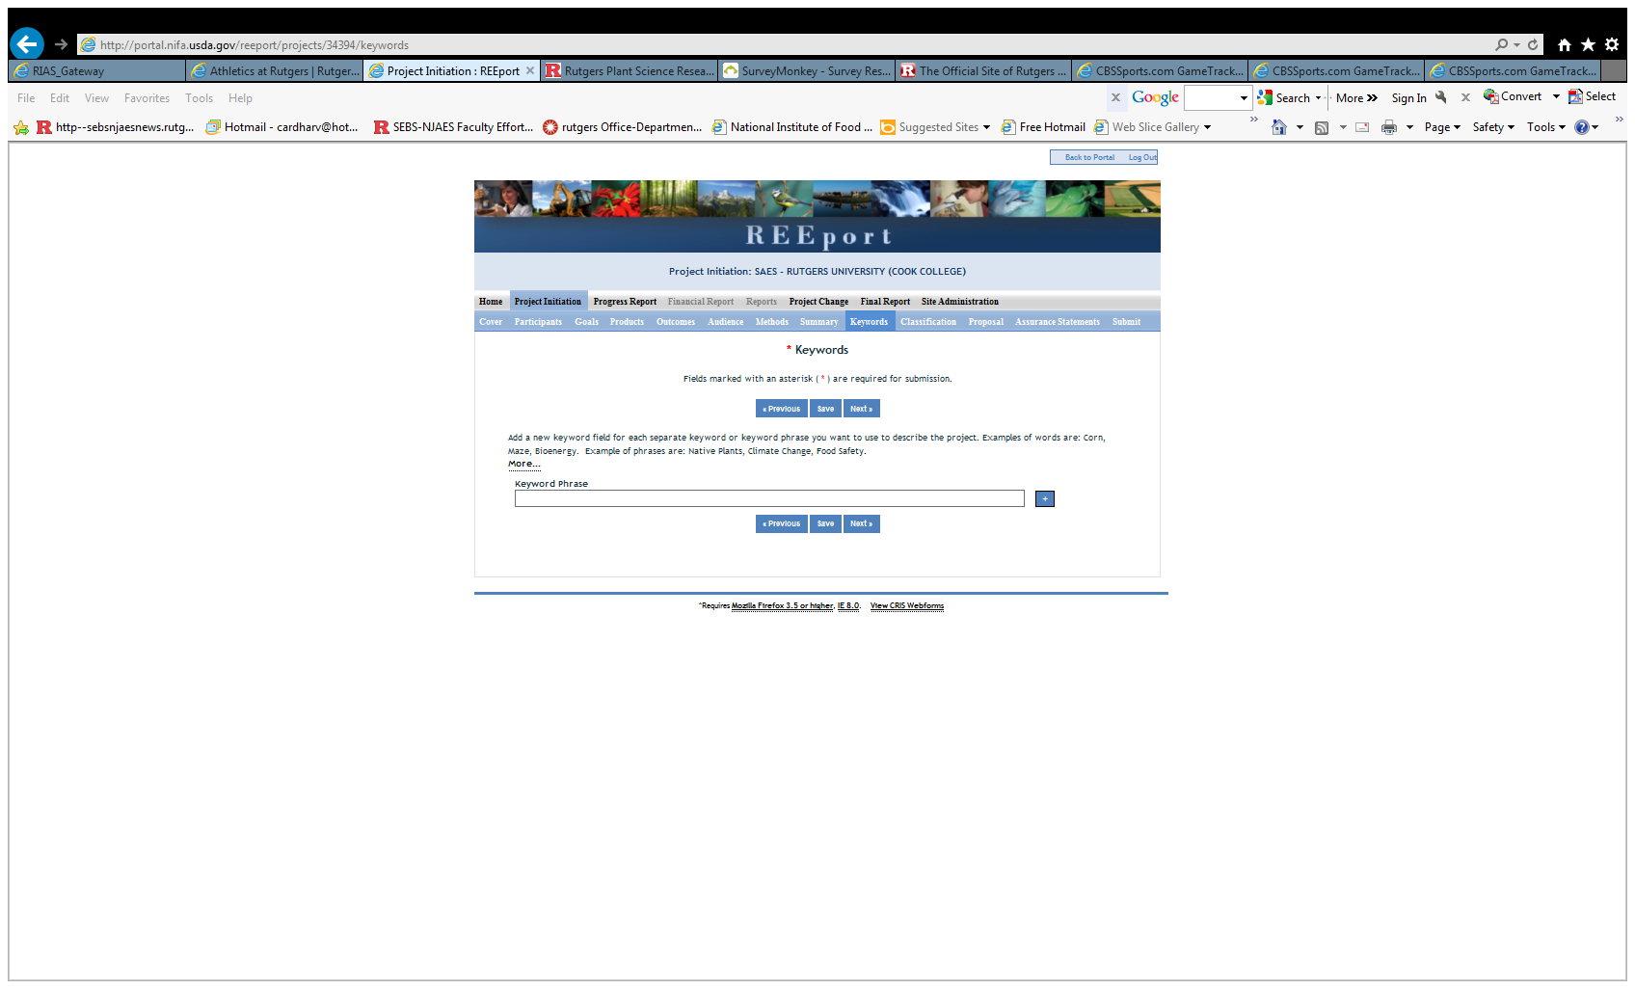

Slide 14
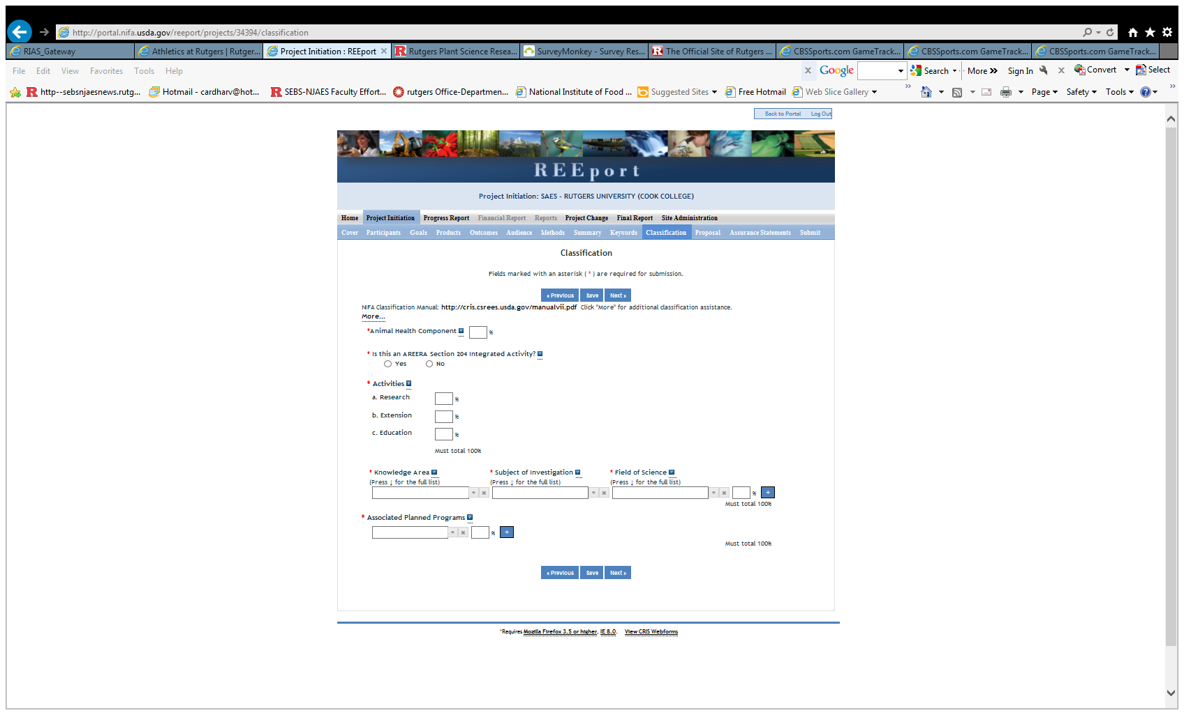

Slide 15
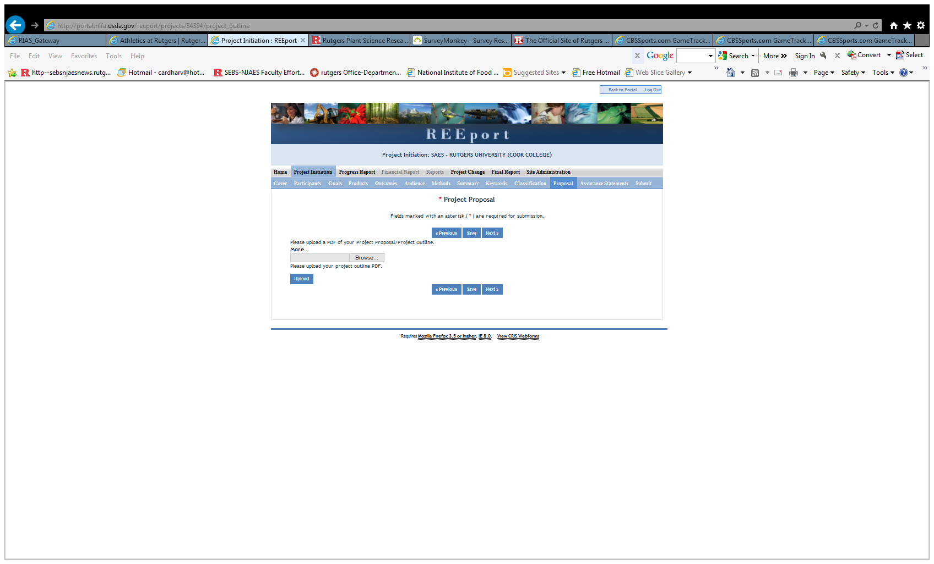

Slide 16
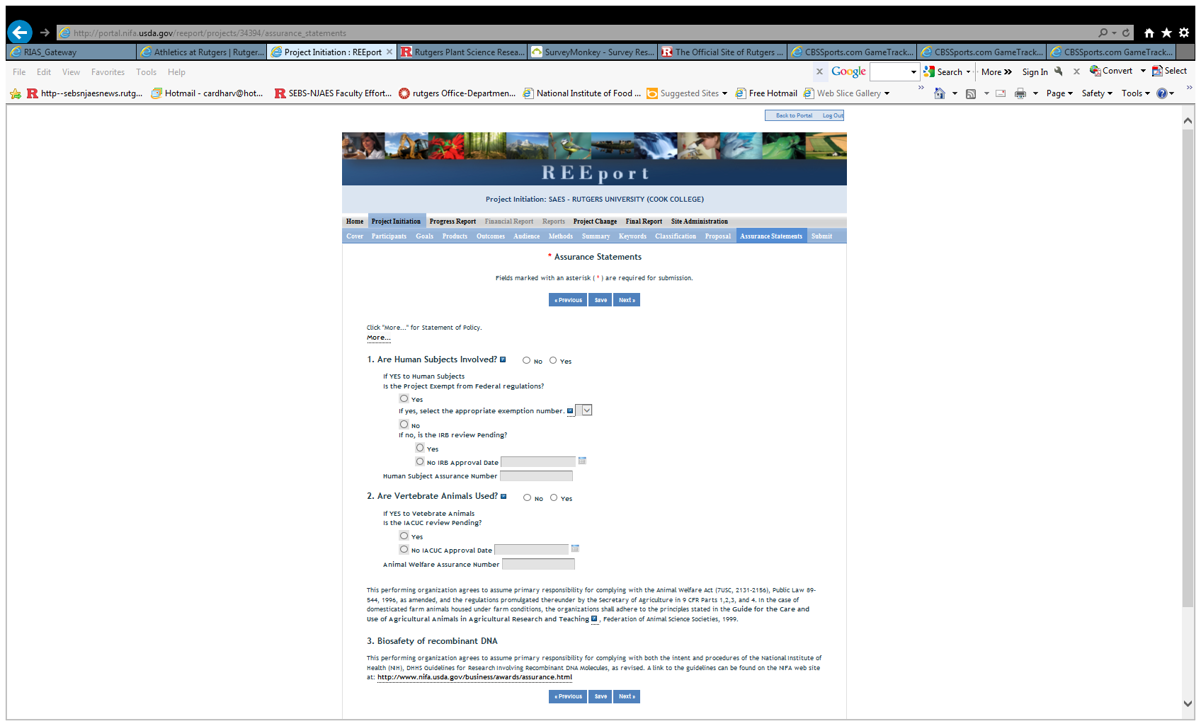

Slide 17
PROJECT CHANGE
THIS MODULE REPLICATES THE PROJECT INITIATION MODULE.
SOME ISSUES:
For projects transferred from CRIS, need to “complete” all modules to make a simple change to one item.
Cannot make any changes to USDA-NIFA competitively-funded projects.

Slide 18
PROJECT REPORTING
COVER PAGE (COMPLETED BY REEPORT)
PARTICIPANTS
TARGET AUDIENCES
PRODUCTS
OTHER PRODUCTS
ACCOMPLISHMENTS
CHANGES/PROBLEMS

Slide 19
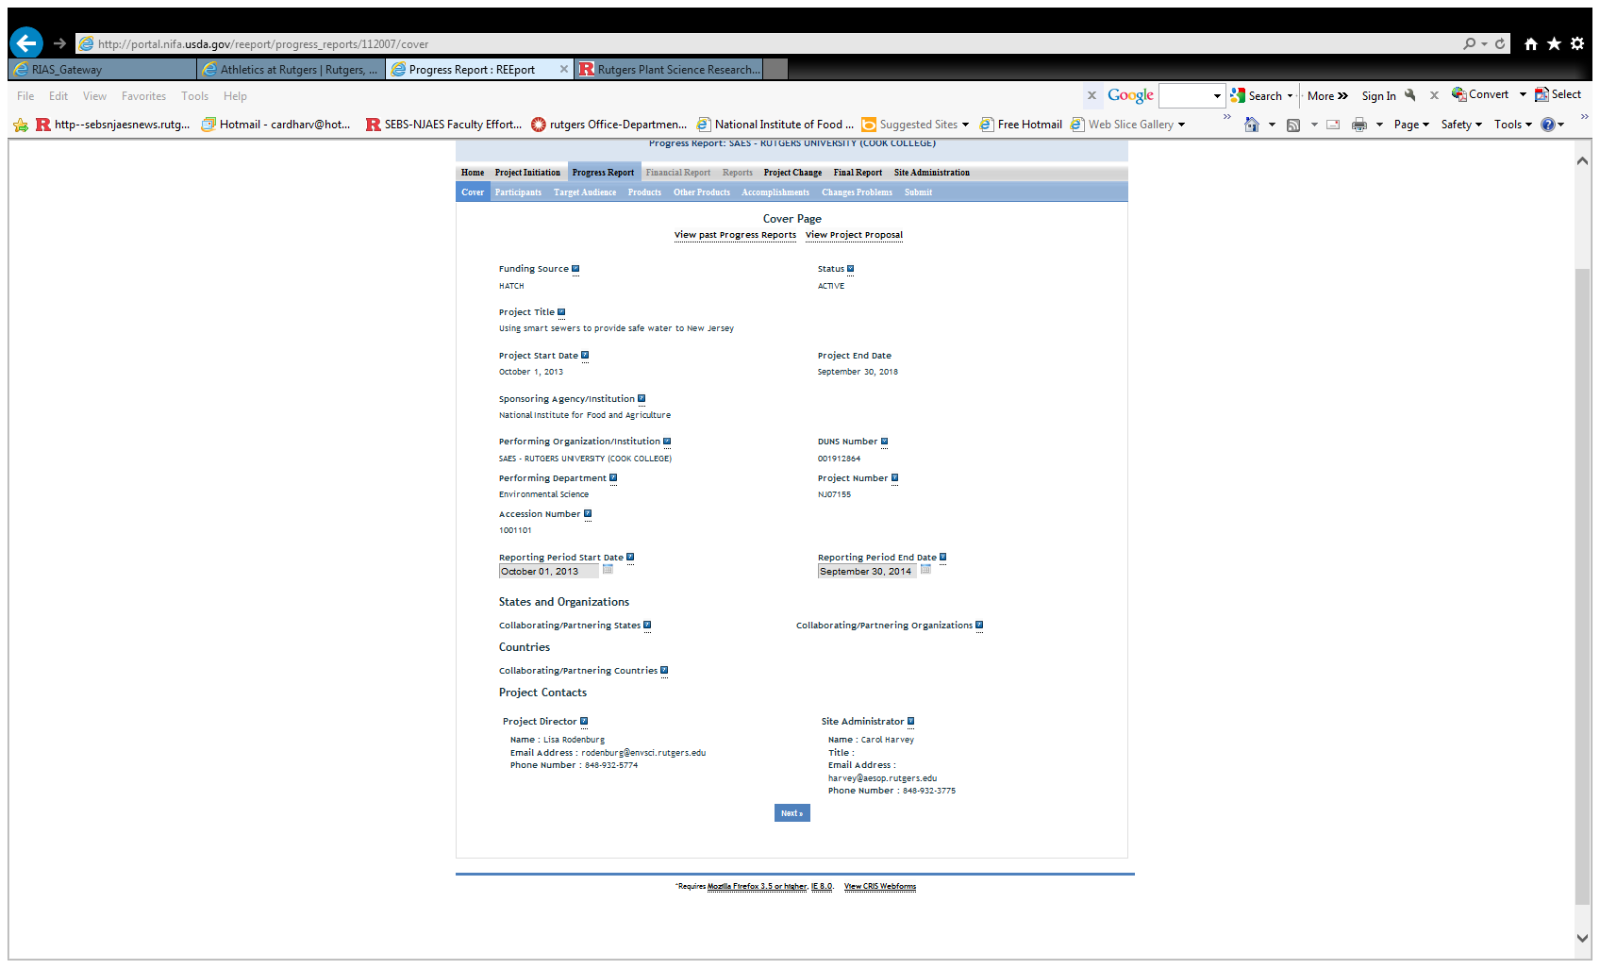

Slide 20
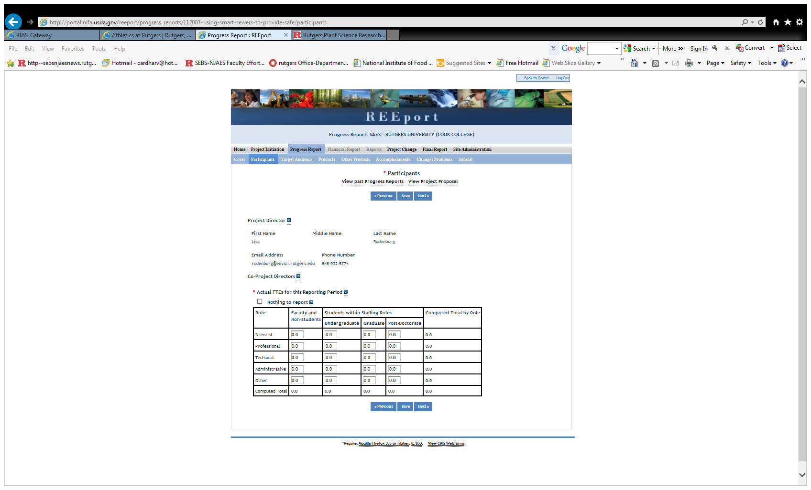

Slide 21
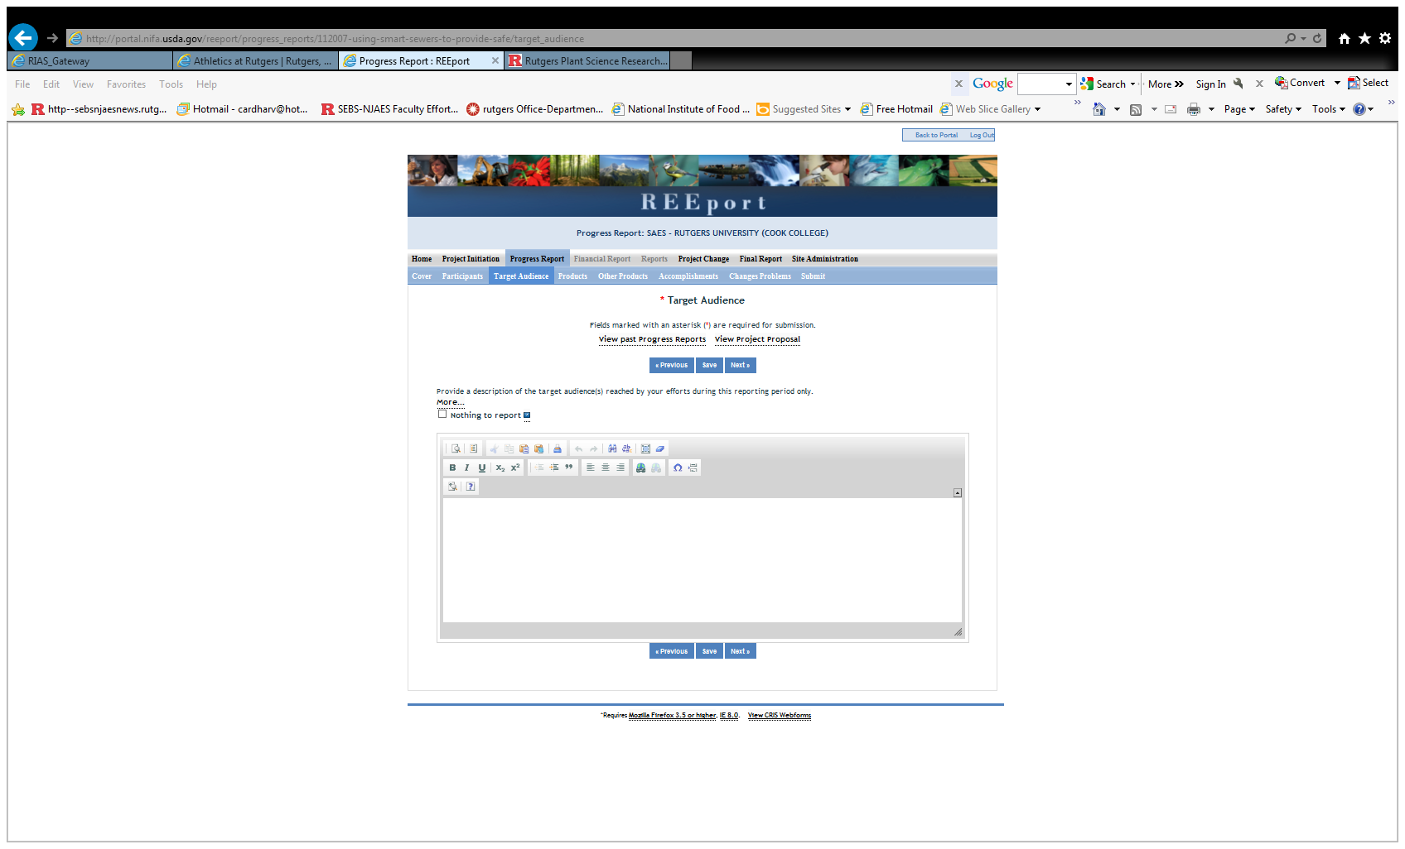

Slide 22
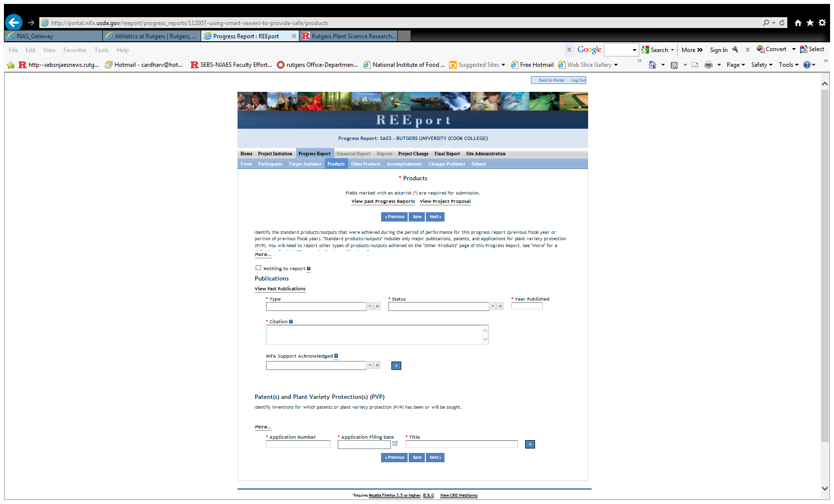

Slide 23
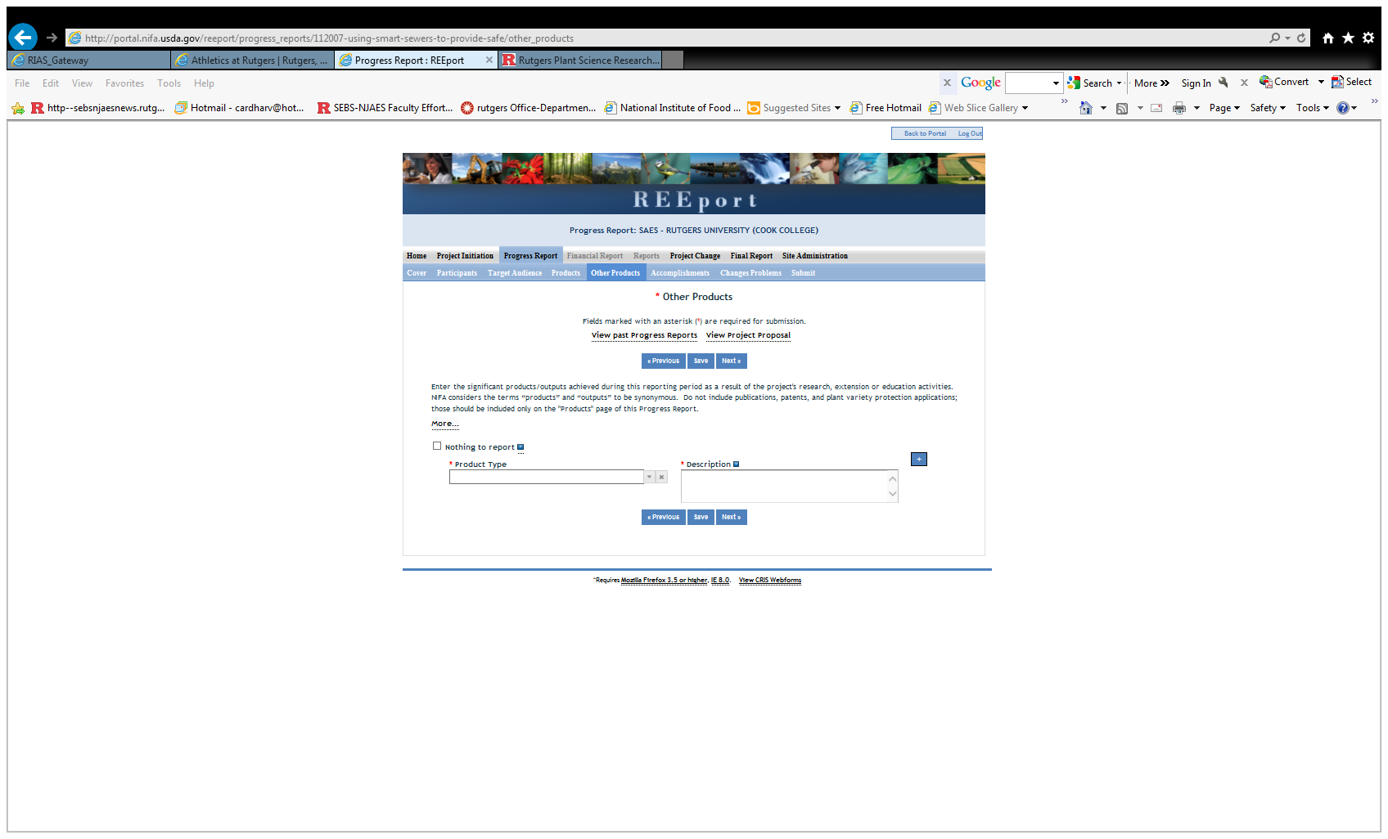

Slide 24
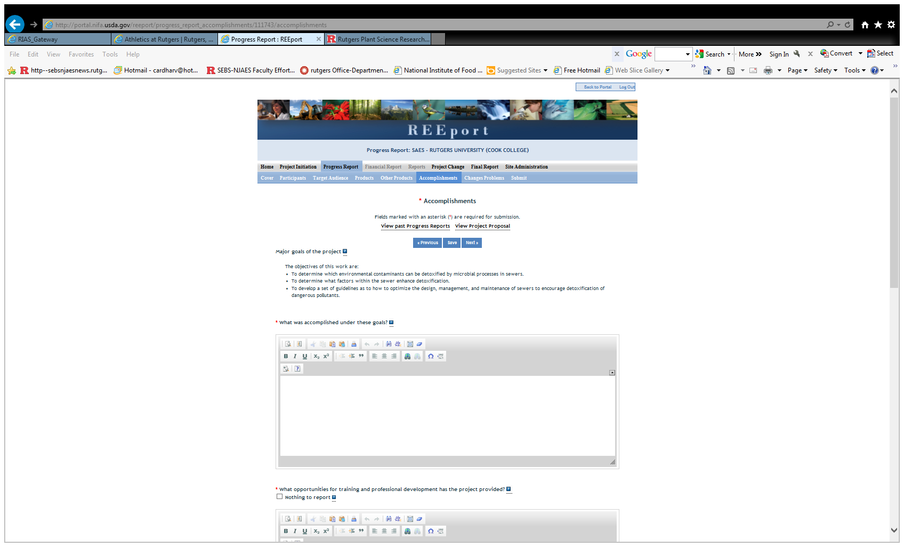

Slide 25
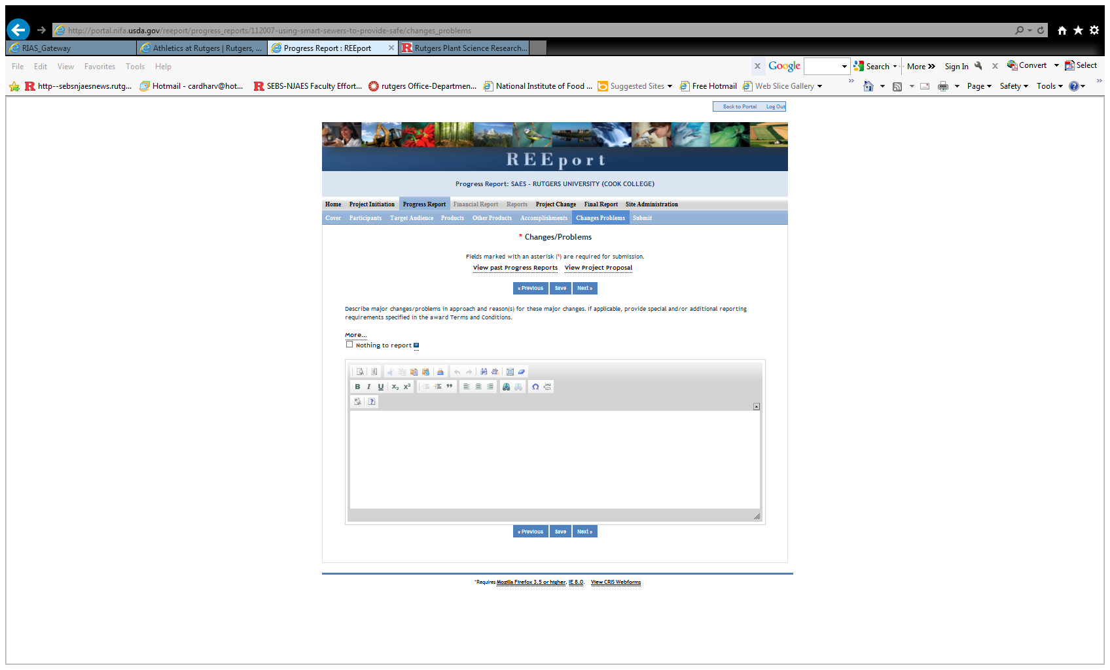

Slide 26
TRAINING/OTHER RESOURCES
USDA-NIFA WEBSITE: http://www.nifa.usda.gov/business/reeport_imp_land_grant_prnts.html
Training videos
User Manual
FAQS
REEPORT SITE
Links to instructions/clarifications
Tab for Site Administrator FAQs in Site Administrator module

