Slide 1
The Language of Science: Interpreting Graphs and Data
Mary Dzaugis
Summer Institute: GEMS-Net
June 28th, 2016

Slide 2
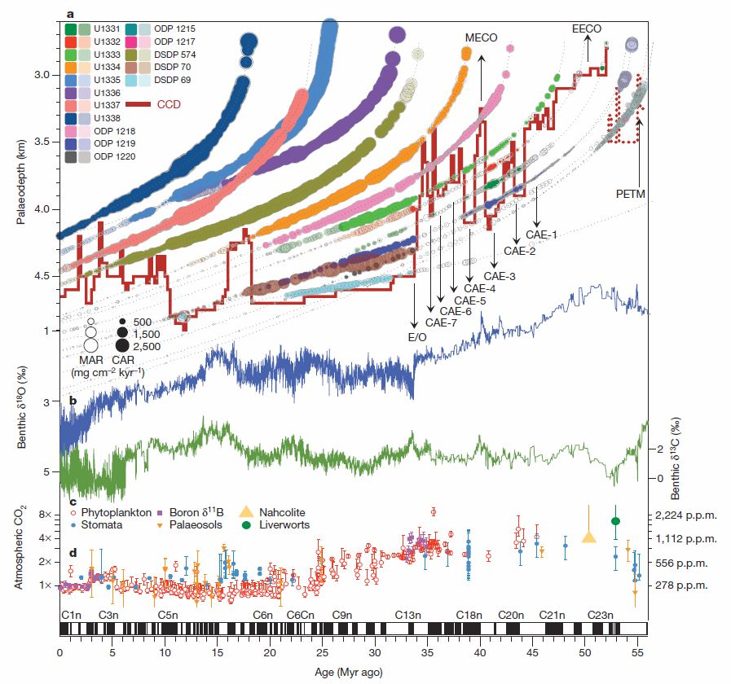
Motivation
Scientists must present extensive, multi-faceted data in a concise visual format.
Interpretation of such complex graphs and figures is key to deciphering scientific research.
Palike et al, 2012
Notes:
Tell story with figures

Slide 3
Axes:
The Basics
Axes are your map and compass!
Always orient to the axes first
Axis: reference line from which angles, distance, or values are measured in a coordinate system.
__
__

Slide 4
Axes:
The Basics
Axes are your map and compass!
Always orient to the axes first
Axis: reference line from which angles, distance, or values are measured in a coordinate system.
y
x

Slide 5
Axes:
The Basics
Axes are your map and compass!
Always orient to the axes first
Axis: reference line from which angles, distance, or values are measured in a coordinate system.
Y axis = dependent variable
Represents the output or effect
Responds to the independent variable
y
x
X axis = independent variable
Represents the input or cause (OR test to see if the variable is the cause of the change)
Stands alone, isn't changed by the other variables
(3) Will affect the dependent variable

Slide 6
Axes:
The Basics
Axes are your map and compass!
Always orient to the axes first
Axis: reference line from which angles, distance, or values are measured in a coordinate system.
Y axis = dependent variable
Represents the output or effect
Responds to the independent variable
y
x
X axis = independent variable
Represents the input or cause (OR test to see if the variable is the cause of the change)
Stands alone, isn't changed by the other variables
(3) Will affect the dependent variable

Slide 7
Axes:
The Basics
Axes are your map and compass!
Always orient to the axes first
Axis: reference line from which angles, distance, or values are measured in a coordinate system.
Y axis = dependent variable
Represents the output or effect
Responds to the independent variable
y
x
X axis = independent variable
Represents the input or cause (OR test to see if the variable is the cause of the change)
Stands alone, isn't changed by the other variables
(3) Will affect the dependent variable

Slide 8
Axes:
The Basics
Axes are your map and compass!
Always orient to the axes first
Axis: reference line from which angles, distance, or values are measured in a coordinate system.
Y axis = dependent variable
Represents the output or effect
Responds to the independent variable
y
x
X axis = independent variable
Represents the input or cause (OR test to see if the variable is the cause of the change)
Stands alone, isn't changed by the other variables
(3) Will affect the dependent variable

Slide 9
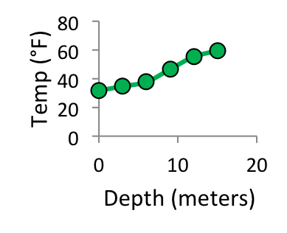
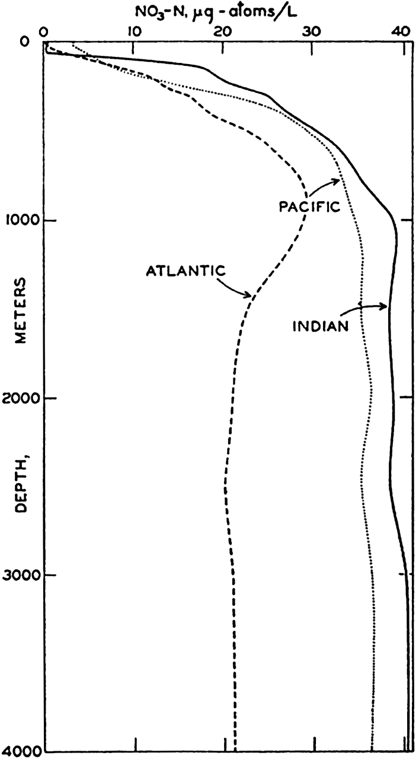
Axes:
Flipping the Script
Sometimes with x-y plots, the axes can be flipped, and which axis is dependent can vary.
Sverdrup et al, 1942

Slide 10
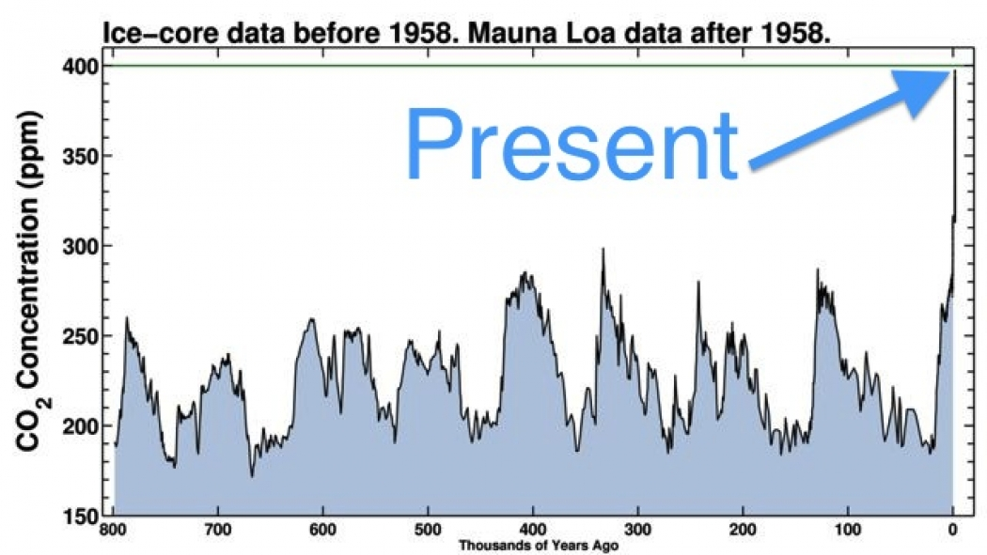
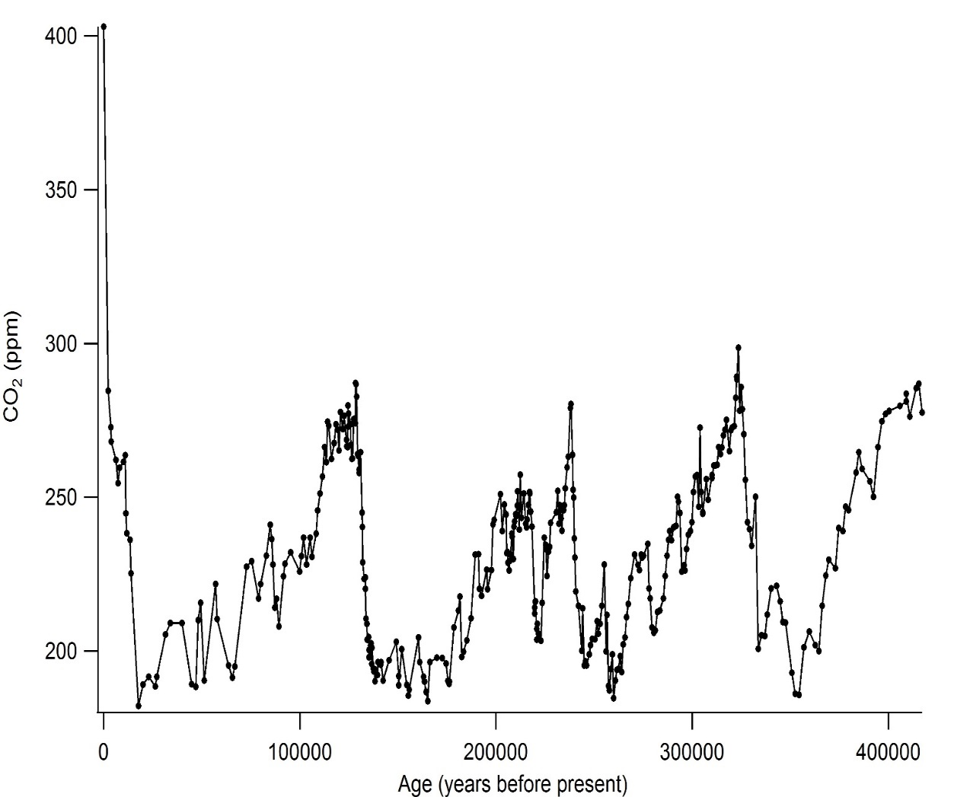
Axes:
Change Through Time
X-axes can be any number of things: one common axis is Time.
It can go either direction, so it’s important to read the axis title and know the scale!
Present
Vostok Ice Core records courtesy of CDIAC
Notes:
Just be careful, make sure you look at the axes to understand what presenting!
Next same graph three ways…important to look at the sale

Slide 11
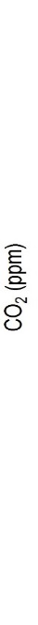

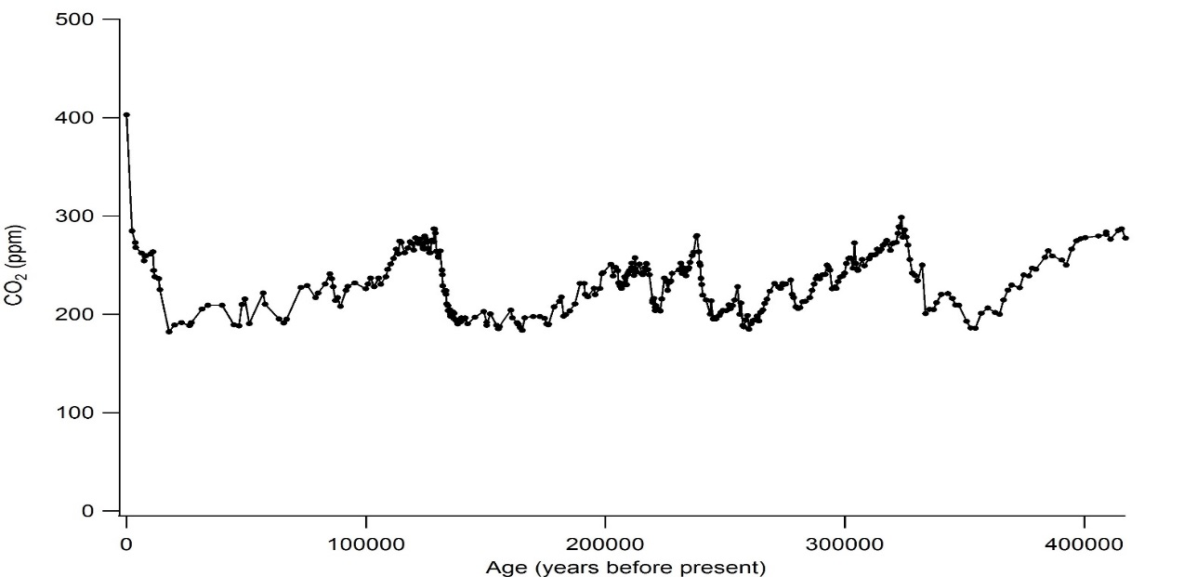

Which figure best presents the data?
Vostok Ice Core records courtesy of CDIAC

Slide 12

Axes:
Scaling
It is possible to convey different messages with the same data by simply changing the scales.
Questions to ask:
Is it starting at zero?
Vostok Ice Core records courtesy of CDIAC

Slide 13

Axes:
Scaling
It is possible to convey different messages with the same data by simply changing the scales.
Questions to ask:
Is it starting at zero?
Is it an appropriate scale?
Vostok Ice Core records courtesy of CDIAC

Slide 14

Axes:
Scaling
It is possible to convey different messages with the same data by simply changing the scales.
Questions to ask:
Is it starting at zero?
Is it an appropriate scale?
Is the scale linear?
Vostok Ice Core records courtesy of CDIAC

Slide 15
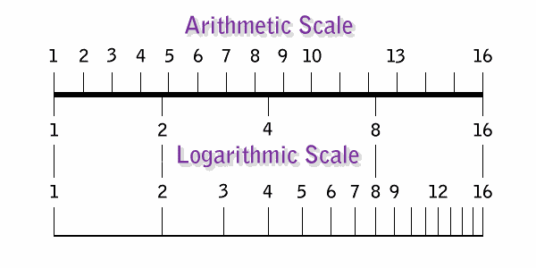

Slide 16
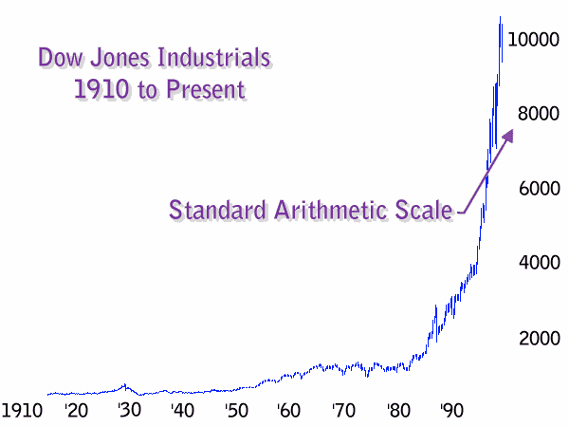


Slide 17
Which figure best presents the data?
Vostok Ice Core records courtesy of CDIAC

Slide 18
Robbins, 2009 (nbr-graphs.com)

Slide 19
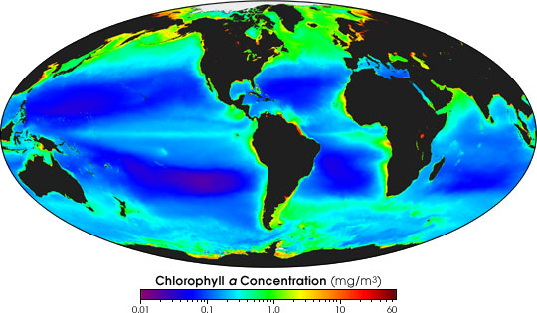
Captions and Color Contours
A good caption can be the difference between an enlightening and an illegible graph.
In a color contour plot, the color bar tells you the scale and the colors show the distribution.
The image above is the average ocean chlorophyll concentration measured by SeaWiFS since launch in 1997 until early 2004. Chlorophyll (and therefore phytoplankton) concentrations are higher in coastal areas than they are in the open ocean. They also are higher in planet's northern oceans than the southern.
NASA

Slide 20
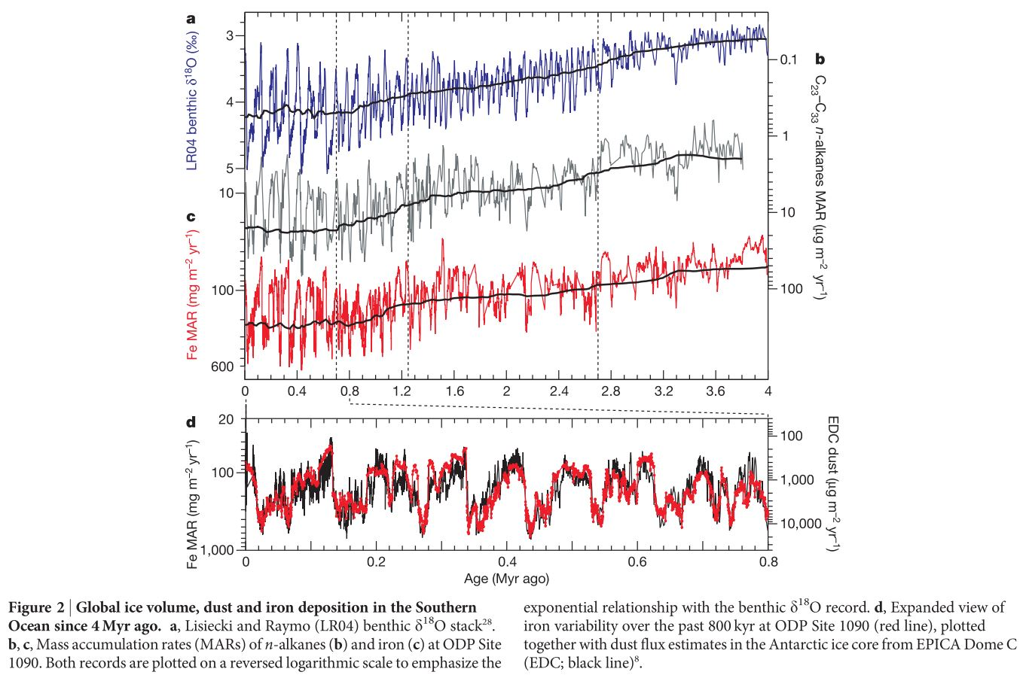
Multiple Layers
Often, data are complex and many sets are presented in a single graph.
In such cases, captions are even more important!
Martinez-Garcia et al, 2011

Slide 21
Multiple Layers
Often, data are complex and many sets are presented in a single graph.
In such cases, captions are even more important!
Martinez-Garcia et al, 2011

Slide 22
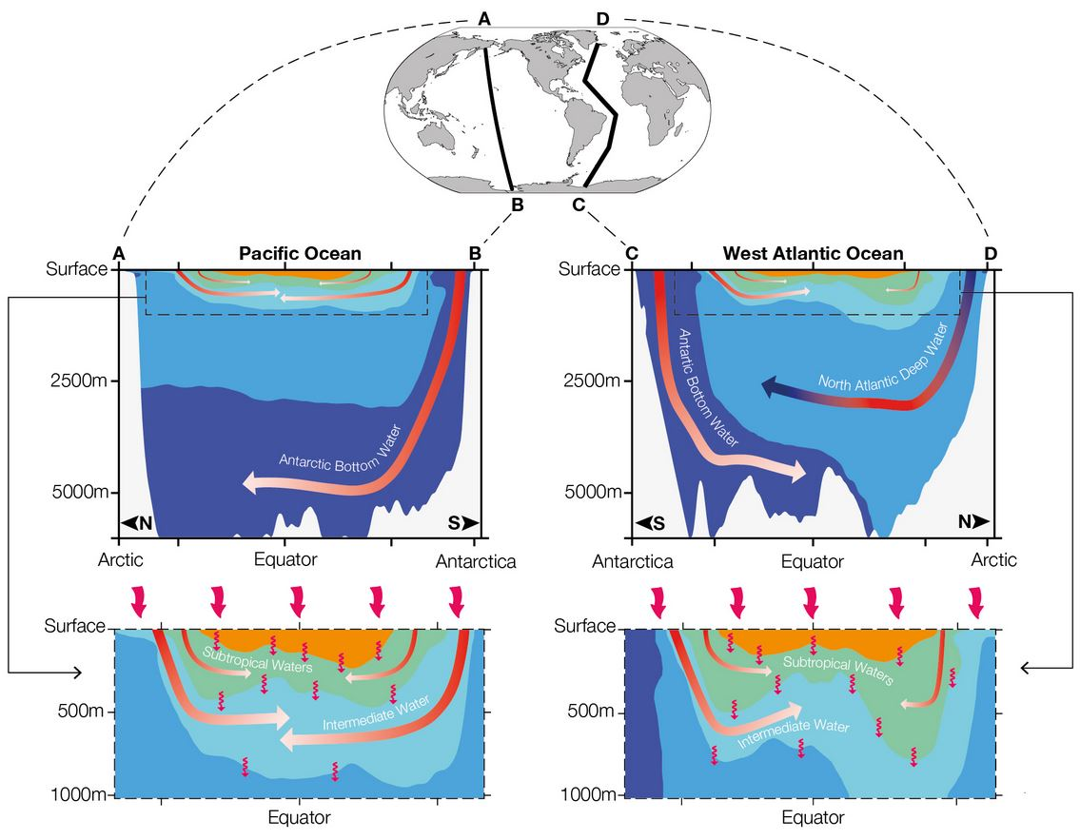
Ocean Transects
These oceanography-specific figures show how factors such as salinity or temperature change with depth and latitude.
Often combined with colored contours.
IPCC Report, Chapter 3

Slide 23
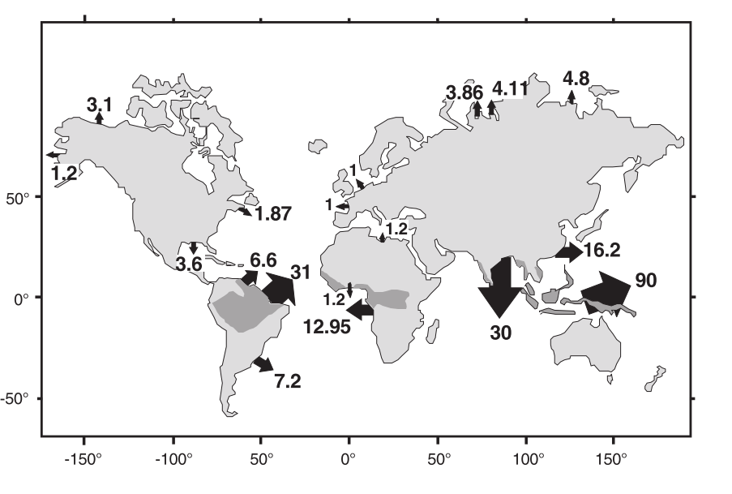
Categorical Data
Some data are classified by category or cutoff point rather than by number.
Fig. 1. Annual discharge of total organic carbon of major world rivers to the oceans (organic carbon fluxes are in 10¹² gCyear⁻¹; wet tropics are underlain in dark grey). Data are from Telang et al. (1991; Mackenzie, Yukon, St. Lawrence, Mississippi); Depetris and Paolini (1991; Orinoco, Parana); Richey et al. (1991; Amazon); Martins and Probst (1991; Zaire, Niger); Degens et al. (1991; Nile); Kempe et al. (1991; Rhine + Elbe, Seine + Loire + Gironde); Telang et al. (1991; Ob, Yelang, Lena); Gan-Wei-Bin et al. (1983; Yangtze); Subramanian and Ittekkot (1991; Ganges + Brahmaputra + Indus); Bird et al. (1995; Oceania)
Schlunz et al, 2000

Slide 24
Categorical Data
Some data are classified by category or cutoff point rather than by number.
Figure 1. Average gaseous Σ15PAH (A) and dissolved Σ18PAH (B) in Lake Erie and Lake Ontario. Orange shading delineates population centers.
McDonough et al, 2014

Slide 25
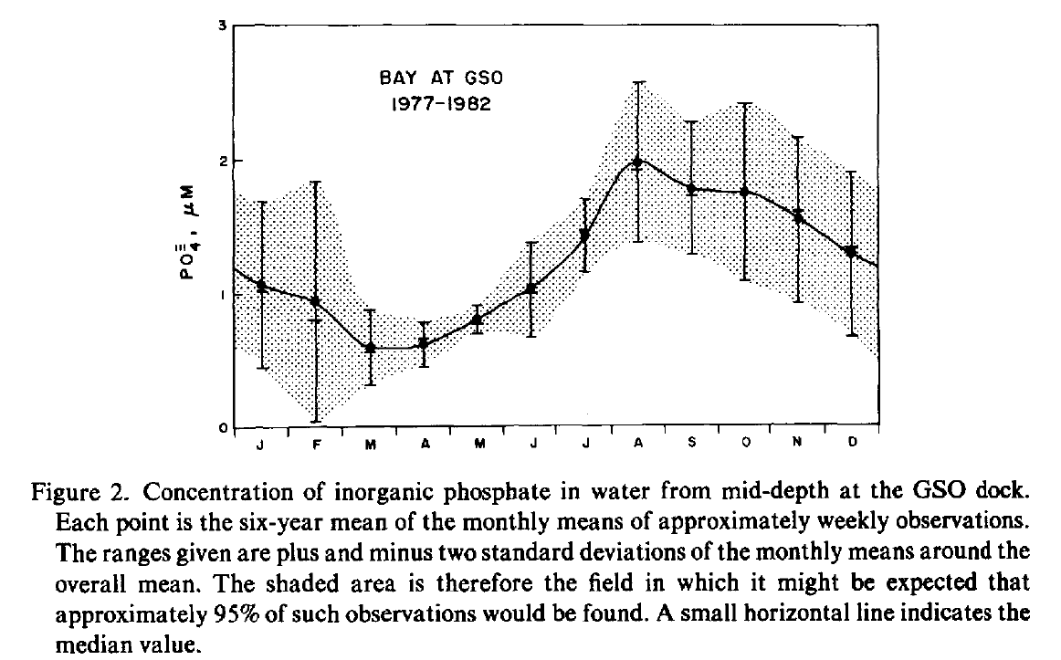
Error Bars
Although nearly all datasets have some experimental error, in some cases it can be difficult to show, such as with contour maps.
Larger error bars indicate more uncertainty or variability within the data. Compare February and May, for instance.
Pilson, 1985

Slide 26
Aliasing
When looking at a set of data over time, you must consider the sampling rate and length!
Real Data
Simplified Version
Adapted from A. Pfeiffer-Herbert

Slide 27
Aliasing
When looking at a set of data over time, you must consider the sampling rate and length!
With cyclical processes correct sampling becomes critical.
Potential issues include:
Incorrect averages
False trends
Sampled only 2-3 times a year
Adapted from A. Pfeiffer-Herbert

Slide 28
Aliasing
When looking at a set of data over time, you must consider the sampling rate and length!
With cyclical processes correct sampling becomes critical.
Potential issues include:
Incorrect averages
False trends
Sampled only 2-3 times a year
Adapted from A. Pfeiffer-Herbert

Slide 29
Aliasing
When looking at a set of data over time, you must consider the sampling rate and length!
With cyclical processes correct sampling becomes critical.
Potential issues include:
Incorrect averages
False trends
Sampled once a month
Sampled 2-3 times a month
Adapted from A. Pfeiffer-Herbert

Slide 30
Challenge Slides Next!

Slide 31
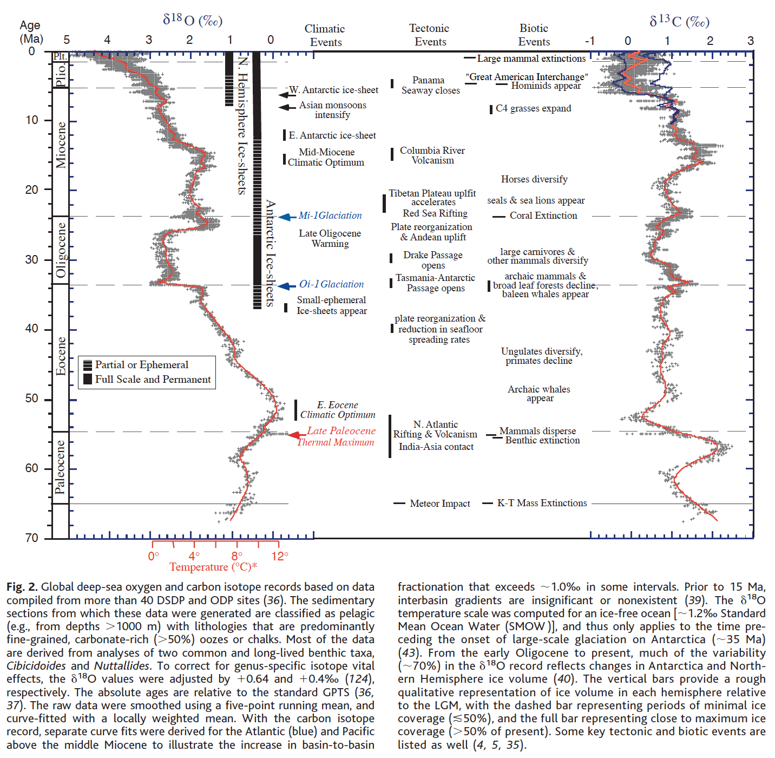
Background:
Global deep-sea oxygen (δ¹⁸O) and carbon (δ¹³C) isotopes from sediment cores taken from the bottom of the ocean.
Oxygen (δ¹⁸O) isotopes: a proxy for global temperature and sea ice volume. Low values = higher temperature and/or less ice; Higher values = lower temperatures and/or more ice.
Carbon (δ¹³C) isotopes: a proxy for global primary production (Carobon production and storage). Low values = decrease in primary production (mass extinction events); High values = rise in primary production
Zachos et al., 2001

Slide 32
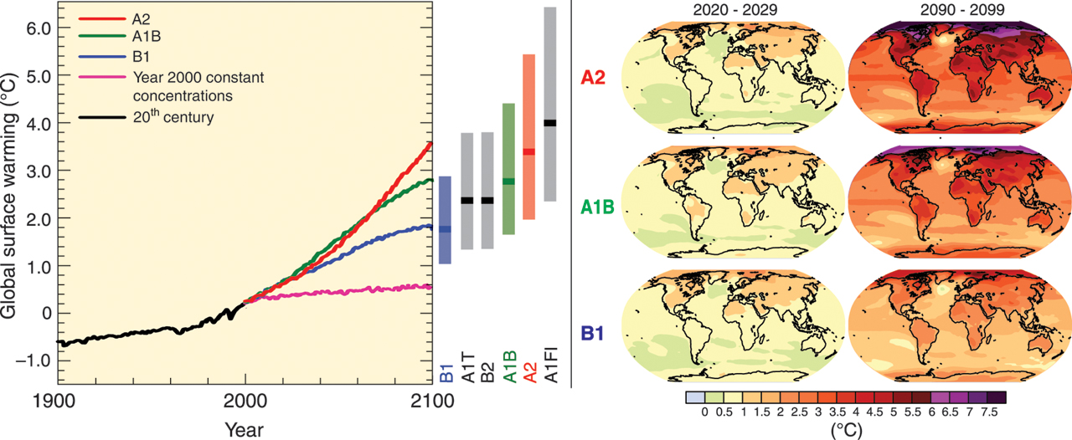
Special Report on Emissions Scenarios (SRES)
Model storylines:
A1: Very rapid economic growth, a global population that peaks in mid-century and rapid introduction of new and more efficient technologies.
A1Fl: Technological change fossil intensive; A1T: non-fossil energy resources; A1B: a balance across all sources.
B1: Convergent world, with the same global population as A1, but with more rapid changes in economic structures.
B2: Intermediate population and economic growth, emphasizing local solutions to economic, social, and environmental sustainability.
A2: Very heterogeneous world with high population growth, slow economic development and slow technological change.
Left panel: Solid lines are multi-model global averages of surface warming (relative to 1980-1999) for the SRES scenarios A2, A1B and B1, shown as continuations of the 20th century simulations. The bars in the middle of the figure indicate the best estimate (solid line within each bar) and the likely range assessed for the six SRES marker scenarios at 2090-2099 relative to 1980-1999.
Right panels: Projected surface temperature changes for the early and late 21st century relative to the period 1980-1999. The panels show the multi-AOGCM (Atmosphere-Ocean General Circulation Models) average projections for the A2 (top), A1B (middle) and B1 (bottom) SRES scenarios averaged over decades 2020-2029 (left) and 2090-2099 (right).
IPCC, 2007

Slide 33
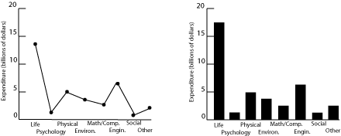
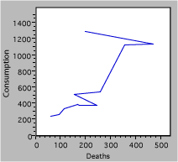
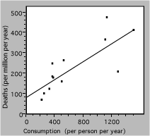
COMPARE AND CONTRAST: WHICH GRAPH IS BEST AND WHY?
A
B
Figure 1 (A,B). Research expenditures for various scientific fields
Figure 2. A) Deaths due to cigarette consumption. B) Death rate from lung cancer vs. cigarette consumption for several countries. The solid line is a linear fit to the data.
A
B
Figure 3. Carbon dioxide concentrations (ppm) from 1960-1990
Figure 1&2: Rice Teaching Lab Resources; Figure 3: Robbins, 2009 (nbr-graphs.com)

Slide 34
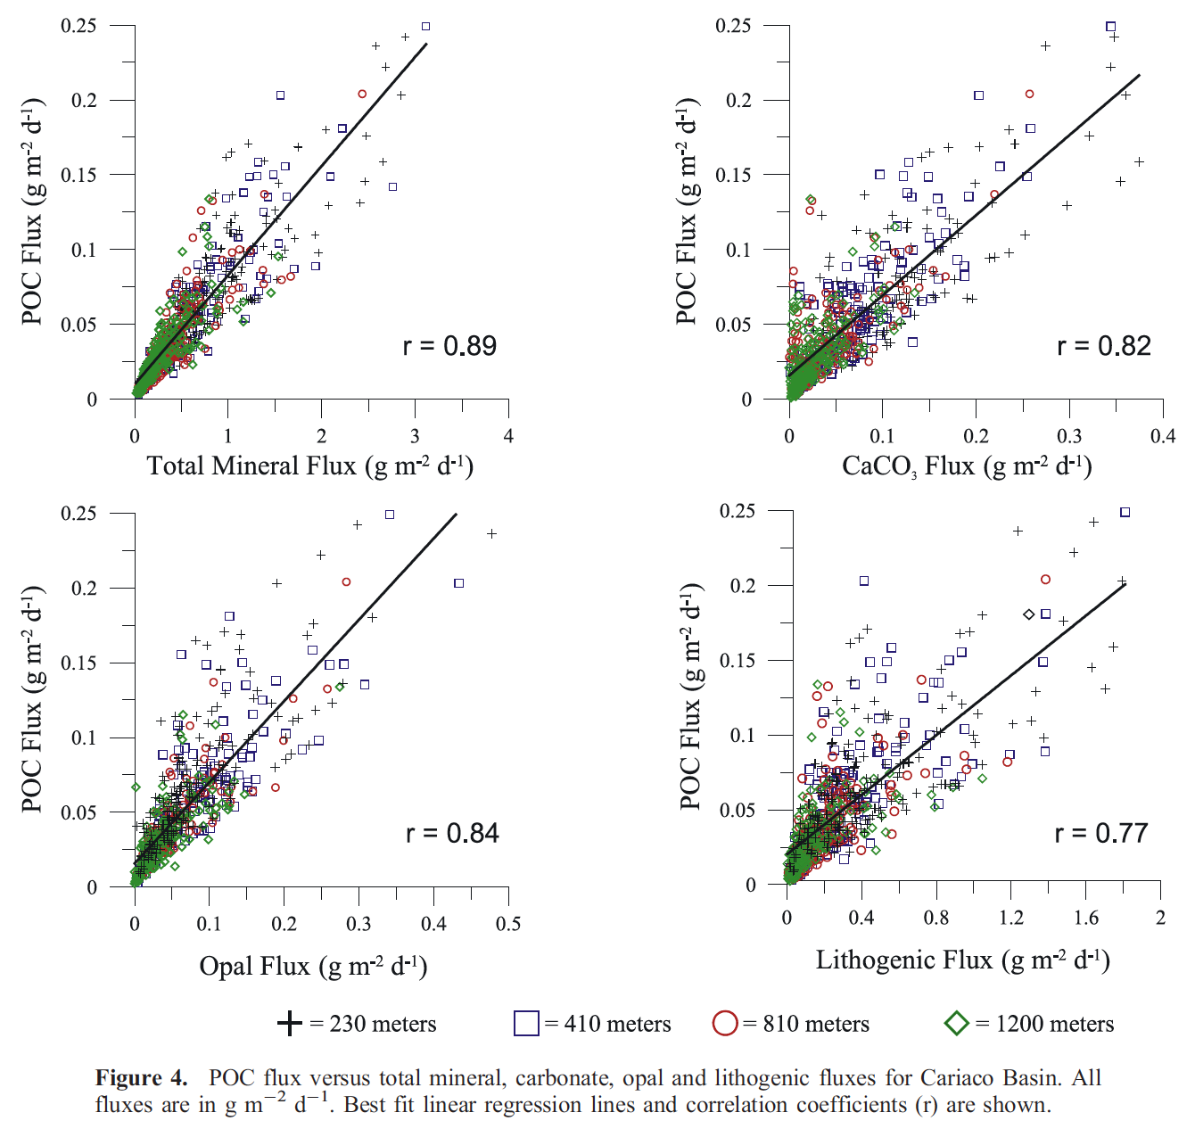
Background:
Particulate organic carbon (POC) fluxes serve as the primary vehicle by which carbon is exported to the deep ocean interior. This process is a key component of the global carbon cycle.
Understanding the mechanisms that control the removal of POC from the surface ocean is critical to predicting how organic matter fluxes vary as a function of depth.
It has been suggested that terrestrially derived material may act as ballast and provide an ‘‘abiotic boost’’ to the settling rates of POC.
Thunell et al, 2007

Slide 35
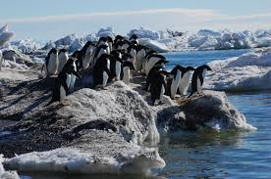
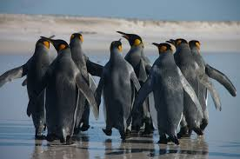
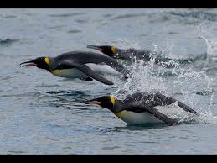
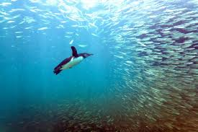
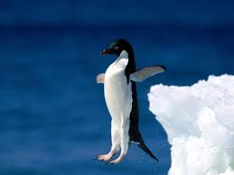
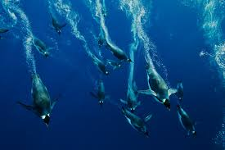
Reading with a purpose!
SET THE PURPOSE
SHARE
SKIM
COLLECT
DIVE IN

Slide 36
What are the ecological effects of plastic waste on marine animals?
SET THE PURPOSE
SHARE
SKIM
COLLECT
DIVE IN

Slide 37
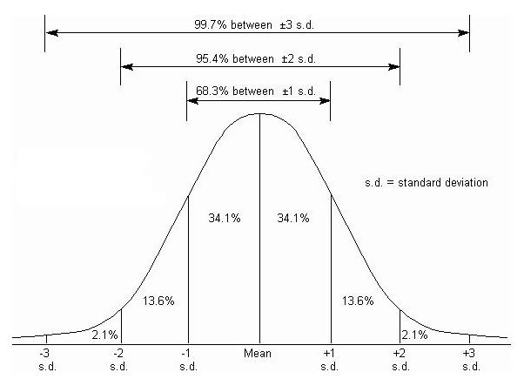
Statistics:
Key Terms
Standard deviation: A measure of how spread the numbers are. Calculated assuming a normal distribution.
s.d. = σ
Biologyforlife.com

Slide 38
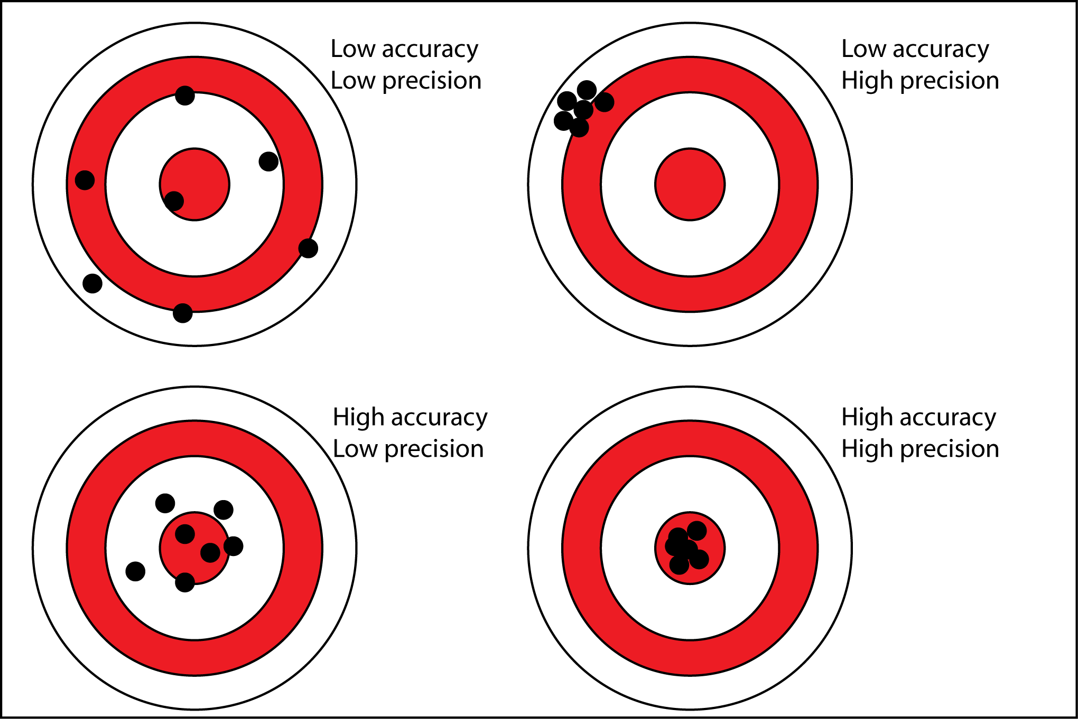
Statistics:
Key Terms
Standard deviation: A measure of how spread the numbers are. Calculated assuming a normal distribution.
Antarcticglaciers.com
Notes:
Talk here about which of these have low stdevs.

Slide 39
Statistics:
Key Terms
Standard deviation: A measure of how spread the numbers are. Calculated assuming a normal distribution.
R²: Fit, coefficient of determination, or “R-squared.” Calculation of how much of the variation in one axis can be explained by the variation of the other. DOES NOT IMPLY CAUSATION!!
CDIAC, Mauna Loa CO₂ Record

Slide 40
Statistics:
Key Terms
Standard deviation: A measure of how spread the numbers are. Calculated assuming a normal distribution.
R²: Fit, coefficient of determination, or “R-squared.” Calculation of how much of the variation in one axis can be explained by the variation of the other. DOES NOT IMPLY CAUSATION!!
CDIAC, Mauna Loa CO₂ Record

Slide 41
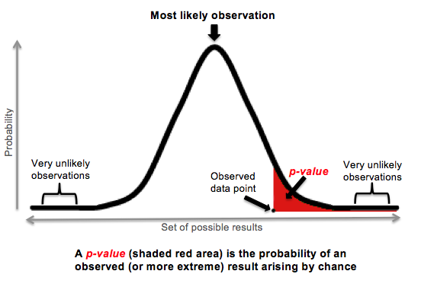
Statistics:
Key Terms
p-value: A calculated number denoting how likely the observed result would be due to chance, considering the control mean and standard deviation. A rule of thumb cutoff is 0.05, which says that the probability of the result happening by chance is less than 5%.
http://www.medical-institution.com/what-is-p-value-video-lecture/

