Slide 1
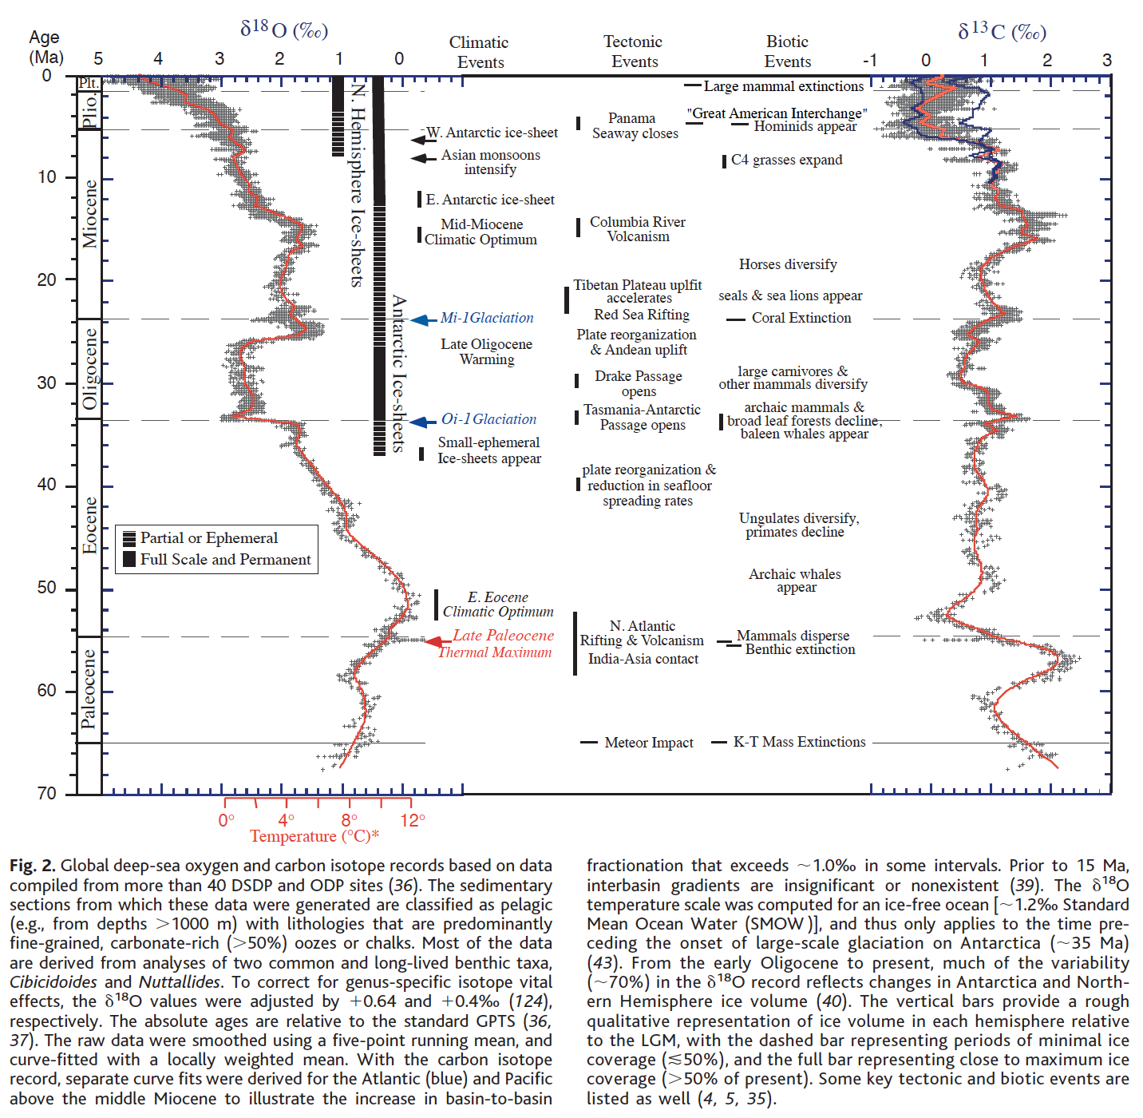
Background:
Global deep-sea oxygen (δ¹⁸O) and carbon (δ¹³C) isotopes from sediment cores taken from the bottom of the ocean.
Oxygen (δ¹⁸O) isotopes: a proxy for global temperature and sea ice volume. Low values = higher temperature and/or less ice; Higher values = lower temperatures and/or more ice.
Carbon (δ¹³C) isotopes: a proxy for global primary production (Carobon production and storage). Low values = decrease in primary production (mass extinction events); High values = rise in primary production
Zachos et al., 2001

Slide 2
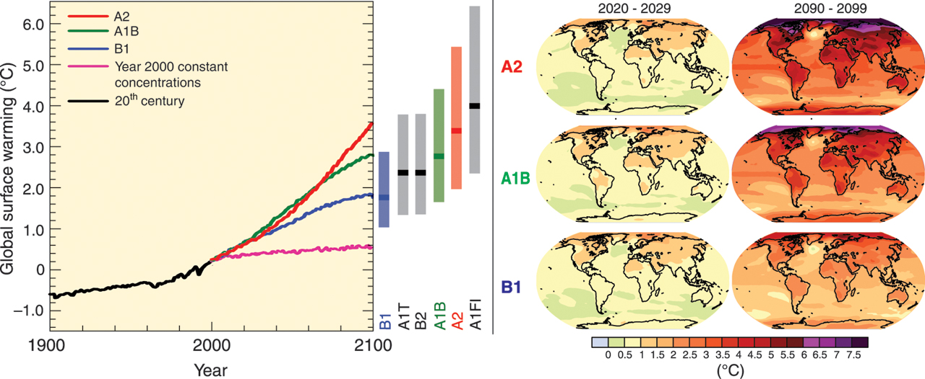
Special Report on Emissions Scenarios (SRES)
Model storylines:
A1: Very rapid economic growth, a global population that peaks in mid-century and rapid introduction of new and more efficient technologies.
A1Fl: Technological change fossil intensive; A1T: non-fossil energy resources; A1B: a balance across all sources.
B1: Convergent world, with the same global population as A1, but with more rapid changes in economic structures.
B2: Intermediate population and economic growth, emphasizing local solutions to economic, social, and environmental sustainability.
A2: Very heterogeneous world with high population growth, slow economic development and slow technological change.
Left panel: Solid lines are multi-model global averages of surface warming (relative to 1980-1999) for the SRES scenarios A2, A1B and B1, shown as continuations of the 20th century simulations. The bars in the middle of the figure indicate the best estimate (solid line within each bar) and the likely range assessed for the six SRES marker scenarios at 2090-2099 relative to 1980-1999.
Right panels: Projected surface temperature changes for the early and late 21st century relative to the period 1980-1999. The panels show the multi-AOGCM (Atmosphere-Ocean General Circulation Models) average projections for the A2 (top), A1B (middle) and B1 (bottom) SRES scenarios averaged over decades 2020-2029 (left) and 2090-2099 (right).
IPCC, 2007

Slide 3
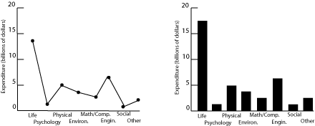
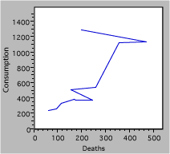
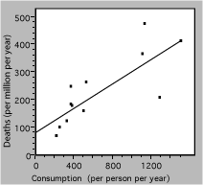
COMPARE AND CONTRAST: WHICH GRAPH IS BEST AND WHY?
A
B
Figure 1 (A,B). Research expenditures for various scientific fields
Figure 2. A) Deaths due to cigarette consumption. B) Death rate from lung cancer vs. cigarette consumption for several countries. The solid line is a linear fit to the data.
A
B
Figure 3. Carbon dioxide concentrations (ppm) from 1960-1990
Figure 1&2: Rice Teaching Lab Resources; Figure 3: Robbins, 2009 (nbr-graphs.com)

Slide 4
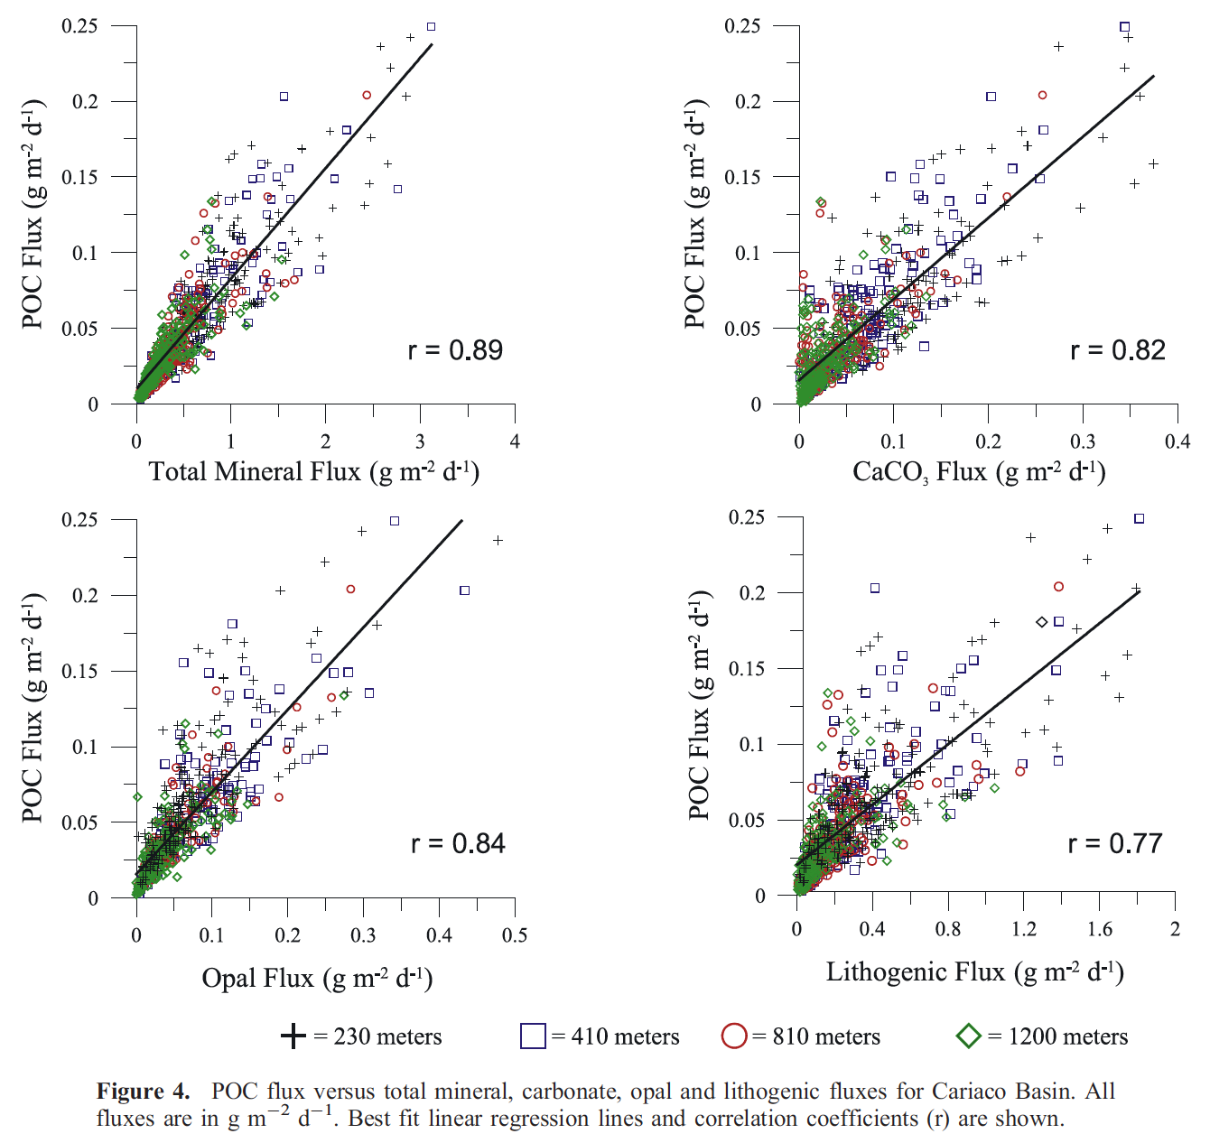
Background:
Particulate organic carbon (POC) fluxes serve as the primary vehicle by which carbon is exported to the deep ocean interior. This process is a key component of the global carbon cycle.
Understanding the mechanisms that control the removal of POC from the surface ocean is critical to predicting how organic matter fluxes vary as a function of depth.
It has been suggested that terrestrially derived material may act as ballast and provide an ‘‘abiotic boost’’ to the settling rates of POC.
Thunell et al, 2007

