Slide 1
CRMC’s Draft Proposals to the Narragansett Bay SAMP Aquaculture Working Group (WG):
Stakeholder Notification
Proposed new enhanced CRMC aquaculture application notification process to include:
Notice to coastal property owners within 500 feet of any proposed site boundaries; and
Listserve notification at all phases of application cycle;
Application Development
Proposed expanded CRMC Aquaculture Preliminary Determination (PD) process for enhanced application development with required:
Submittal of a draft application; and
Applicant led local scoping session before a PD meeting is held by CRMC.
Notes:
Notification #1 response from WG
Application development provides context for notification and related input
All 3 phases - next slide

Slide 2
Draft Application*
and
Scoping Session*
Preliminary Determination (PD)
Initial review with town, US Coast Guard, Dept of Environmental Management, Army Corps of Engineers, non-governmental agencies, fishing industry
Phase 1:
Application Development
Recommendations to applicant
*(New Process)
Full Aquaculture Application
Director; Dept of Environmental Management; Fish and Wildlife; Water Resources; Enforcement
RI Historical Preservation and Heritage Commission
Phase 2:
Application Review
30 Day Public Notice
Army Corps of Engineers; General Permitting
Shellfish Advisory Panel
No Objections
Objections
RI Marine Fisheries Council
CRMC
Phase 3:
Final Decision
No Objections and meets § 1.1.6(D)(5) criteria
Objections
CRMC Public Hearing
APPROVAL
APPROVAL WITH MODIFICATION
DENIAL

Slide 3
New Enhanced Notification Processes for Aquaculture Applications:
Aquaculture Listserve – a versatile tool for enhancing communication:
Live since July 2021, over 200 subscribers;
Provides notice at all three phases of the application cycle including PD meetings, 30 Day Public Notices, MFC/SAP meetings, and CRMC Public Hearings;
Notification of coastal property owners – part of new expanded PD process:
Purpose of notification is to help inform application development;
Coastal property owners within 500 feet of a proposal will receive notice from the applicant at earliest phase of application development;
Coastal property owners will have an opportunity to learn about proposals and provide input through the new scoping session requirement before a PD meeting is held by CRMC with the town.

Slide 4
500 foot notification radius for coastal property owners – “Why 500 feet?”
Consistent with other core aspects of the Rhode Island Coastal Resource Management Program (i.e., the Red Book) with regards to water type categories:
650-RICR-20-00-1.2.1(A): “The six categories of waters defined in this Program are directly linked to the characteristics of the shoreline, since the activities on the adjacent mainland are the primary determinant of the uses and qualities of any specific water site.”
650-RICR-20-00-1.6(C): “[T]he water type along any shoreline generally runs parallel to the shoreline and extends five hundred (500) feet seaward from the mean high water mark.”

Slide 5
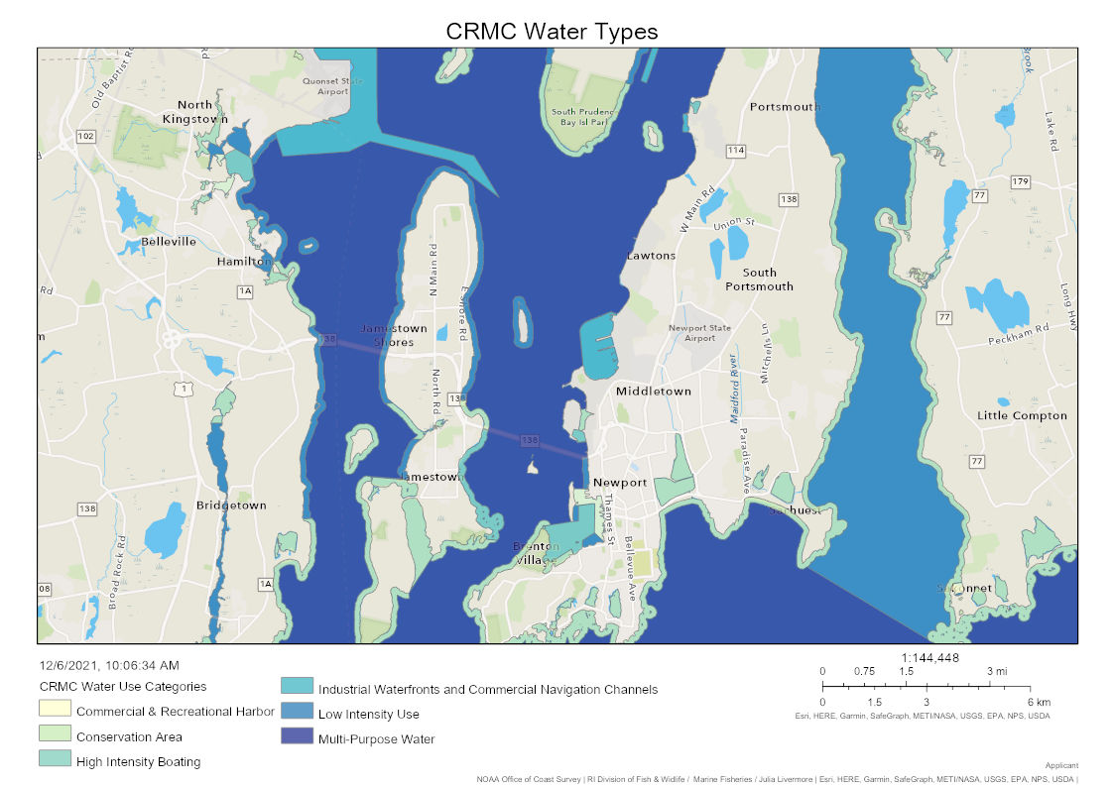
“[T]he water type along any shoreline generally runs parallel to the shoreline and extends five hundred (500) feet seaward from the mean high water mark.” 650-RICR-20-00-1.6(C)
The Red Book

Slide 6
Draft Application
and
Scoping Session
Preliminary Determination (PD)
Initial review with town, US Coast Guard, Dept of Environmental Management, Army Corps of Engineers, non-governmental agencies, fishing industry
Aquaculture Application Process with Proposed New Notification Requirements
Recommendations to applicant
Full Aquaculture Application
Director; Dept of Environmental Management; Fish and Wildlife; Water Resources; Enforcement
RI Historical Preservation and Heritage Commission
All events marked with triangle include notification to property owners listed on application.
30 Day Public Notice
Army Corps of Engineers; General Permitting
Shellfish Advisory Panel
No Objections
Objections
RI Marine Fisheries Council
All events marked with star include notification through the new CRMC Aquaculture Listserve.
CRMC
No Objections and meets § 1.1.6(D)(5) criteria
Objections
CRMC Public Hearing
APPROVAL
APPROVAL WITH MODIFICATION
DENIAL

Slide 7
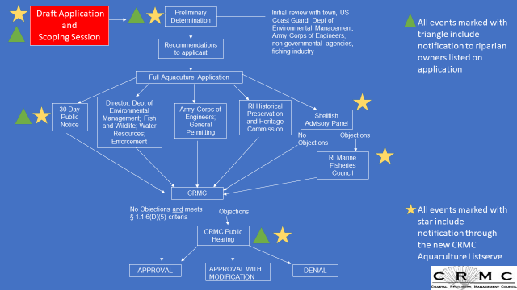
New Application Development Process before PD with Scoping Session and Riparian Notice
Draft Application
Accepted by CRMC
Phase 1:
Application Development
(Different Location)
Scoping Session held by applicant
Revised application
All events marked with triangle include notification to property owners listed on application
Preliminary Determination (PD) Meeting
All events marked with star include notification through the new CRMC Aquaculture Listserve

Slide 8
Expanded Application Development Process; Step 1: Draft Application
Before scheduling the scoping session, an applicant must submit a draft application to CRMC;
Draft application must include (in addition to current requirements):
An operational plan that describes any off lease activity associated with the proposed farm including a plan for access to the site and the landing of product for sale;
A list of any coastal property owners within 500 feet of the proposed site
Town may have to assist applicant in identifying coastal property owners and should certify contact list info is accurate similar to land based zoning requirements.
DRAFT APP
SCOPING
PRELIMINARY
DETERMINATION

Slide 9
Expanded Application Development Process; Step 1: Draft Application (cont’d)
When CMRC accepts a draft application as complete, CRMC will notify the closest town(s), the Listserve, and instruct the applicant to being scheduling the scoping session in the town(s) closest to the application;
Once scoping session is scheduled, the applicant must send notice of the scoping session to the property owners listed on the draft application accepted by CRMC;
The applicant will also notify CRMC of the scoping session and CRMC will notify the town(s) as well as post notice of the scoping session to the Aquaculture Listserve;
Town may publish notice of the scoping session as they see fit and may review draft application prior to scoping meeting for consistency with any local zoning ordinances.

Slide 10
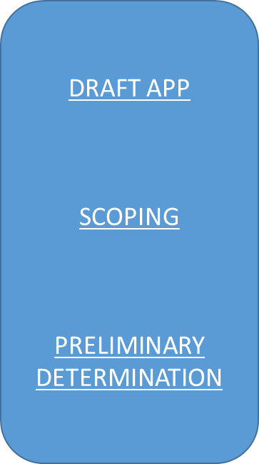
Expanded Application Development Process; Step 2: Scoping Session
Before a PD meeting can be scheduled, the applicant shall hold a scoping session in the town closest to the proposal.
The purpose of a scoping session shall be to:
Familiarize the general public with the proposal;
Allow the public an opportunity to provide the applicant with additional local information to inform development of the application; and
To allow the public an opportunity to ask questions of the applicant.

Slide 11
Expanded Application Development Process; Step 2: Scoping Session (considerations)
The applicant is required to attend the scoping session and should be prepared to present the application and answer any questions;
Scoping sessions are open to the public and town officials, or members of town bodies, are welcome to attend the scoping session;
The scoping session should be scheduled in a manner that is conducive for public participation with regards to location, time and place;
For example, the scoping session should take place in a publicly accessible building such as library, community center, town hall, etc., during reasonable non-working hours (weekday evenings/weekend);
CRMC’s attendance at the scoping session is discretionary and therefore, scheduling can be accomplished independent of CRMC staff’s availability.

Slide 12
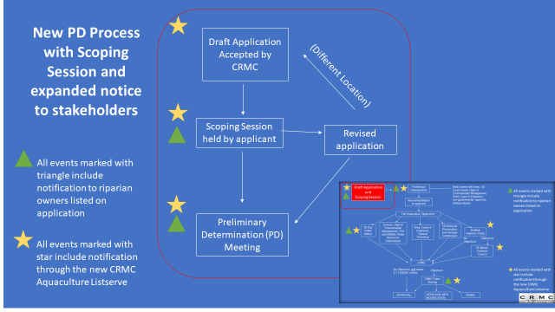
Draft Application Revision post Scoping Session:
After the scoping session, the applicant may wish to revise the draft application based on feedback from the community and town.
CRMC may accept a revised application if the location is not substantially different from the site originally noticed for the scoping session.
The applicant may be required to hold another scoping session addressing the revised location before the revised application is accepted.

Slide 13
Expanded Application Development Process; Step 3: Preliminary Determination (PD) Meeting:
After the scoping session has been held by the applicant, CRMC will schedule the PD meeting with the town closest to the application according to the existing process;
Once scheduled, CRMC will publish notice of the PD meeting to the Listserve with a copy of the current application, including any accepted revisions thereto;
CRMC will also send notice of the meeting to the listed property owners on the application;
The town may choose where to hold the PD meeting and may choose to publish notice of the meeting as they see fit.
DRAFT APP
SCOPING
PRELIMINARY
DETERMINATION

Slide 14
Phase 2 – Application Review: Full Category B Application for Aquaculture
When an applicant has satisfied all Preliminary Determination requirements, they may now submit a full Category B application for an aquaculture lease.
Once a full application is accepted as complete, CRMC will publish a 30 day Public Notice and post notification to:
Aquaculture Listserve;
The closest town(s); and
The property owners listed on the application.*
Public Notice will include a copy of the application, standard NOAA Chart and reference to any related file numbers, i.e. PD file number, existing lease number for proposed expansions, etc.*
Phase 1:
Application Development
Phase 2:
Application Review
Phase 3:
Final Decision
*New Process

Slide 15
Phase 2 - Application Review (cont’d); Rhode Island Marine Fisheries Council and Shellfish Advisory Panel Meetings
CRMC will post notice of any Rhode Island Marine Fisheries Council and/or Shellfish Advisory Panel meetings that involve an aquaculture application to the Aquaculture Listserve.*
*New Process

Slide 16
Phase 3 - Final Decision: CRMC Public Hearings
CRMC will post notice of any CRMC public hearing involving an aquaculture application to:
The aquaculture Listserve and;
The closest town(s);
The listed property owners on the application;*
Notice will reference to any related file numbers, i.e. PD file number, existing lease number for proposed expansions, etc.*
Phase 1:
Application Development
Phase 2:
Application Review
Phase 3:
Final Decision
*New Process

Slide 17
Draft Application
&
Scoping Session
Preliminary Determination
Initial review with town, US Coast Guard, Dept of Environmental Management, Army Corps of Engineers, non-governmental agencies, fishing industry
All events marked with triangle include notification to riparian owners listed on application, i.e. within 500 feet.
Recommendations to applicant
Full Aquaculture Application
Director; Dept of Environmental Management; Fish and Wildlife; Water Resources; Enforcement
RI Historical Preservation and Heritage Commission
30 Day Public Notice
Army Corps of Engineers; General Permitting
Shellfish Advisory Panel
No Objections
Objections
RI Marine Fisheries Council
CRMC
No Objections and meets § 1.1.6(D)(5) criteria
Objections
All events marked with star include current notification through the new CRMC Aquaculture Listserve
CRMC Public Hearing
APPROVAL
APPROVAL WITH MODIFICATION
DENIAL

Slide 18
Request for Feedback from Bay SAMP Aquaculture Working Group and Next Steps:
CRMC will accept comments, recommendations, and feedback from the working group on the proposed concepts until December 31, 2021 (comments can be sent to the CRMC Aquaculture Coordinator, Benjamin Goetsch, at bgoetsch@crmc.ri.gov);
After review of all comments, any new proposed changes to the aquaculture program will be sent to the CRMC Policy and Procedures Subcommittee for review with recommendation for implementation (expected January 2022);
Some aspects of these changes may be implemented administratively while others may require regulation changes, public hearings, rule making, etc.;
CRMC will continue to work on the other issues identified through the stakeholder working group process and will present follow up proposals to the WG for feedback at a later date.

Slide 19
CRMC thanks you for your participation!
“Public participation is necessary in all phases of program development and implementation. Therefore, it shall be the policy of the Council to promote the participation of federal, state, and local governmental bodies, public and private organizations, and private citizens in the preparation of its plans, programs, policies and regulations” 650-RICR-10-00-1.5(A)(1)

