Slide 1
more than just number using idea results for all their worth chairs’ workshop series
office of the provost
office for the advancement of teaching and learning
dr. anna santucci
faculty development specialist
asantucci@uri.edu
sean krueger
coordinator, course evaluation
skrueger@uri.edu

Slide 2
When you think about IDEA…
What are your thoughts on the role that student voice should have in the evaluation of teaching process?
office of the provost
office for the advancement of teaching and learning

Slide 3
Student voice as one piece of a bigger picture
Teaching Effectiveness
Student Feedback
Peer Review
Self Reflection
See example benchmark frameworks: https://teval.net/resources.html
office of the provost
office for the advancement of teaching and learning

Slide 4
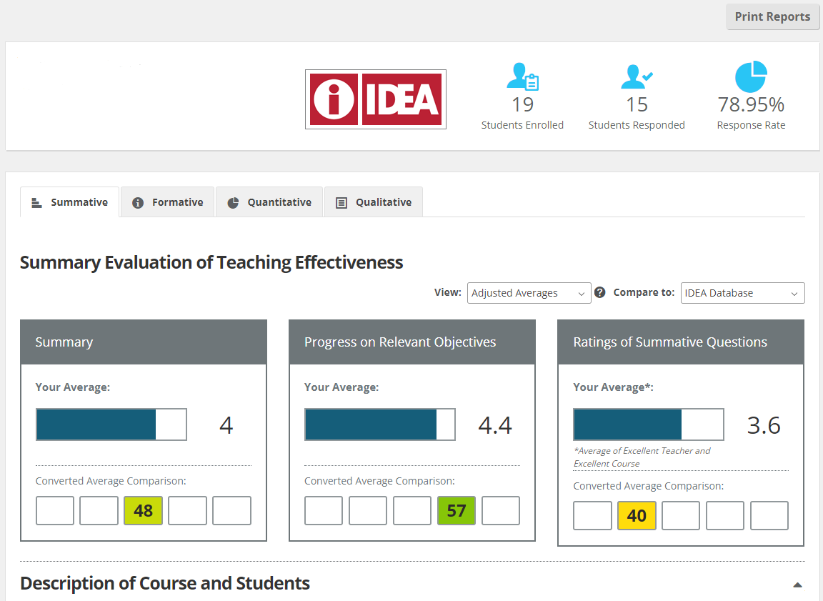
idea: behind the numbers
Summary average of the other two Summary scores
Progress on Relative Objectives weighted average of selected objectives
Ratings of Summative Questions average of 2 questions
Overall, I rate this instructor as excellent teacher
Overall, I rate this course as excellent.
office of the provost
office for the advancement of teaching and learning

Slide 5
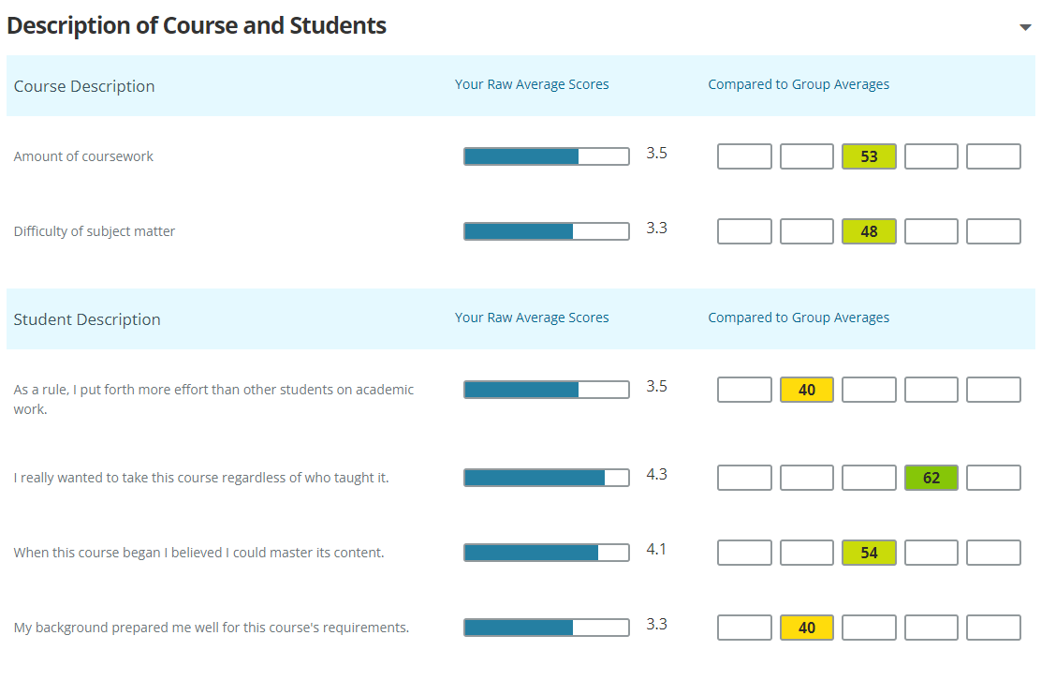
idea: behind the numbers
Response rate Percentage of enrolled students who completed the IDEA form
Adjusted vs Raw Averages Uses the Course and Student description questions to adjust summary scores.
Description of Course and Students Student’s description of themselves and courses. These questions are used when adjusting scores.

Slide 6
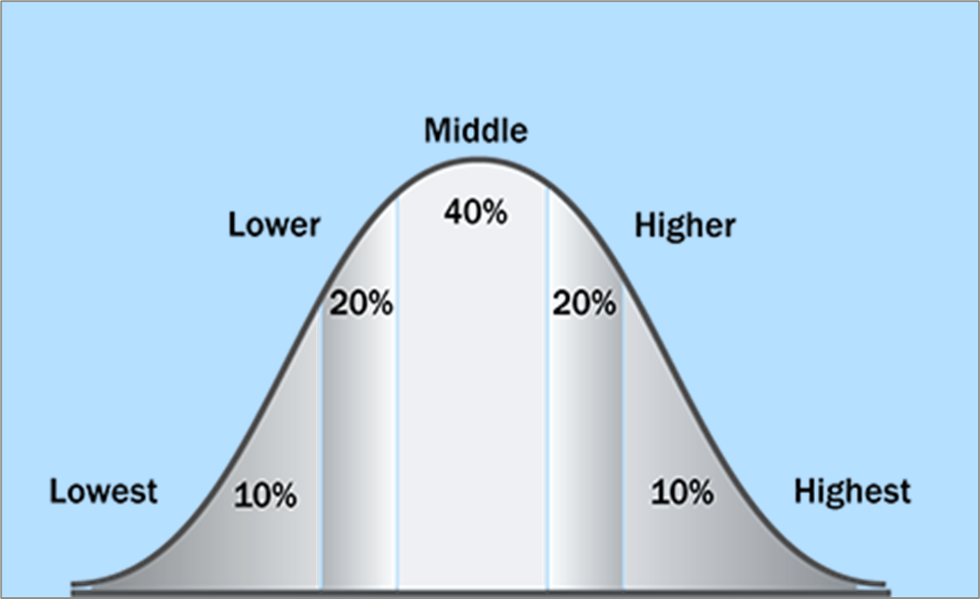
idea: behind the numbers
Converted Average Comparison
Converts the 5-point scale score to a T-score with an average of 50 and a SD of 10.
office of the provost
office for the advancement of teaching and learning

Slide 7
Why collect student feedback? - IDEA @ URI helps instructors:
Tell their unique teaching story (e.g. context of teaching innovations)
Collect additional evidence for teaching portfolios (e.g. track patterns)
Explore strategies to enhance classroom practice
Gather formative information as a reflective practitioner + Demonstrate that process
office of the provost
office for the advancement of teaching and learning

Slide 8
common idea use cycle
Adjust subsequent course
& Document for portfolio
Set Relevant Objectives
3-5 Important/Essential Objectives
5
1
4
Reflect on Formative feedback
Teaching Methods recommendations
Collect Feedback
Final 2 weeks of the term
2
3
Review Progress on
Relevant Objectives

Slide 9
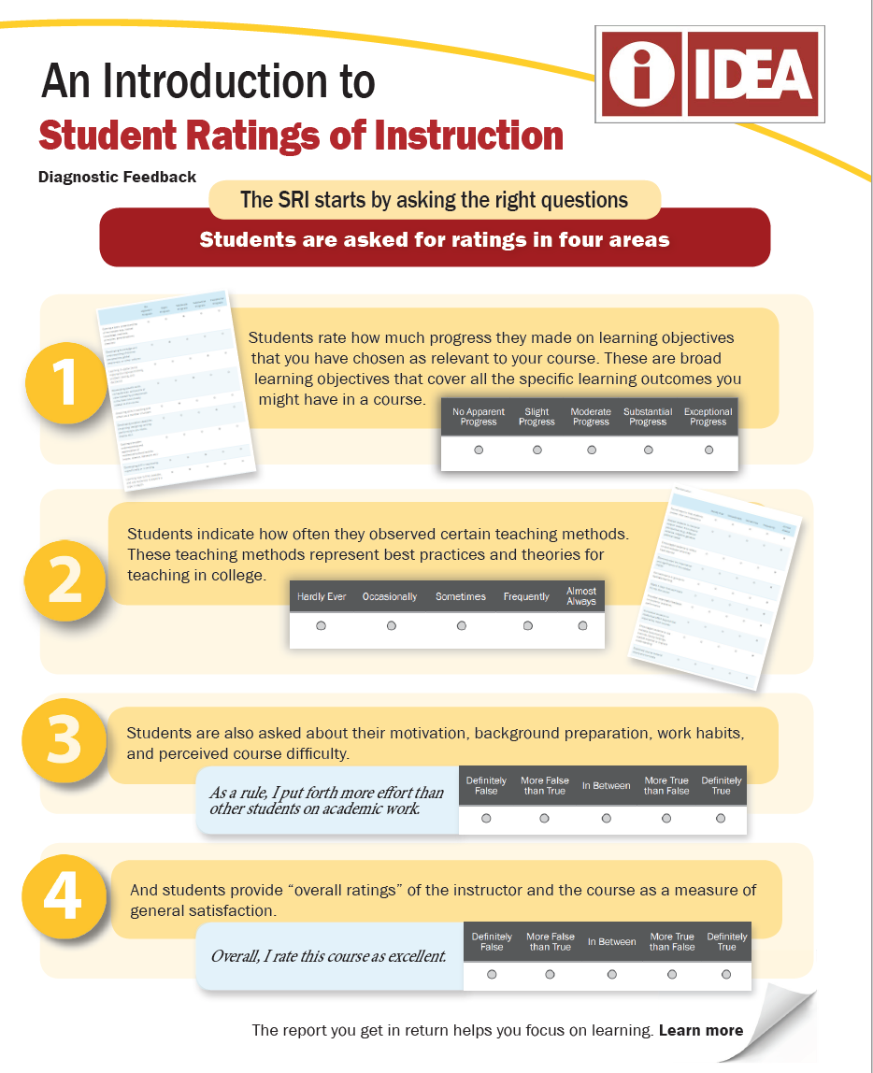
1. Progress On Relevant Objectives
13 questions
50% of SUMMARY SCORE
2. Observation Of Teaching Methods
19 questions
Generate FORMATIVE FEEDBACK
3. Description Of Course And Students
6 questions
Factored in adjusted overall score (SUMMARY SCORE)
4. Summative Rating Questions
2 overall satisfaction ratings
50 % of SUMMARY SCORE

Slide 10
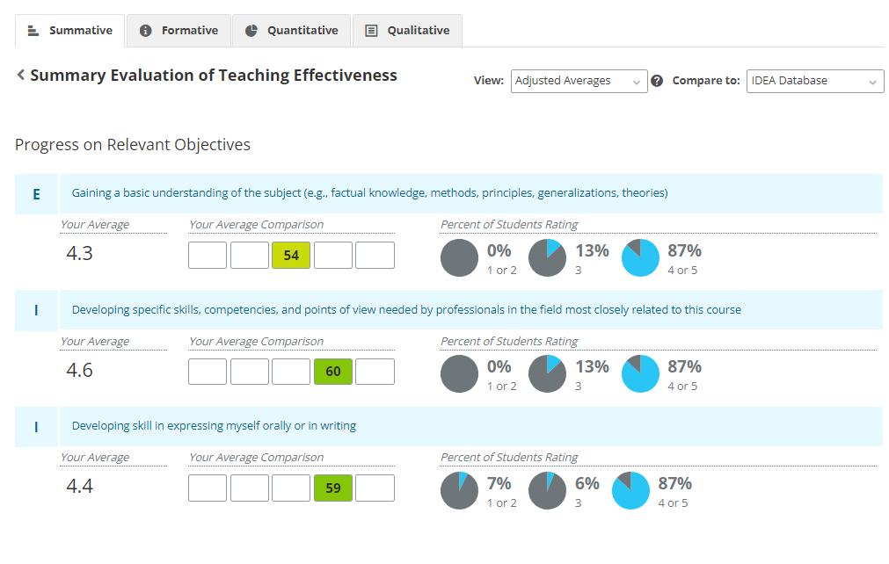
Progress on Relevant Objectives

Slide 11
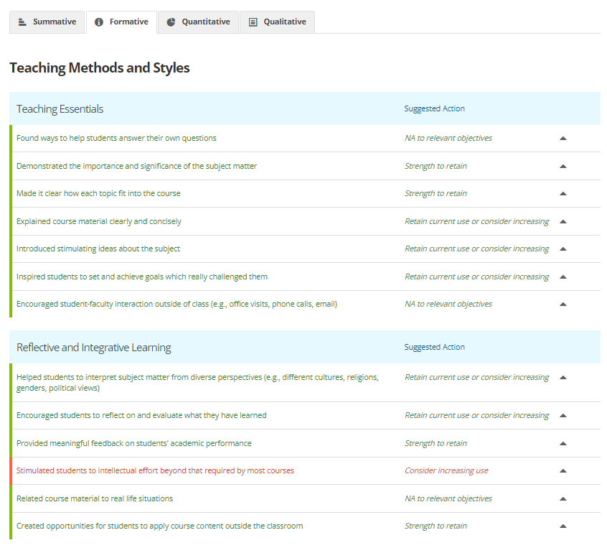
Teaching Method Recommendations
office of the provost
office for the advancement of teaching and learning

Slide 12
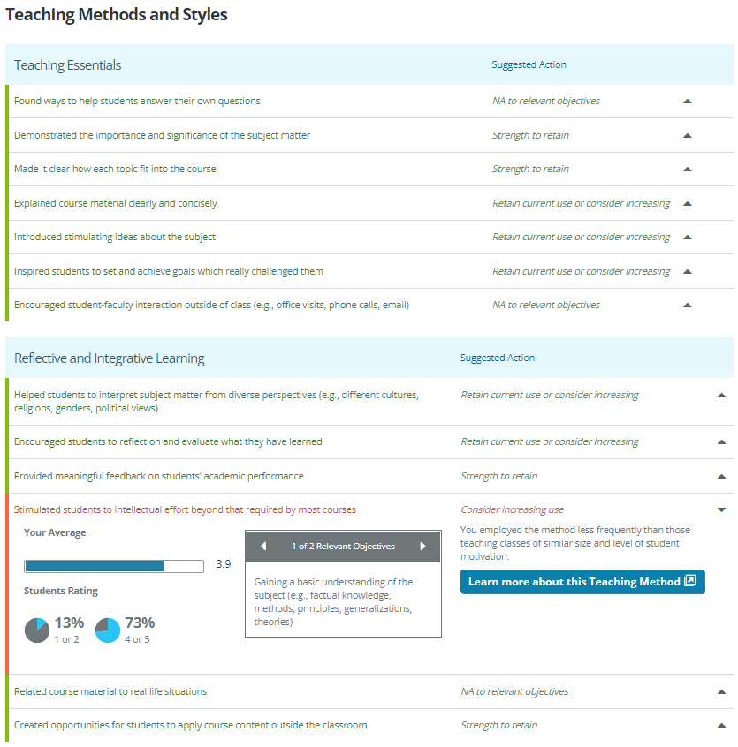
Click here to open dropdown
Relevant Objectives linked to this Teaching Method
Resources for this
Teaching Method

Slide 13
idea as part of ongoing communications with students
Consider establishing a communications cycle
Asking the right questions (what can and should my students tell me?)
Asking at the most effective time for your goals: before/during/at the end of course
Example mid-semester 3-questions model: https://web.uri.edu/atl/facilitated-mid-semester-feedback/
A note on qualitative open-ended questions: remind students that effective feedback is specific, polite, and constructive; this is an opportunity to talk directly to you!
Photo by Shane Rounce on Unsplash

Slide 14
Q&A
What are your current concerns?
office of the provost
office for the advancement of teaching and learning

Slide 15
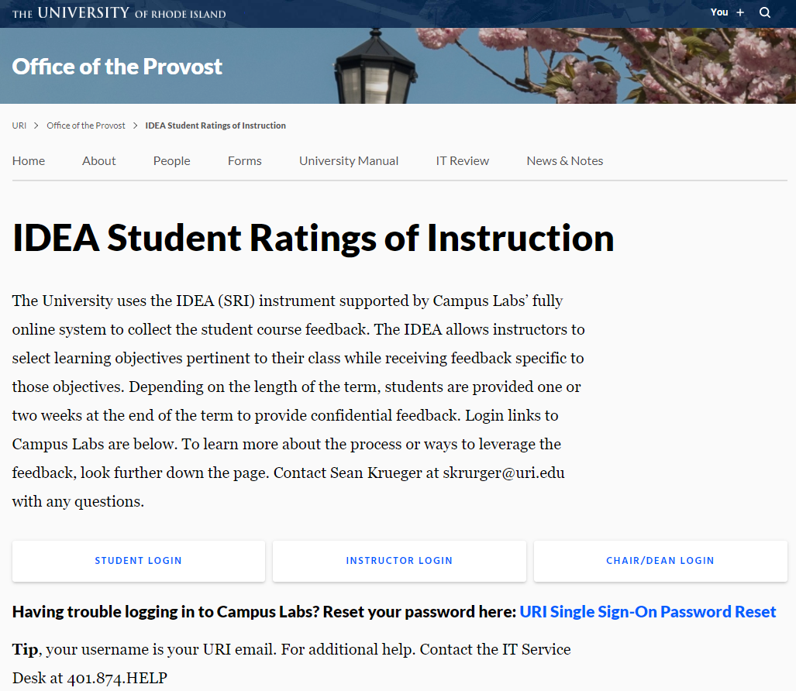
Where to Begin
office of the provost
office for the advancement of teaching and learning

Slide 16
office of the provost
office for the advancement of teaching and learning
dr. anna santucci
faculty development specialist
asantucci@uri.edu
sean krueger
coordinator, course evaluation
skrueger@uri.edu

