Slide 1
Interfolio Review Promotion & Tenure Candidate Workshop

Slide 2
Agenda
Interfolio Overview
Logging In
Dossier Institution
Collections
Guidelines
Sharing
Packet
Uploading materials
Submitting review
How to find support

Slide 3
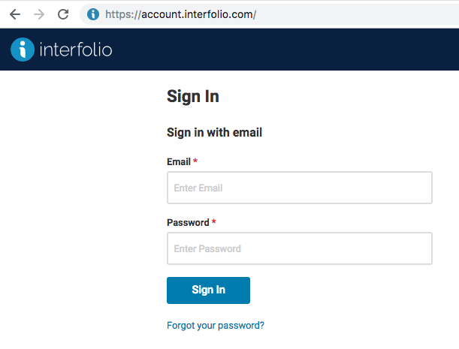
How to log in:
Go to account.interfolio.com
Enter in your URI email address and password
*If you have not created a password, click “Forgot your password?”

Slide 4
Some important terms…
Review, Promotion & Tenure: An Interfolio module used to facilitate the review process anytime a candidate submits materials and one or as series of committees need to review or approve the materials.
Templates: the building blocks of Review Promotion and Tenure that allow Administrators to create a standardized, repeatable process for all review cases in their institution, colleges, schools, and departments.
Packet: the collection of materials by which a candidate is being reviewed (documents and other files)
Dossier: A tool for faculty to store and manage job, fellowship, and promotion or review documents in one place. The Dossier will act as the central archiving tool for your candidate’s materials. All information submitted for a review will be copied into the faculty Dossier for archiving or reusability purposes.
Notes:
Part two: rational drowning
Over the past forty years, changes in hiring patterns have created an impact in academic decision making.
With 51% of all faculty in the US adjunct, and 19% full-time, non-tenure track, only 30% of faculty, on average, are available to shoulder the burden of shared governance decisions on campus. Research has shown that this load falls disproportionately to associate professors who cover for junior colleagues on the tenure track and pick up the slack for senior colleagues who seek to take on less service.
A 2014 study from Harvard’s Collaborative on Academic Careers in Higher Education found that this increased service load is linked with lower job satisfaction and lower overall satisfaction with the department and institution.
So I’d ask you: How are you helping your tenure-track faculty with professional service and collaboration?

Slide 5
Review Promotion and Tenure Training

Slide 6
How to find support:
Check out our help articles for detailed advice on most everything you can accomplish with Interfolio: product-help.interfolio.com
Our Scholar Services team is available to help provide one-on-one support if you have trouble with anything from signing in to sending a case forward. Give them a shout at help@interfolio.com

Slide 7
Our Support: All Users, Monday – Friday Access
Help for administrators faculty, staff, applicants, external evaluators, and IT.
“The #1 thing I like about Interfolio is the client service. Every time I call, they get right back to me; they always have an answer for me.”
Georgia Davidis, Faculty Dossier Coordinator, Office of the Provost, Haverford College

