Slide 1
Review, Promotion & Tenure
Committee Manager Training: Department Chairs & Deans

Slide 2
Today’s Training Objectives
Interfolio Overview
Important Terms
User Roles
Candidate Experience
Add Materials
Submit Packet
Dossier
Manage Cases
Review Case Materials
Upload Committee Files
Committee Communications
How to Find Support

Slide 3
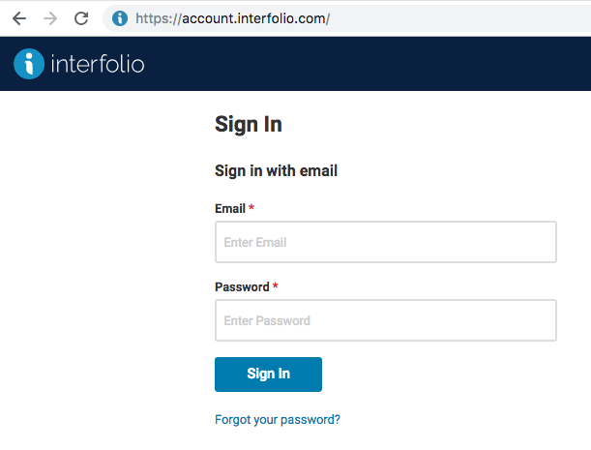
How to log in:
Go to account.interfolio.com
Enter in your URI email address and password
*If you have not created a password, click “Forgot your password?”

Slide 4
Important Terms
Review, Promotion & Tenure: An Interfolio module used to facilitate the review process anytime a candidate submits materials and one or as series of committees need to review or approve the materials.
Templates: The building blocks of the RPT module that allow administrators to create standardized, repeatable processes for all review types at their institution, colleges, schools, and departments. Templates can be created centrally or copied down to specific unit for customization.
Cases: The lifecycle of a candidate as they progress through a standardized review cycle. Committees have the ability to add a case analysis or evaluation to the case as it progresses through the workflow leading up to the final decision.
Packet: The collection of materials by which a candidate is being reviewed (documents and other files). The packet is divided into sections which can be worked on and submitted independently of one another. All materials submitted in the packet will be copied to the candidates Dossier for record keeping.
Dossier: A tool for all faculty to store and manage job, fellowship, and promotion or review documents in one place. The Dossier will act as the central archiving tool for your candidate’s materials. All information submitted for a review will be copied into the faculty Dossier for archiving or reusability purposes.
Committee: Groups of users that can review the candidates’ case at a given step of the review process. Committees can be: Standing (managed from the central committee tab), Ad Hoc (case specific) or individual assignment (committee of one).

Slide 5
User Roles
Types of users in Interfolio Review, Promotion & Tenure
Administrators can access documents, email candidates and committees, and move a case forward or backward. Administrators are the only users who can create templates, forms, and cases for the units to which they have access.
Committee Managers are assigned to specific committee or steps. They can review a candidate, move a case forward or backward, and communicate with both the candidate and committee members from within the system.
Committee Members have the most basic permissions within the system. They can view a candidate’s packet, download documents (if allowed), and leave comments (if allowed) on the particular case they have access to.
Candidates complete a packet with their documents and other files to submit for review.

Slide 6
Review Promotion and Tenure Training

Slide 7
How to find support:
Check out our help articles for detailed advice on most everything you can accomplish with Interfolio: product-help.interfolio.com
Our Scholar Services team is available to help provide one-on-one support if you have trouble with anything from signing in to sending a case forward. Give them a shout at help@interfolio.com or call 877-997-8807 M-F 9:00am -6:00 pm EST.

Slide 8
Our Support: All Users, Monday – Friday Access
Help for administrators faculty, staff, applicants, external evaluators, and IT.
“The #1 thing I like about Interfolio is the client service. Every time I call, they get right back to me; they always have an answer for me.”
Georgia Davidis, Faculty Dossier Coordinator, Office of the Provost, Haverford College

