Slide 1
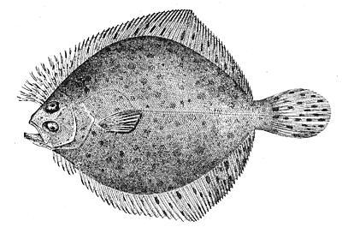
Utilizing fishers’ observations to inform SNE/ MA windowpane science and management
Richard J. Bell¹, M. Conor McManus², Jason E. McNamee², James Gartland³, Ben Galuardi⁴, Chris McGuire¹
¹The Nature Conservancy
²RI DEM Division of Marine Fisheries
³Virginia Institute of Marine Science
⁴GARFO, NMFS

Slide 2

Fishery dependent data
Monitoring
Quota management
Catch reporting
  Discards
Stock assessments
  Total biomass
  Length/age data
Compliance
Spatial management
Research
Ecological questions, etc…
Photo credit GMRI
Notes:
Fishery dependent data are an essential part of any management system and are used in a number of ways.
Number of ways to collect fishery dependent data: log books, VTRs, dealer reports, port side monitoring, observers and electronic monitoring.

Slide 3
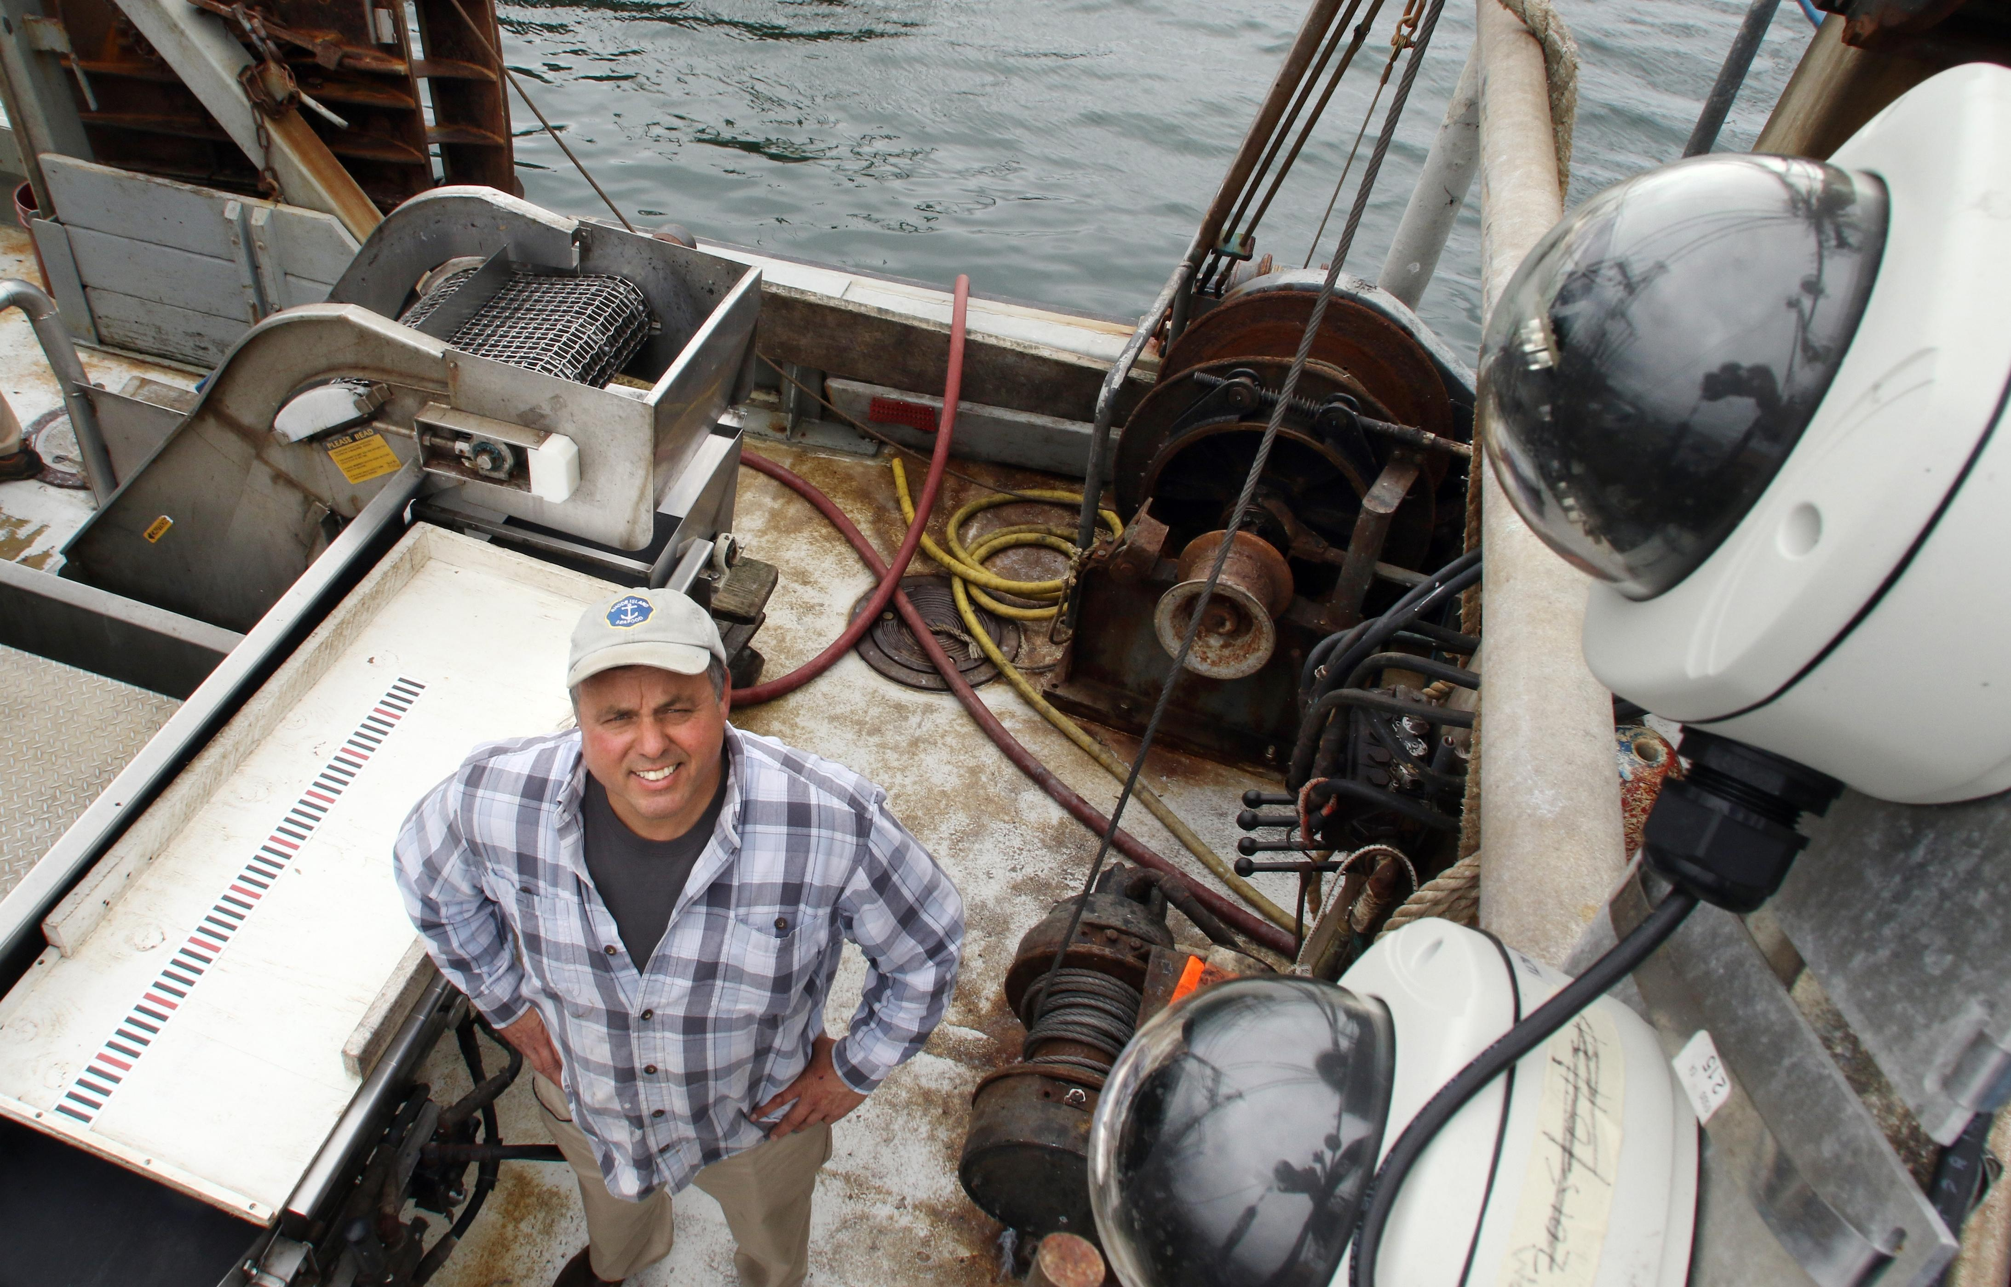
Electronic Monitoring
Compliance
Catch reporting
  Discards
Length/age data for stock assessments
Use of EM to refine management measures
Notes:
Number of ways to collect fishery dependent data: log books, VTRs, dealer reports, port side monitoring, observers and electronic monitoring.
EM is the Digitally record of fishing activity while engaged in regular fishing operations. Often discussed replacement or complement to Observers, in terms of compliance or catch reporting, particularly discards. Information for enforcement or information that would go into a stock assessment. Curious is a small amount of EM data could help inform the implementation of management.
They came to us wanting us to look at their data.
Turns anecdotal obs into real data.data could help inform the implementation of management

Slide 4
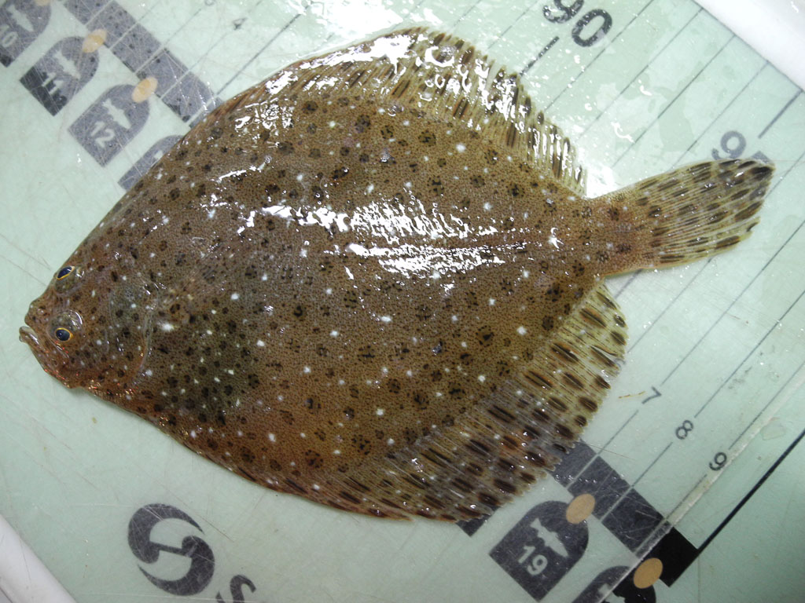
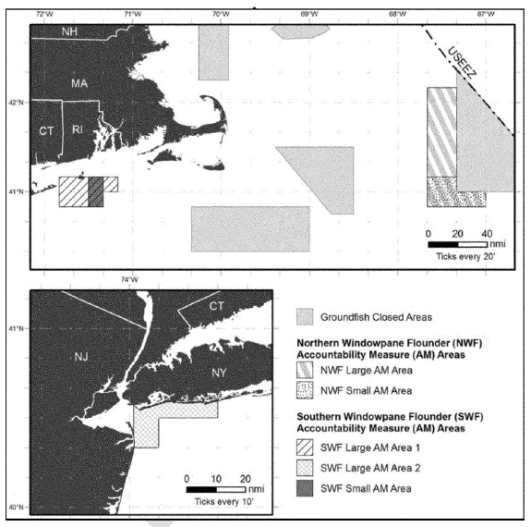
S. Windowpane Flounder
S. Windowpane are currently a prohibited stock
Temporary restricted area imposed if discards hit threshold
Notes:
Windowpane are a small/thin flatfish on the US East coast that has an onshore/offshore seasonal migration. There was a small fishery for them though it was minimal since the mid 1990s, but commercial catch was prohibited in 2010. The assessment is the index of abundance from a fishery independent trawl survey and removals are only discards. Because of concerns for low biomass, managers instituted a restricted area that would come into effect if discards hit a certain threshold.

Slide 5
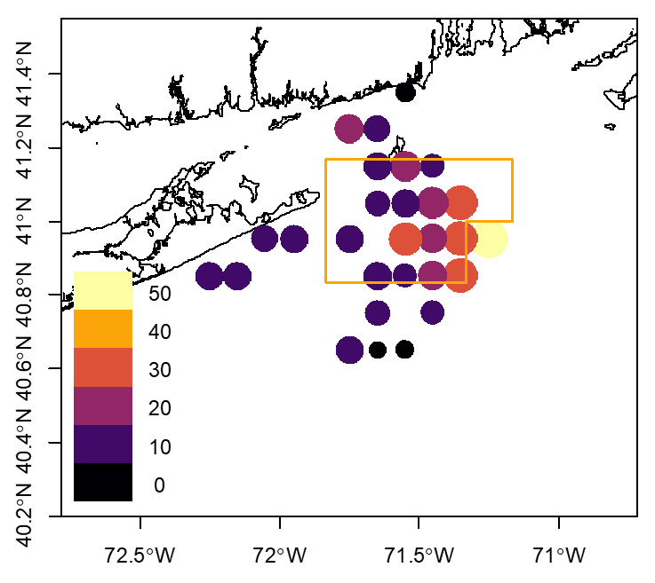
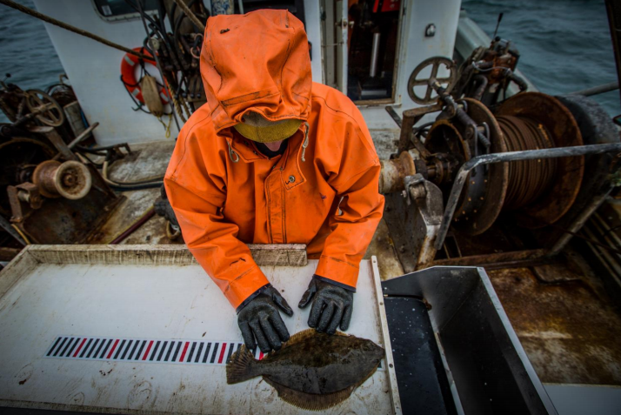
Electronic Monitoring Program
Electronic Monitoring Program Data
Notes:
EM program being run by Chris and a number of partners collecting species and length data on discards at the tow level. Because fisherman were sending each discard fish overboard one at a time, they were very aware of their discards and were thinking about windowpane in comparison to the regulated area. Gridded EM data showing the amount discarded. Can see that the areas with high discard were at the edge or outside the regulated area. Regulated area restrictive during this period. Concern that the regulated area may not be in the correct location (too big) and that and that they were using data when the fishery did not really exist to establish the box. The good fishing areas for windowpane were outside of this area and totally missed in the analysis. They could catch large amounts if they wanted.

Slide 6
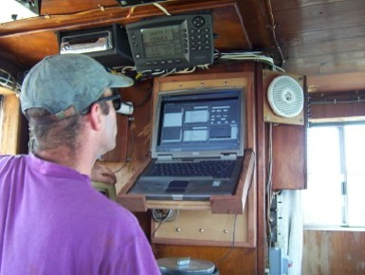
Combined Fishery Dependent and Independent data to examine Windowpane distribution.
Trawl Data Used in Abundance Estimates
  Electronic Monitoring Data
  NEFSC Spring Trawl Survey
  RI DEM Spring and Monthly Trawl Surveys
  NEAMAP Spring Trawl Survey
  Block Island Wind Farm Trawl
Years included: 2010-2017
Months included: January - May
Notes:
Attempting to determine where the disconnect between fisherman’s knowledge on high abundance areas and the temporary regulated area. Combine a range of data types to identify areas of high density.
process of selecting sampling locations is independent of the process generating difference in population density. Windowpane generally not targeted or avoided

Slide 7
Distribution of Windowpane
Notes:
Nodes are set by number of points per year and where they are. We set the node # and node placement is based on density if sampling points.
8 years of data, aggregated in 1 figure.
Map is relative importance (0-1 scale).

Slide 8
Abundance in the Context of Management: Reduce Fishing Mortality
VAST Relative Abundance
Discards
Abundances not greatest in the AM areas: are they effective?
  Depends on the spatial distribution of effort
Fishery-dependent data (GARFO) indicates high discards in the AM areas
So while the AM area may not indicate best-windowpane habitat, it is most effective at reducing discard mortality
Study Fleet Relative Catch

Slide 9
Conclusions
Electronic Monitoring data can be used to convert fishers observations into ‘hard numbers’ for quantitative analyses
High resolution data prompted a specific industry questions that directly lead to a research project
Highest density windowpane areas were not in the AM areas
Discards were highest in the AM areas
The AM areas would do the most to reduce fishing mortality on Windowpane

Slide 10









Thanks to Partners
U.S. Fish and Wildlife State Wildlife Grant Program
Rhode Island Marine Fisheries Institute
@Mark Hager/GMRI

Slide 17
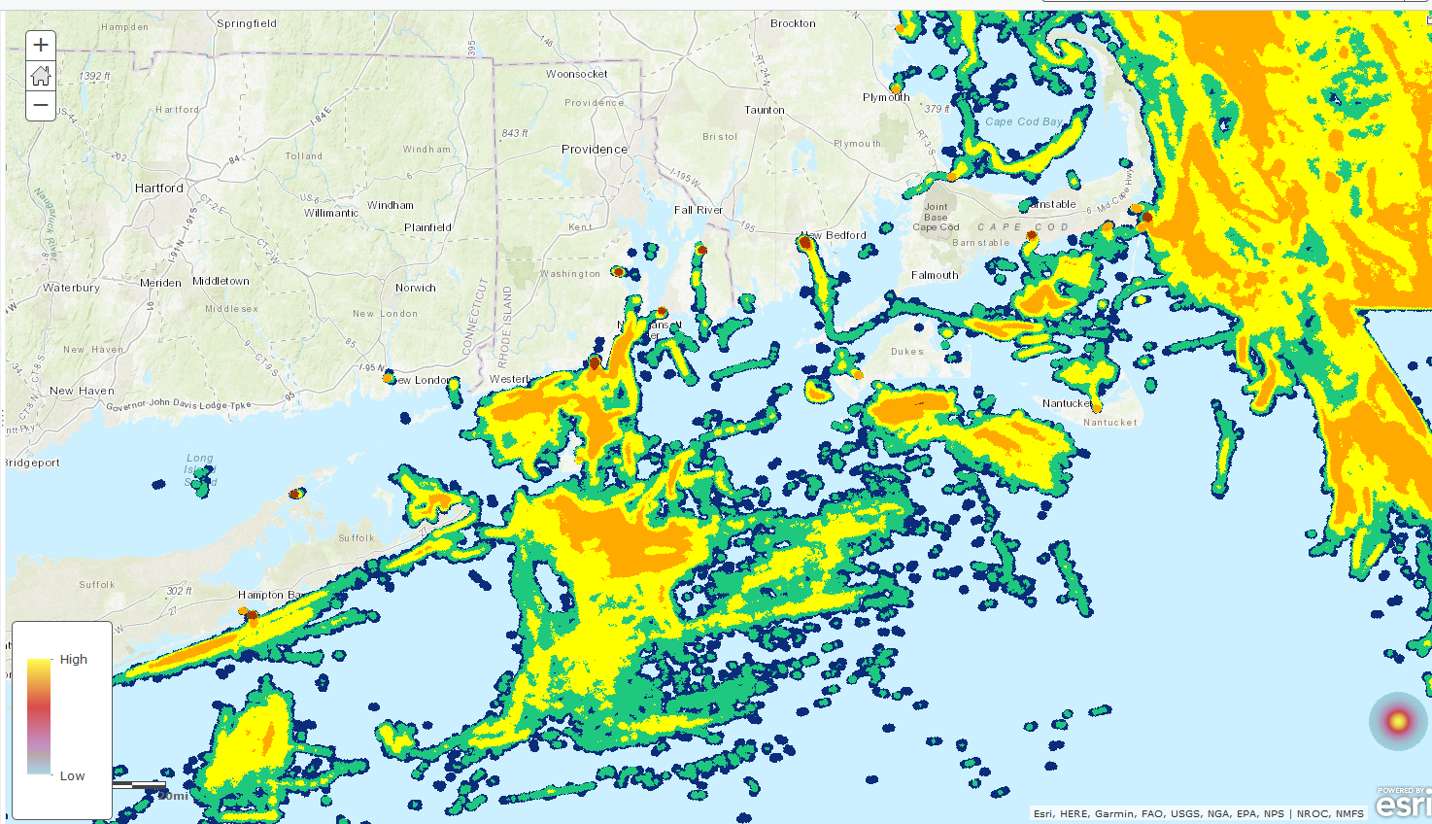
Commercial Fishing Activity
Ground fish VMS data
Notes:
NE data portal

Slide 20
Next Steps
Include temporal (e.g. months) and habitat variables (depth, temperature) within the spatial – delta GLMM
Further refine the windowpane biomass distribution model in VAST
Extend data stream through 2018 (EM and FI data)
Discuss findings with industry participants (corroboration of results)
Compare abundance estimates to VTR discard data
Present findings to the NEFMC PDT

Slide 21
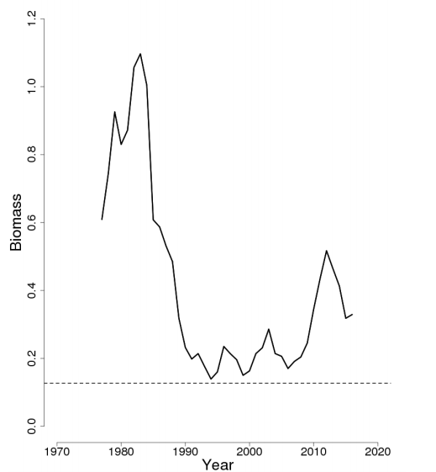
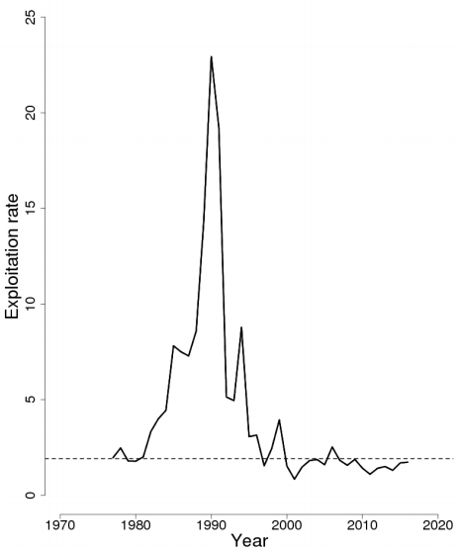
Windowpane Flounder
NOAA 2017
Windowpane are currently a prohibited stock
Temporary restricted area imposed if discards hit threshold
Notes:
Windowpane are a small/thin flatfish on the US East coast that has an onshore/offshore seasonal migration. There was a small fishery for them though it was minimal since the mid 1990s, but commercial catch was prohibited in 2010. The assessment is the index of abundance from a fishery independent trawl survey and removals are only discards. Because of concerns for low biomass, managers instituted a restricted area that would come into effect if discards hit a certain threshold.

Slide 22
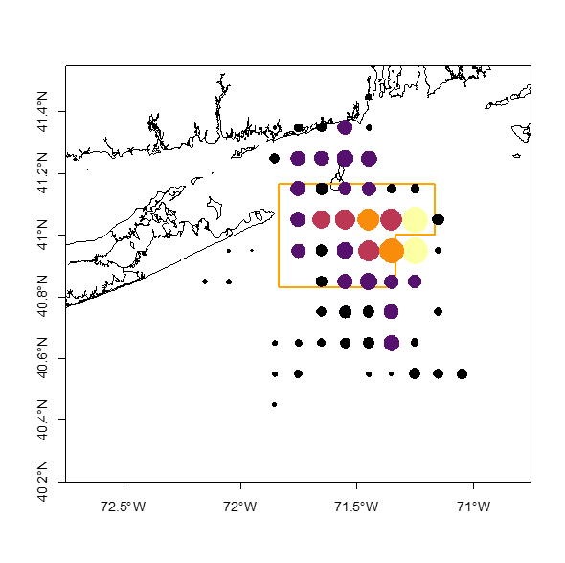
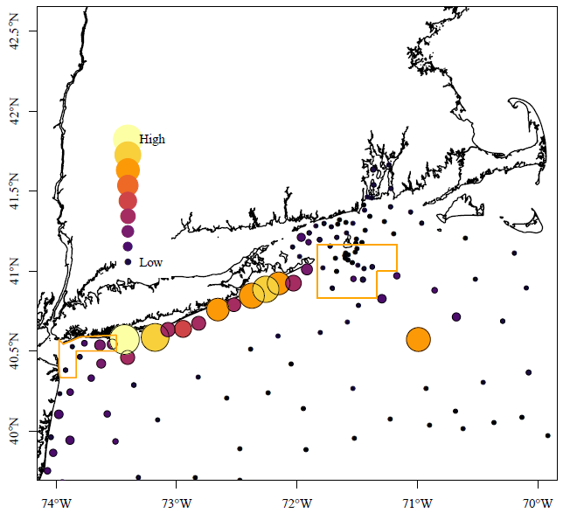
Abundance in the Context of Management: Reduce Fishing Mortality
Abundances not greatest in the AM areas: are they effective?
  Depends on the spatial distribution of effort
Fishery-dependent data (NOAA Study Fleet Program) indicates effort is high in the AM areas
So while the AM area may not indicate best-windowpane habitat, it may be effective in reducing discard mortality
VAST Relative Abundance
Study Fleet Relative Catch

Slide 23
Research Goals
Examine the spatial distribution of windowpane flounder
Examine seasonal changes in abundance
Estimate selectivity across multiple surveys
Examine spatio-temporal dynamics in the context of discards
Notes:
High resolution EM data could examine
high probability of occurrence and to evaluate the coherence of those areas across data sources. Length-compositions will be directly compared across the various surveys to understand the size selectivity of the various programs

Slide 24
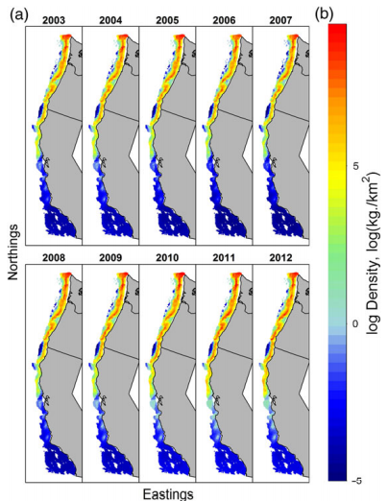
Spatial Delta Generalized Linear Mixed Model
Linear model - mixed (fixed and random) effects
  Random effect → multiple surveys
Delta model
  Presence/absence
  Positive tows
Spatial-Gaussian Markov random fields
  Smooth field representing unobserved aggregate impact of environmental and biological factors
Arrowtooth Flounder
  VAST package (R)
  Thorson and Ward 2014, Thorson et al 2015, Thorson and Haltuch 2018, Thorson 2018
Notes:
environmental and habitat factors points close are more similar, and allow for creating a smooth surface- Gaussian Markov random fields representing the density and variance without major spikes- can then add habitat variables and see if they account for some of the spatial variability.
Takes a random variable and makes it 2-dimensional
Points close to each other are more similar
Smooths over a surface to empty space with not data
Lat+Lon+

