Slide 1
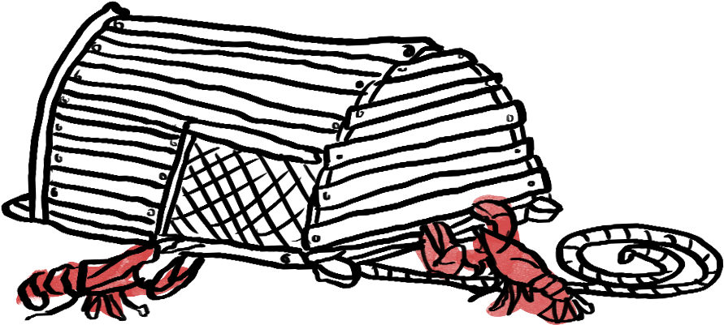
Early Life History of American Lobsters in Coastal Southern New England Waters
Declan McCormick - Dr. Jeremy Collie - Dr. Conor McManus - Dr. Rick Wahle

Slide 2
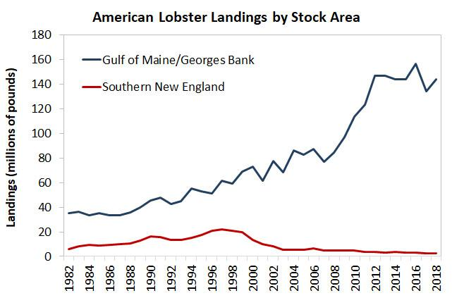
Southern New England (SNE) Lobster Stock
SNE lobster stock robust in late 1990s, has declined abruptly
Combination of fisheries mortality, environmental changes, epizootic shell disease etc.
Climate warming primary environmental cause (Rheuban et al. 2017)
ASMFC 2020

Slide 3
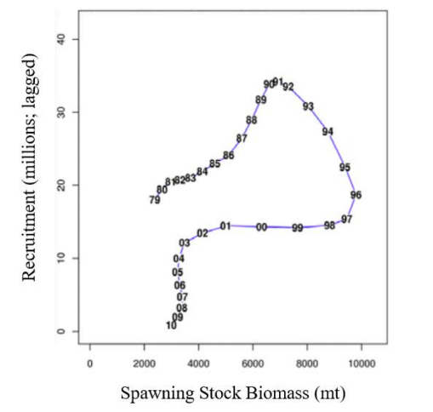
Recruitment Failure
SNE lobster stock appears to be experiencing recruitment failure
Population bottleneck occurring between egg and recruit stages
Figure adapted from ASMFC 2017

Slide 4
Project Objectives
To understand and quantify the recruitment bottlenecks in the lobster life history
To assess the abundance and spatial distribution of larval and post-settlement lobsters in SNE
To compare observations of abundance and spatial distributions with historical data to observe changes over time

Slide 5
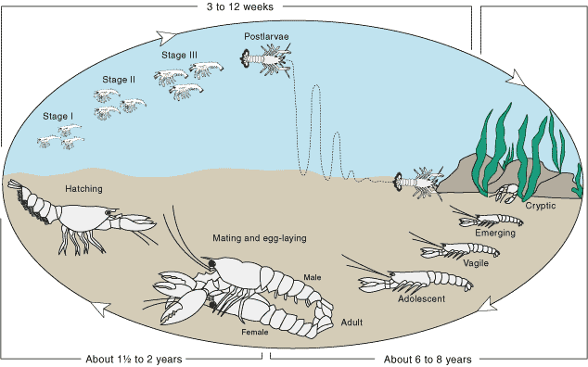
American Lobster Life History Overview
Larval Stage
Post-Larval Settlement
Source: St. Lawrence Global Observatory 2011

Slide 6
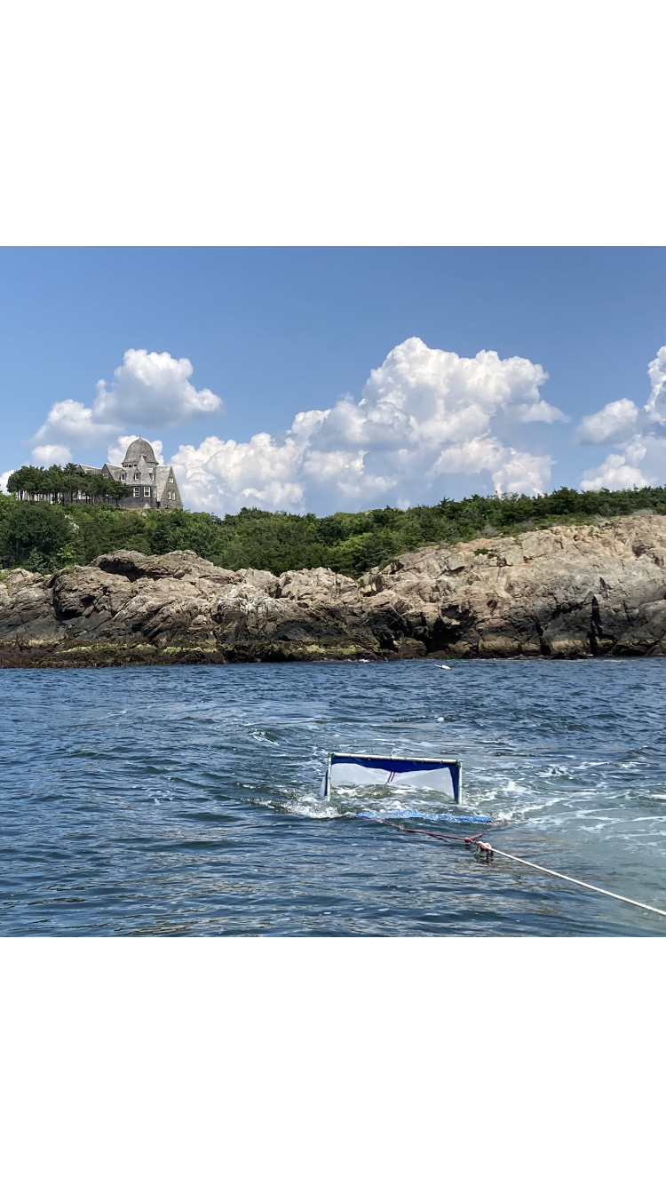
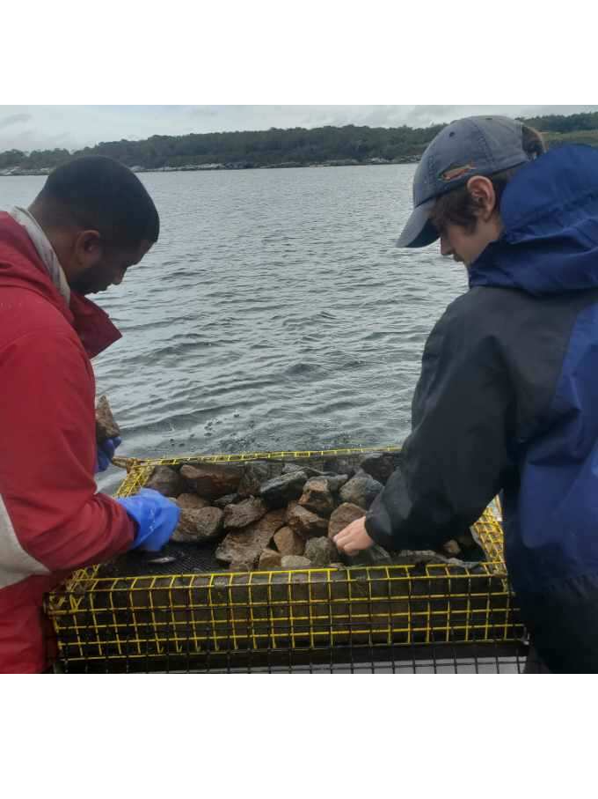
Sampling methods
Larval sampling
Neuston tows
Young-of-year/juvenile sampling
Passive post-larval benthic collectors

Slide 7
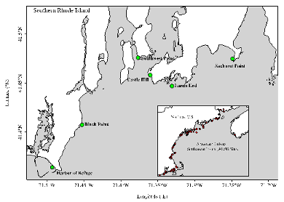
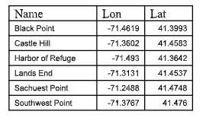
Field Work: Neuston tows
6 sample dates from June 1st - August 1st
Two 15-minute tows conducted at each site ≈ 2.5-3 kts
1000 micron mesh
Flow meter used to calculate volume of water sampled
Samples preserved in with 4% formaldehyde and returned to lab for analysis
Environmental data collected at each site using CTD probe
6 Sample locations in Rhode Island Sound

Slide 8
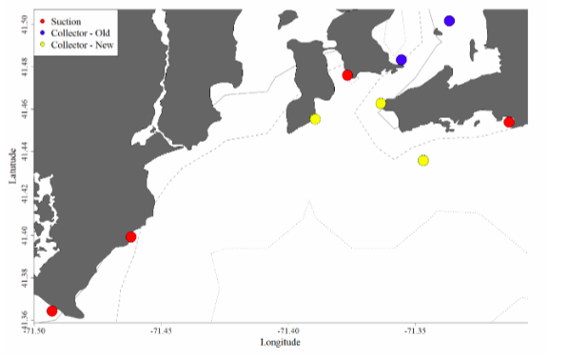
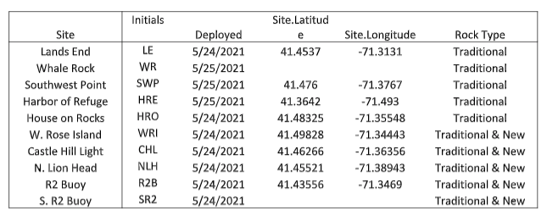
Field Work: Benthic Collectors
Deployed from late May - September
10 Collectors deployed at each site in trawl
Collectors occupy 0.53 m² area and are filled with cobble to simulate suitable lobster settlement habitat
2mm mesh on floor retains organism during retrieval
Filled with ≈ 80 kg of Cobble
Larger organisms measured and released, everything else bagged and frozen for further laboratory analysis
Traditional
COBBLE
New
COBBLE & GRAVEL
10 Sample locations in Rhode Island Sound

Slide 9
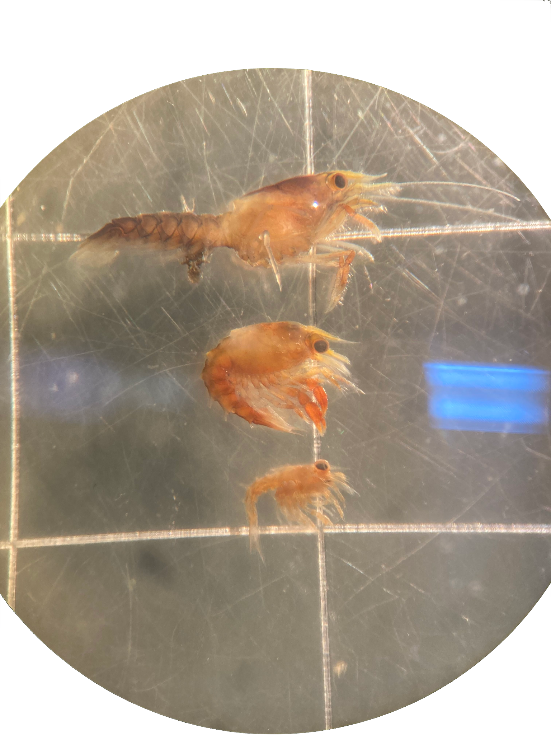
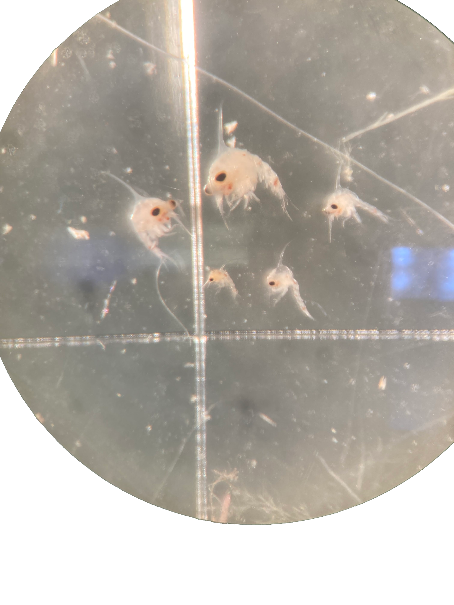
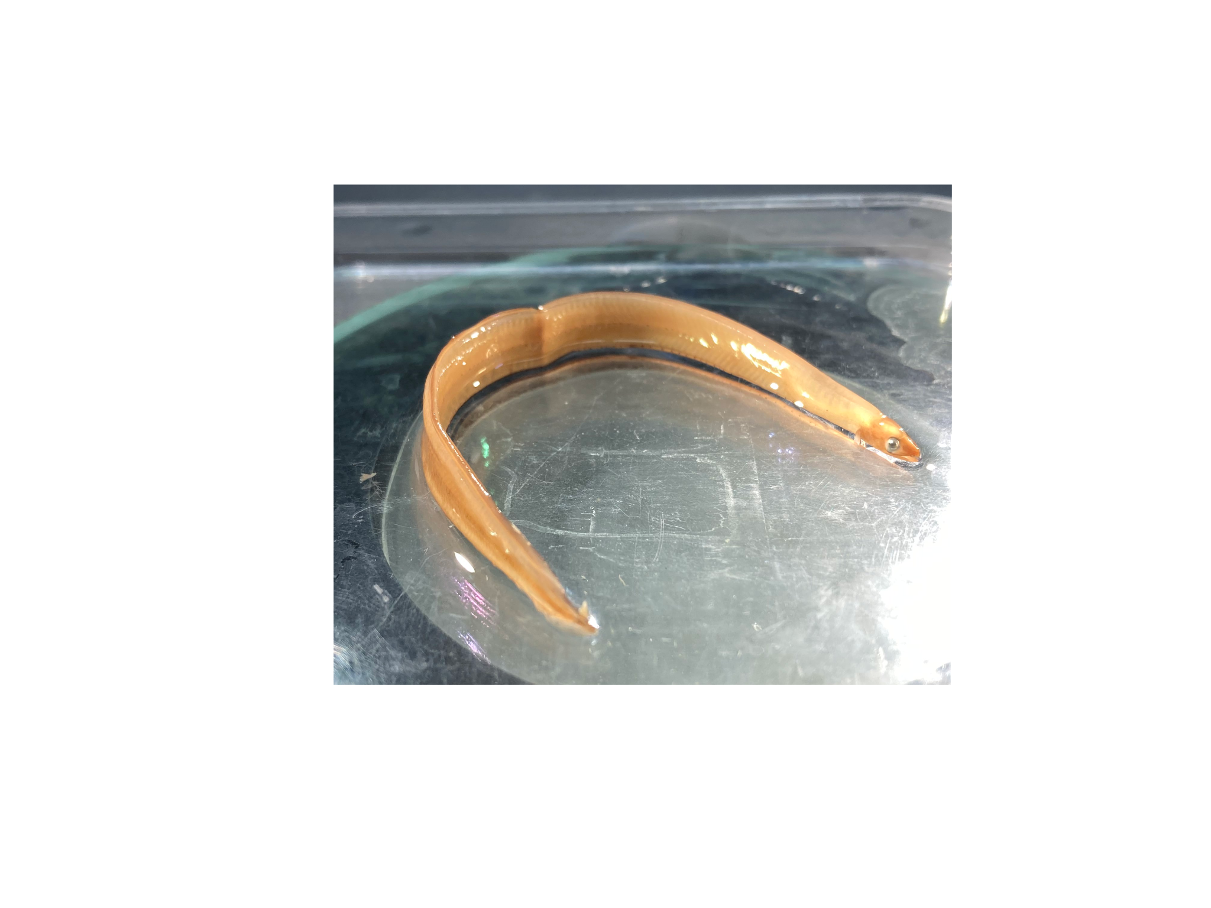
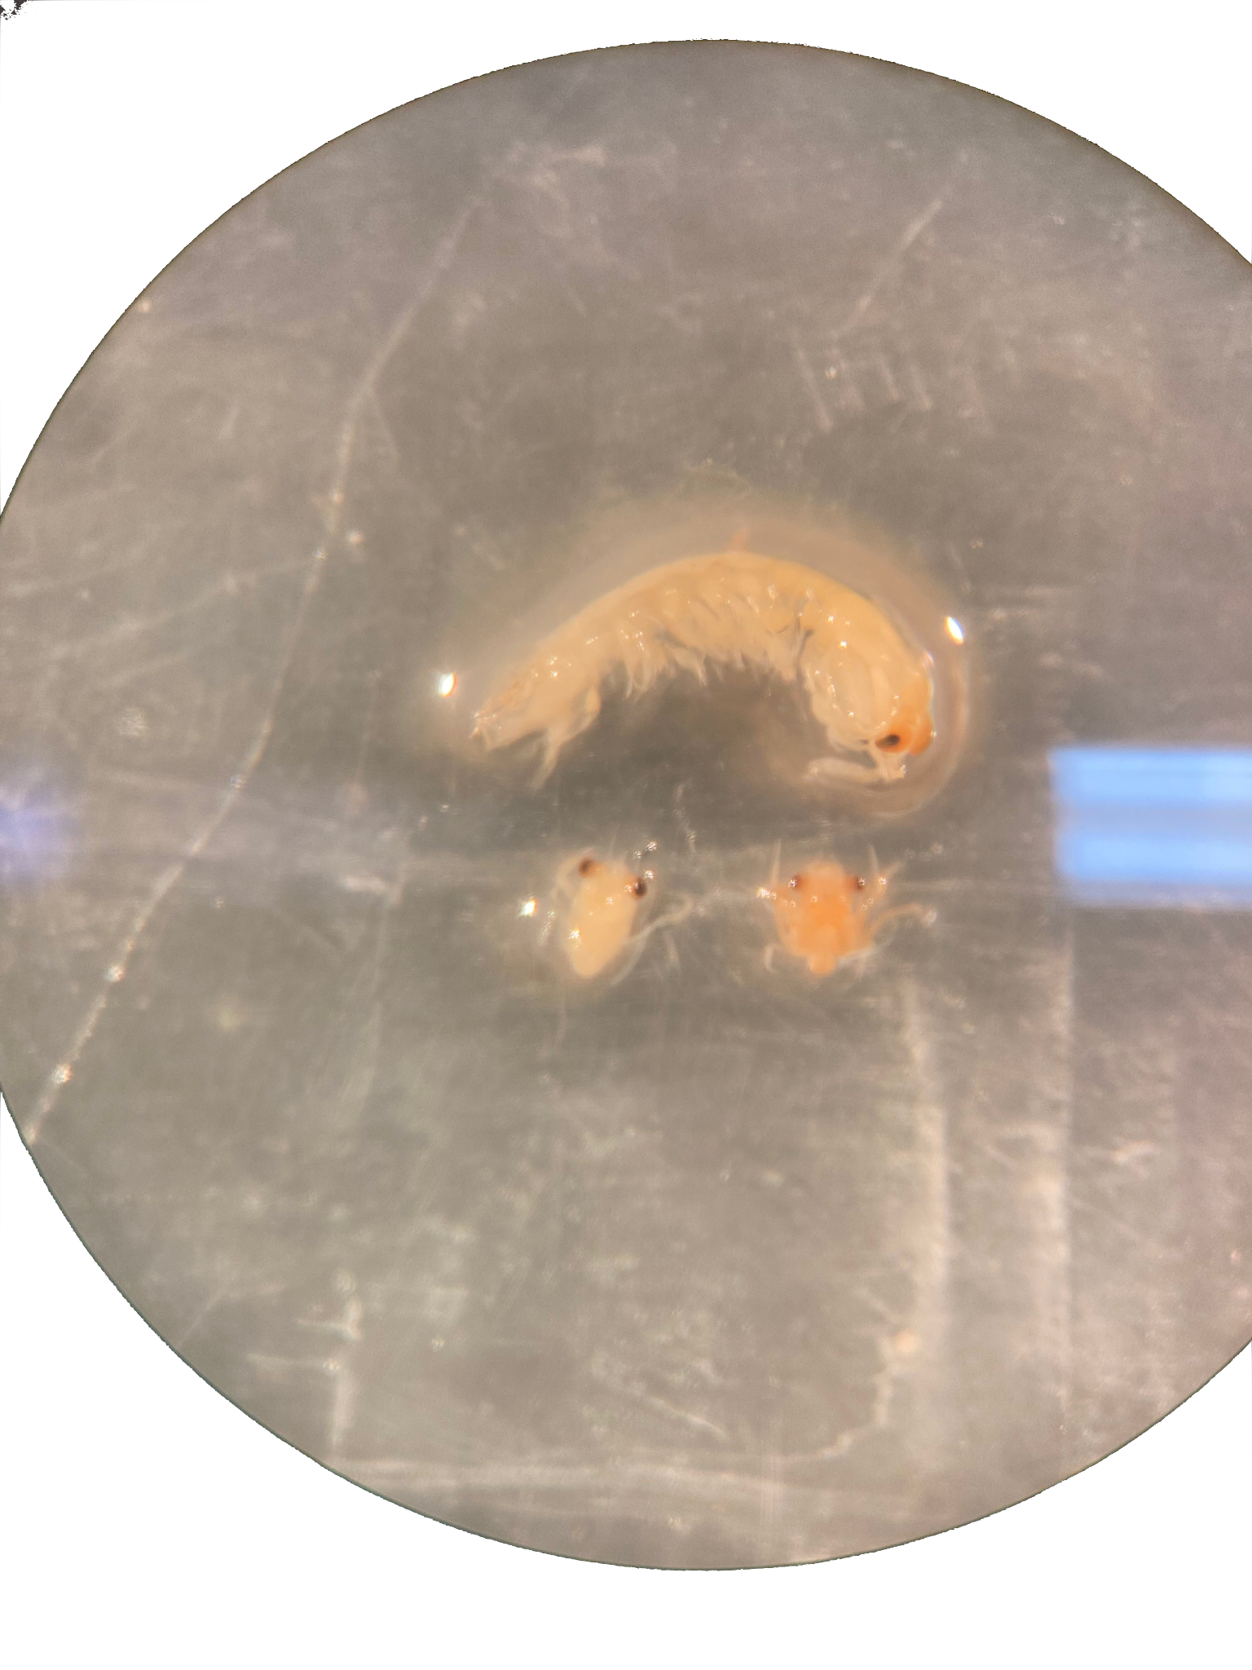
Lab analysis: Neuston samples
Samples sorted into crustacea, fish and other zooplankton and stored in 70% ethanol
Crustacea and fish identified to species
Lobster larvae identified to stage (I, II, III, IV) and measured

Slide 10
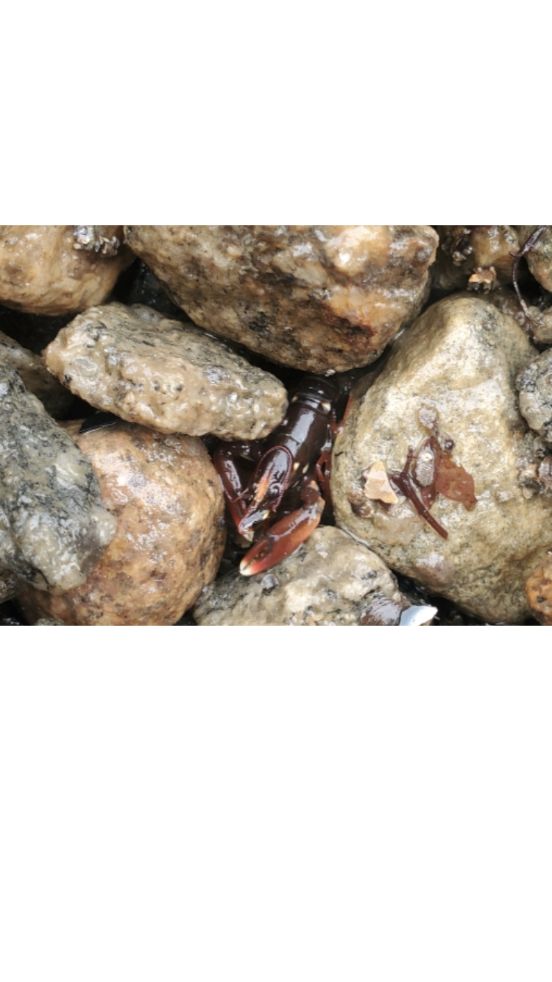
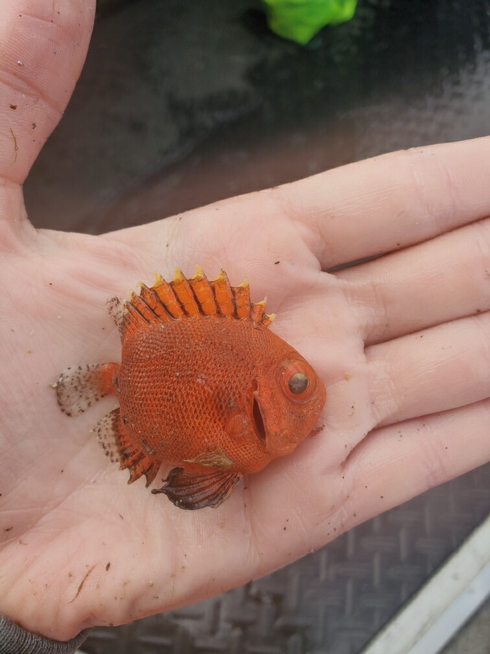
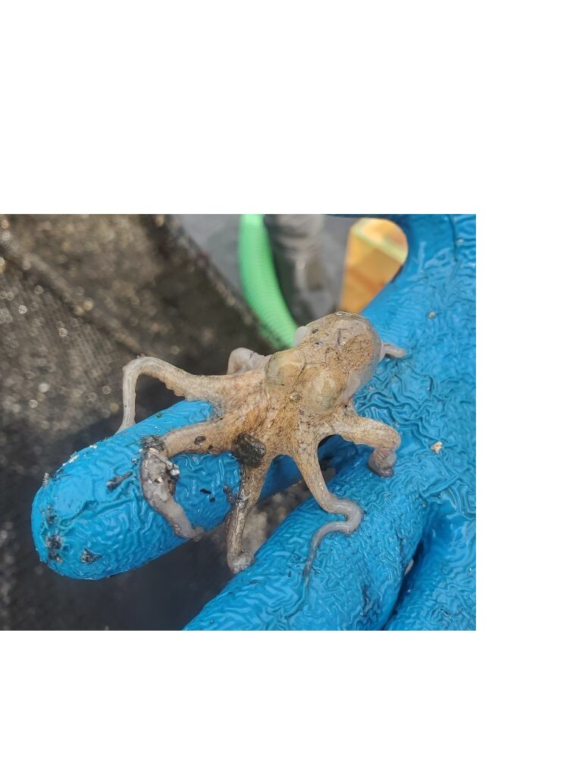
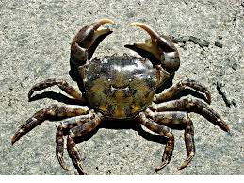
Lab analysis: Benthic Collectors
Frozen samples thawed and crustaceans and fish identified and measured
Stored in 70% ethanol
Species identified include: Black Sea Bass, Cunner, Asian Shore Crab, Cancer Crabs, Mud Crab, Short Bigeye etc.

Slide 11
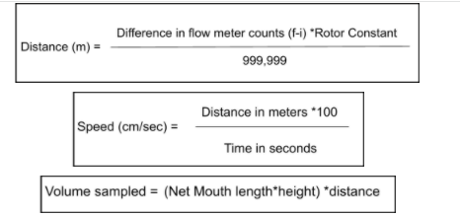
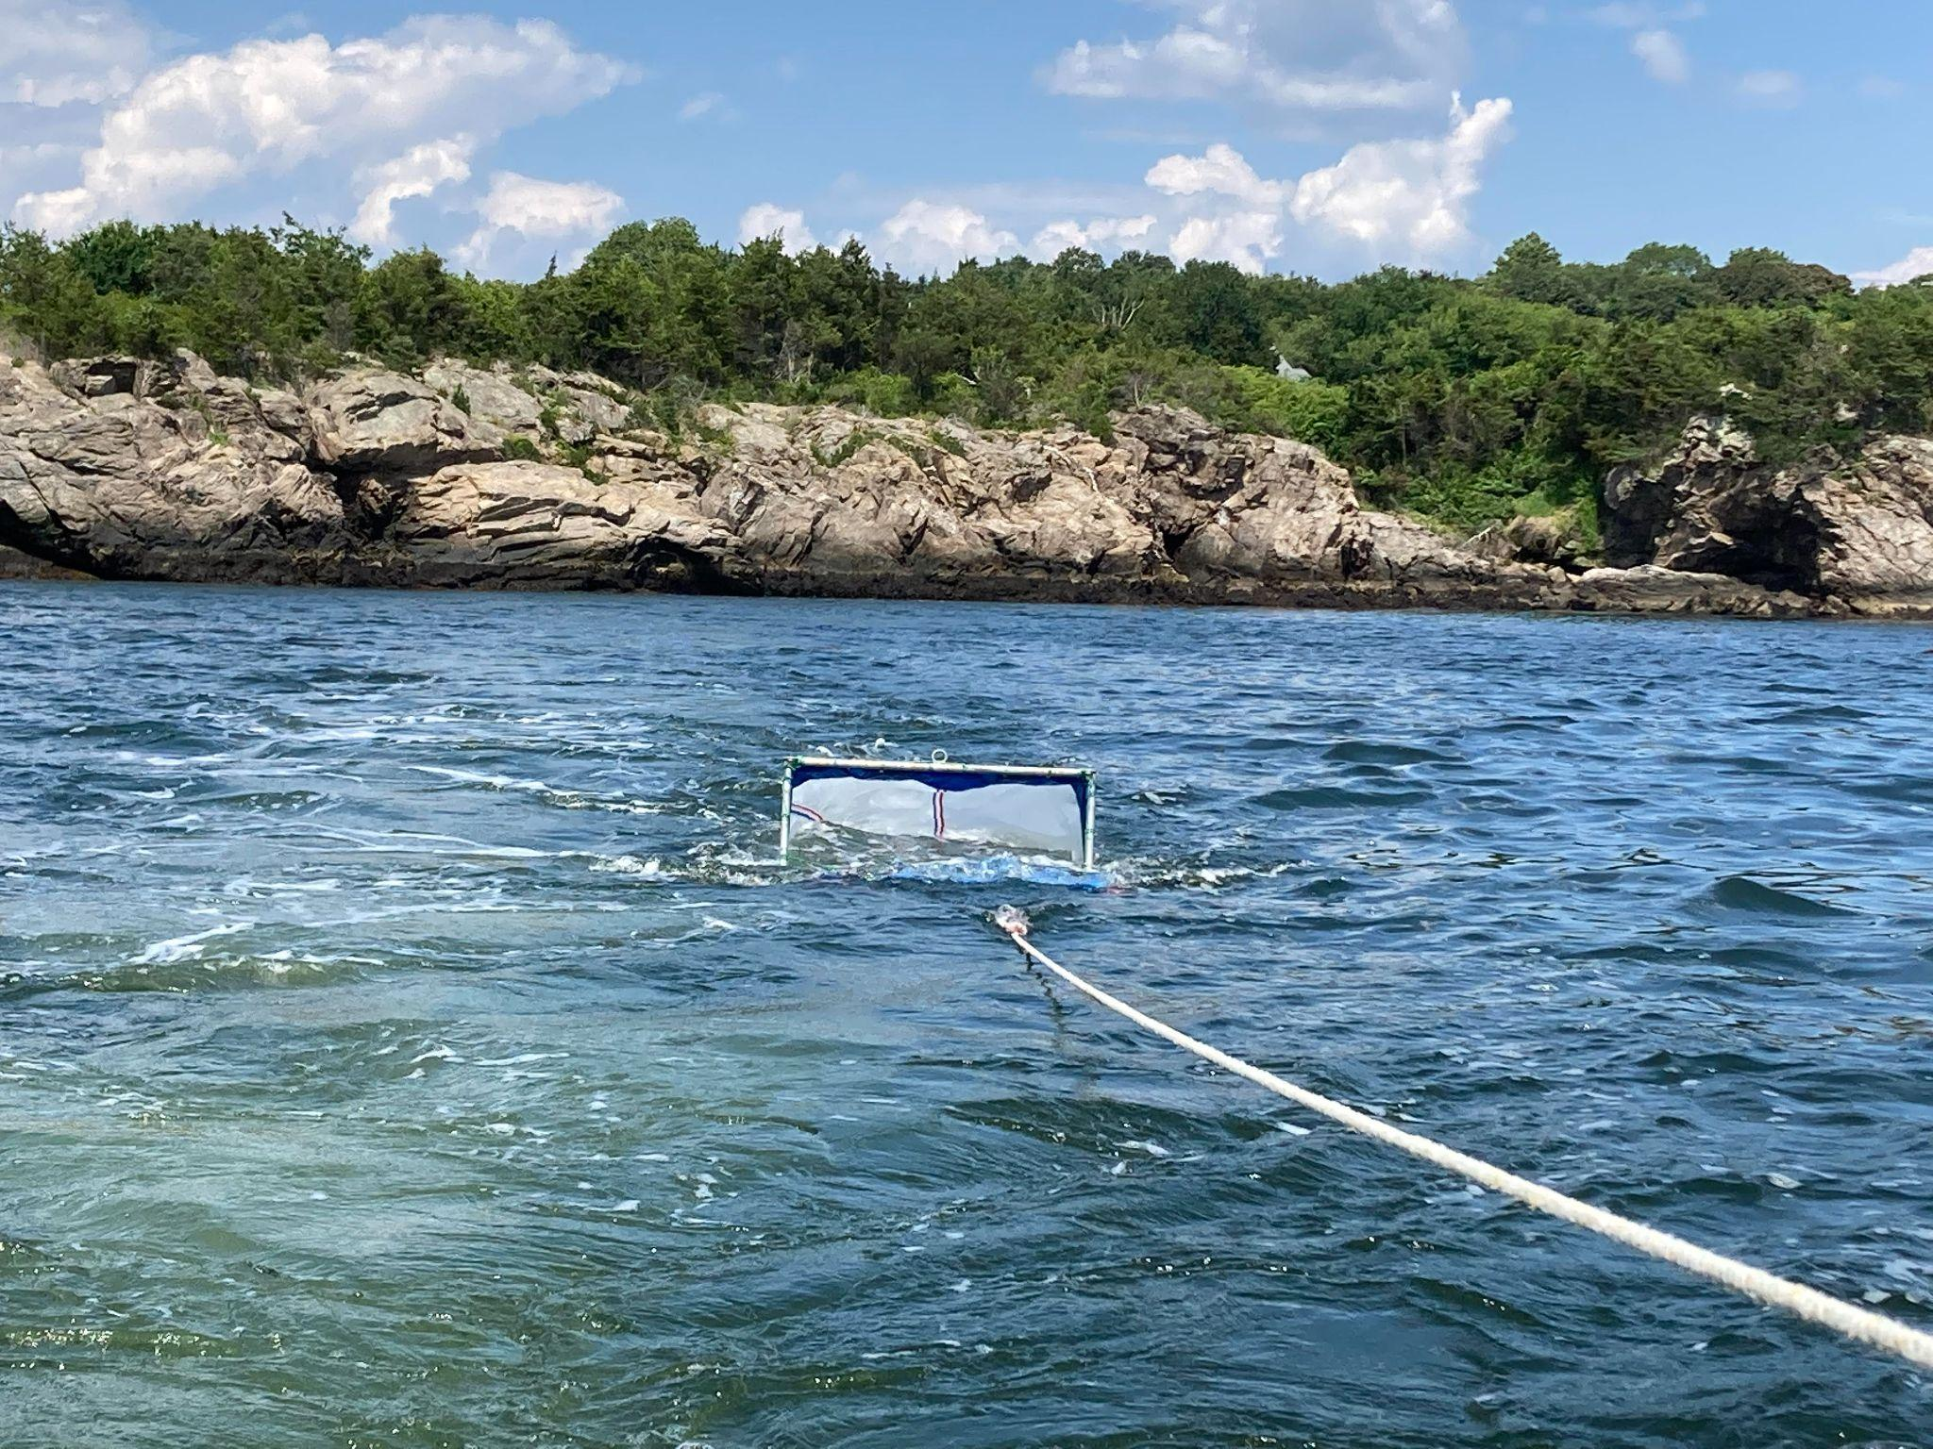
Flow Meter Calculations
Sample Date:
06/01/21: 376.5 ± 44.2 m³
06/25/21: 319.9 ± 30.1 m³
07/08/21: 312.2 ± 35.0 m³
07/16/21: 329.6 ± 29.1 m³
07/23/21: 313.9 ± 14.3 m³
07/30/21: 272.1 ± 41.3 m³
Net mouth dimensions: (1.016m x 0.6096m)/2

Slide 12
Summary & Future Steps
Preliminary Data:
13 juvenile lobsters in benthic collectors
1 classified as young-of-year (< 12mm)
Stage I, III, and IV lobsters identified in neuston tows
Lab Analyses:
Continue sorting through neuston and benthic samples
Identify, measure and count species
Compile count data to determine larval abundances (lobsters/1000m³ ) and settlement index (lobsters m⁻²)
Sampling 2022:
Planned Neuston sampling from June - August 2022
Benthic collectors restored and deployed from May-September 2022
Potentially target deeper sample sites and/or investigate offshore habitats

Slide 13
References
Atlantic States Marine Fisheries Commission (ASMFC). 2015. American Lobster Benchmark Stock Assessment and Peer Review Report Conducted on June 8–11, 2015, Woods Hole, MA. ASMFC,Arlington, VA. 462 pp
Atlantic States Marine Fisheries Commision (ASMFC) . 2020 American Lobster Benchmark Stock Assessment and Peer Review Report
Rheuban, J. E., Kavanaugh, M. T., & Doney, S. C. (2017). Implications of future northwest Atlantic bottom temperatures on the American lobster (Homarus americanus) fishery. Journal of Geophysical Research: Oceans, 122(12), 9387-9398.
St. Lawrence Global Observatory - SLGO 2011

Slide 14
Acknowledgements & Thanks
Dr. Jeremy Collie
Dr. Conor McManus
Dr. Rick Wahle
Kristyn Kleman
Corinne Truesdale
Doug and Marsha Ward
Shaina Harkins
Al Eagles
Gwen Riendeau
Annabelle Leahy
Rachel Marshall
Lanny Delinger
Questions?

