Slide 1
Portals and Logins

Slide 2
Research.gov (Fastlane)

Slide 3
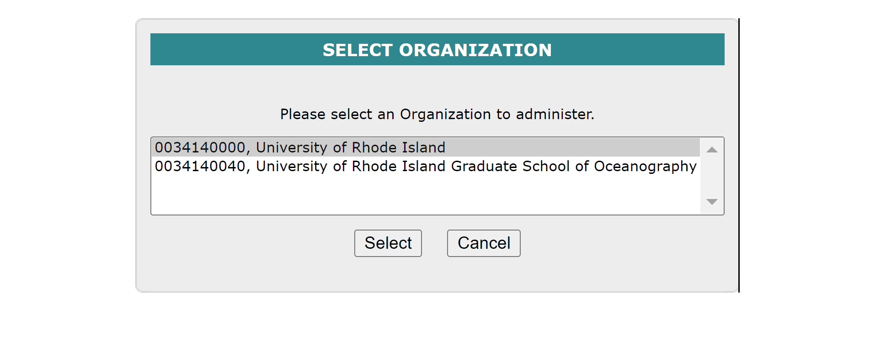
When registering with Research.gov, please use the first institution above. The Research Office will approve your role once you register. If you are coming from another institution, you will need to update your profile.
You can log in with:
Single Sign On Credential
NSF ID
Login.gov
Power Point Presentation on how to register: PowerPoint Presentation (research.gov)

Slide 4
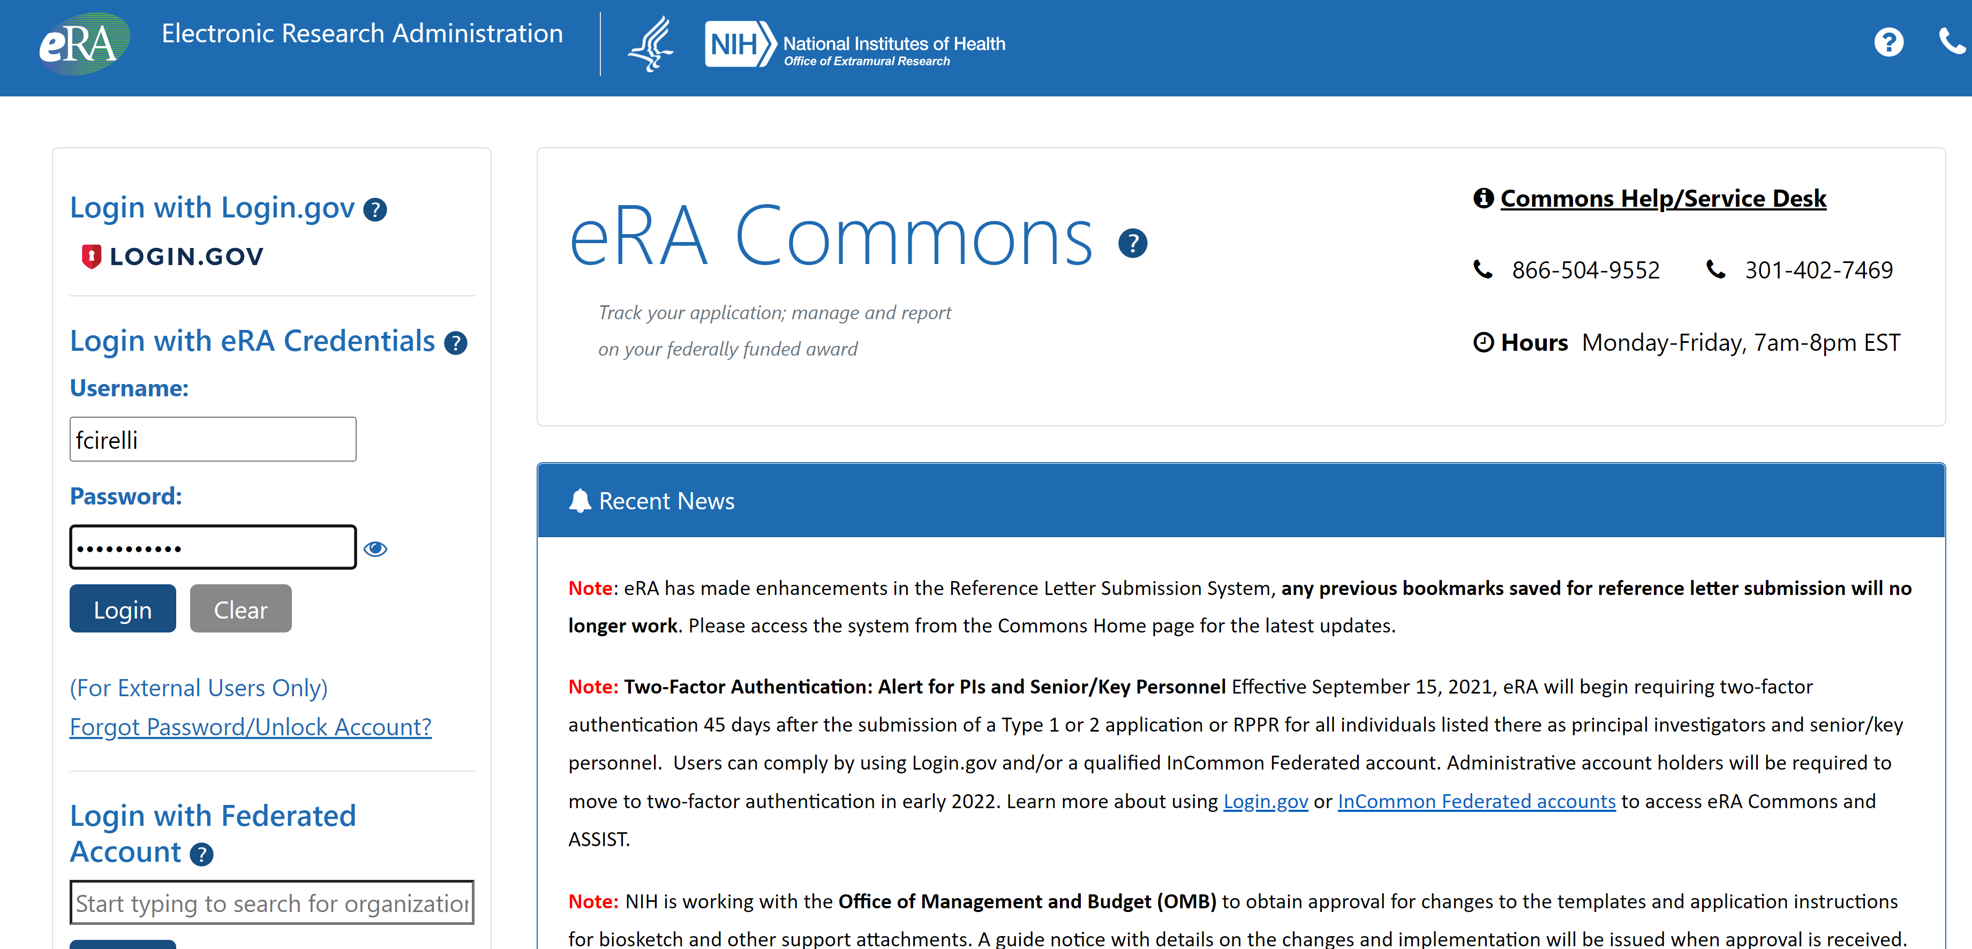
ERA commons
Login with Federated Account
For NIH ERA Commons, you can log in using the following:
Login.gov
NIH user ID and password
Federated Account

Slide 5
Era commons continued
If you wish to have an ERA commons user Id for yourself or your students, please contact the Associate Director of Preaward. We will need the following information from you.
Full Name
User Role
Email Address
We will need to know if the individual has ever had an ERA commons account at another institution. If yes, all we need to do is to affiliate the individual and update their email address.

Slide 6
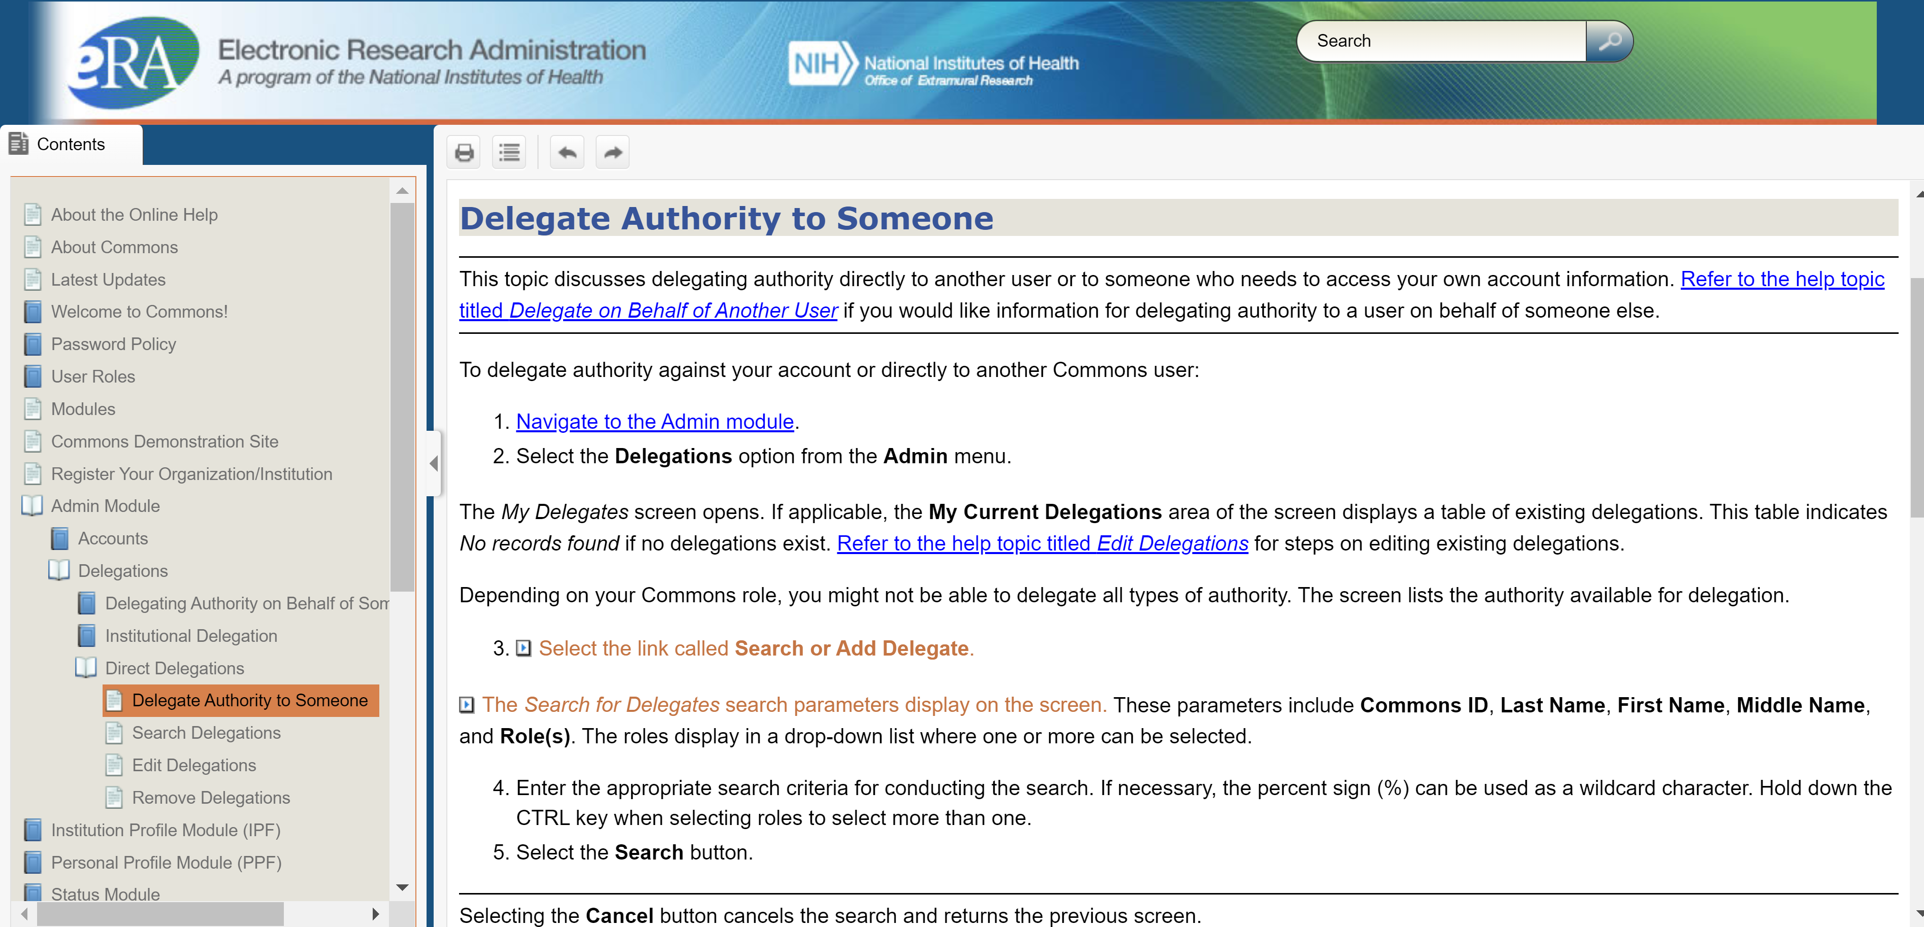
NIH Delegates
How do you make someone a delegate in ERA Commons? Delegate Authority to Someone (nih.gov)

Slide 7
NASA NSPIRES
When registering for NASA NSPIRES, you must be sure to select the correct DUNS number 144017188. If the incorrect DUNS is chosen your affiliation request will be denied and your will be asked to withdraw that request and create a new one.
The other option for a DUNS number is 796475382. The only reason this number is an option is for older awards that were originally created with this DUNS number. You should not use this.

Slide 8
Grantsolutions
About
GrantSolutions is a grants and program management Federal shared service provider that supports Federal agencies throughout the entire grants lifecycle-from forecast and funds planning to closeout.
When did my awarding bureau deploy GrantSolutions?
DOI bureaus transitioned in three groups:
Group A (transitioned on May 18, 2020): Fish and Wildlife Service, Bureau of Ocean Energy Management, and Bureau of Safety and Environmental Enforcement
Group B (transitioned on October 13, 2020): National Park Service
Group C (transitioned on November 30, 2020): Bureau of Indian Affairs/Bureau of Indian Education, Bureau of Land Management, Bureau of Reclamation, Departmental Offices (Office of Internal Affairs and Interior Business Center), Office of Surface Mining Reclamation and Enforcement, and U.S. Geological Survey

Slide 9
Grantsolutions continued
What data from my open DOI financial assistance awards will be available in GrantSolutions?
The data that recipients are able to view regarding their open DOI financial assistance awards includes, but is not limited to, the following:
Grant Number
Grant Program
Program Office
Project Title
Award Issue Date
Project Period dates
Budget Period dates
Total Approved Budget (Federal and Non-Federal)
Non-Federal Budget amount
Next Terms and Conditions Due Date (if applicable)
Amendment Status (if applicable)
Non-Competing Status (if applicable)
Non-Competing Due Date (if applicable)
Most recent Notice of Award

Slide 10
Grantsolutions continued
How do I request a new user account with grantsolutions?
Recipients can request new user accounts through the GrantSolutions homepage ( www.grantsolutions.gov) by completing and submitting the Recipient User Account Request Form to the GrantSolutions Help Desk. How will my organization receive award funding now that DOI has transitioned to GrantSolutions?

Slide 11
Grantsolutions Partners

Slide 12
Grantsolutions Partners Continued

Slide 13
Login.gov
What Is login.gov?
One account and password
“Login.gov is a secure sign in service used by the public to sign in to participating government agencies. Participating agencies will ask you to create a Login.gov account to securely access your information on their website or application.
You can use the same username and password to access any agency that partners with Login.gov. This streamlines your process and eliminates the need to remember multiple usernames and passwords.”

Slide 14
Login.gov continued
All participating agencies use Login.gov for secure sign in.
You provide two pieces of information to securely sign in and protect your information.
Password
Authentication method (such as a one-time code sent to your phone or an authentication app)
Using both a password and another method makes it difficult for others to access your information.

Slide 15
Login.gov
When you are ready to create a login.gov account – Please go to the following link Create an account | Login.gov

