Slide 1
Research Community Meeting October 13, 2022

Slide 2
Sponsored Projects Reminders and Updates
Updated Subrecipient Monitoring Guide is available: https://web.uri.edu/research-admin/submit-a-proposal/subcontract-requisition-po-internal-processes/
Guidance on submission of NIH Research Performance Progress Report (RPPR) - https://web.uri.edu/research-admin/submit-a-proposal/sponsored-projects-policies-and-procedures/research-performance-progress-report/
Please validate RPPR before releasing to OSP / Ensure ASSIST record is correct (set to “Ready for Submission”) / Provide ASSIST Record #
Updated guidance on Other Support Reporting - https://web.uri.edu/research-admin/submit-a-proposal/federal-agency-information/

Slide 3
Who does What?
Preaward staff College assignments - https://web.uri.edu/research-admin/submit-a-proposal/faq-pre-award/sponsored-projects-pre-award-college-contact/
Postaward staff College assignments – https://web.uri.edu/research-admin/post-award-college-area-contact/
Roles and Responsibilities - https://web.uri.edu/research-admin/files/Roles-and-Responsibilities-Matrix-9.22.21.pdf

Slide 4
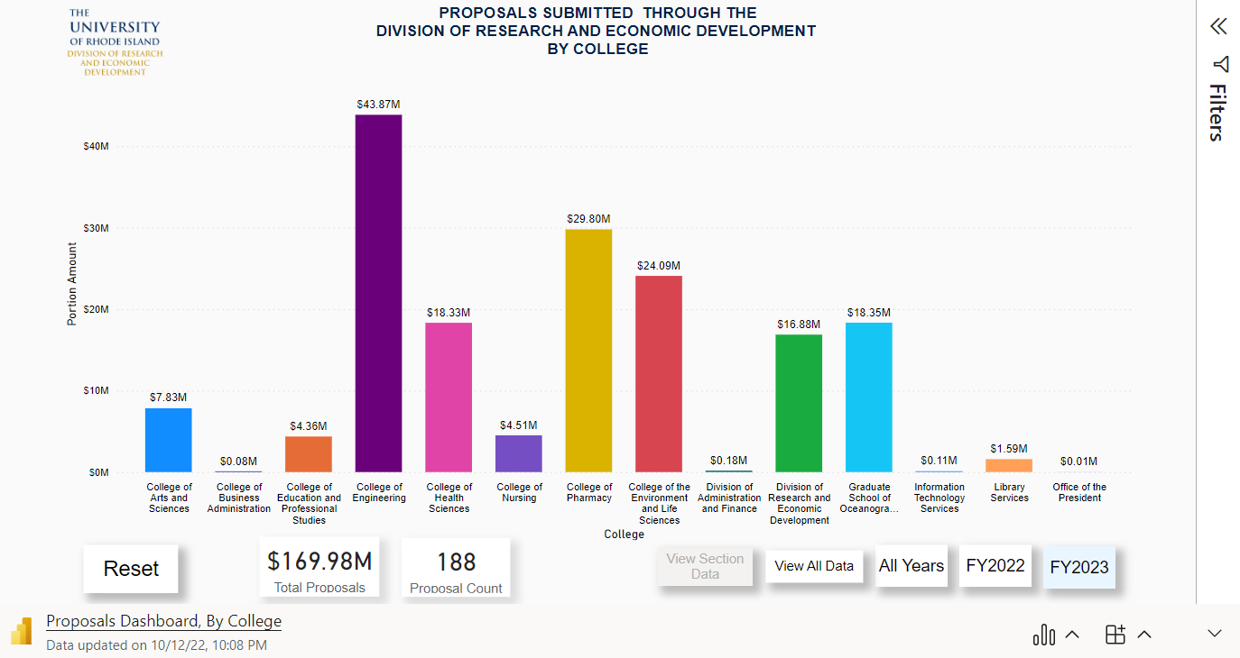
Microsoft Power BI
Proposals

Slide 5
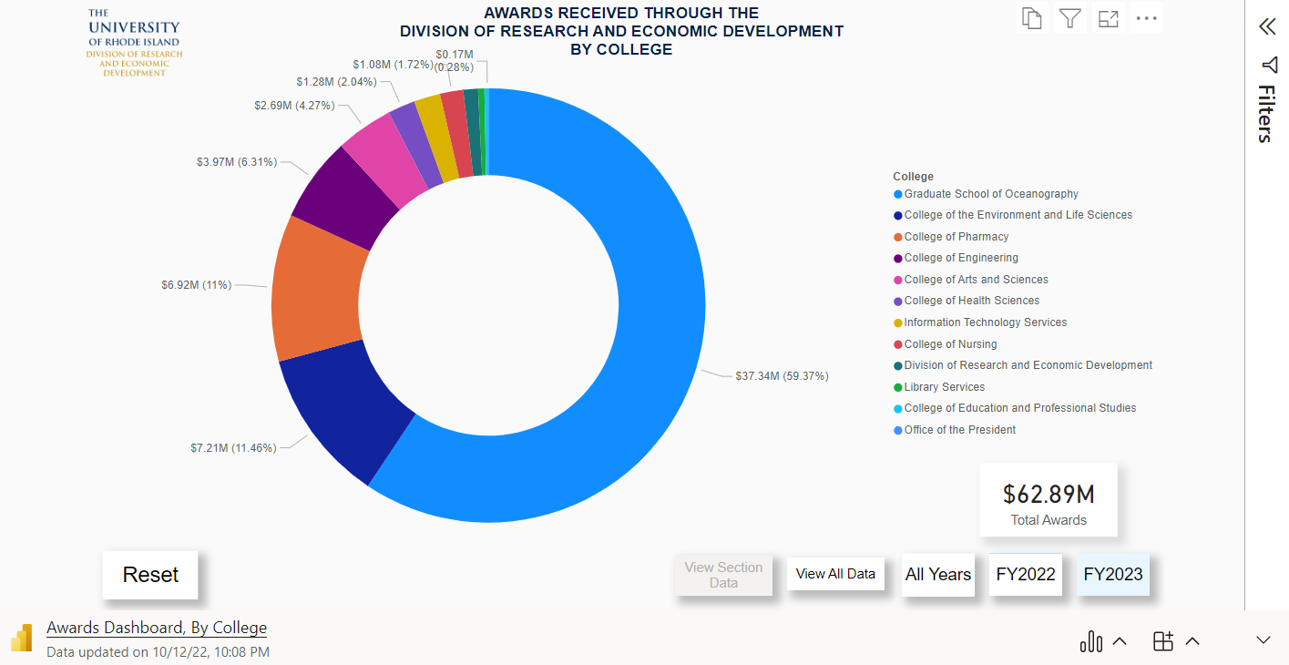
Microsoft Power BI
Awards

Slide 6
InfoEd Updates and Reminders
THANK YOU FOR THE EFFORT AS URI MIGRATES TO INFOED
When submitting a new proposal, please include title that will be submitted to the sponsor
Development of guidance for linking supplements to existing records in InfoEd - https://web.uri.edu/research-admin/infoed-era-system/infoed-training-and-documentation/user-documentation/
If an award is received, please include InfoEd number
Coming Soon:
Method to revise budget after award or after submission but before award soon.
Updated Transmittal Form coming soon.

Slide 7
Minimum Effort
Minimum Effort on Sponsored Projects Guidance (May 2022)
https://web.uri.edu/research-admin/files/Minimum-Effort-Guideline-May-2022.pdf
“The minimum amount of effort committed to a specific sponsored research activity may be no less than 1 percent of the Principal Investigator and other key personnel’s university effort.”
Any portion of effort for which the sponsor does not pay is considered cost-share and must be approved by VPR
Exclusions exist
Federal guidance on the topic:
“most Federally-funded research programs should have some level of committed faculty (or senior researchers) effort, paid or unpaid by the Federal government. This effort can be provided at any time within the fiscal year (summer months, academic year, or both).”
The clarification memo also states that, “...Some types of research programs...do not require committed faculty effort, paid or unpaid by the Federal government...”

Slide 8
Research Brown Bags
Monthly Research Brown Bag Forums – First Wednesday of the month @ Noon
All recordings are here: https://web.uri.edu/research-admin/externalrelations/news/
Topics:
March: What to Know about Federal Research Portals (e.g., Research.gov, GrantSolutions, eRA Commons) w/ Franca Cirelli
April: Purchasing Requirements w/ Tracey Angell
May: How do I complete a subaward w/ Ted Myatt
June: HR Issues Related to Research w/ Laura Kenerson
September: Cost Share: What is it and How do we Monitor It
October: Subrecipient Monitoring: PI and Department Responsibilities

Slide 9
Working Groups Reminder
InfoEd Working Group – Meets monthly
NIH Working Group – Meets quarterly
Contact tedmyatt@uri.edu to be added to invite.

Slide 10
Sponsor and Cost Accounting Updates
Under the VP of Administration & Finance – responsible for billing and receivables, reporting and audits of sponsored projects. Also, service center rate reviews and preparation of indirect cost rate (F&A rate).
F&A rate is likely to remain the same beyond 6/30/23
Staffing:
Associate Controller, Sponsored & Cost Accounting – vacant
Eileen Tobin – Director, Sponsored & Cost Accounting – audits and reporting
Stephanie DiBenedetto – Sponsored & Cost Accounting, billing
Ann Cannon – service centers, F&A rate
Chen Gu – PeopleSoft matters, F&A analysis
Steve Rydell – audits and reporting
Jeanette Vaganek – billing specialist
Daniel O’Toole – billing specialist
Lori Carr – billing specialist

Slide 11
Research Integrity Updates
Human Subjects Research
Guidance for Electronic Data Security for Human Subjects - https://web.uri.edu/research-admin/office-of-research-integrity/human-subjects-protections/human-subject-guidance/
Animal Research
New FY23 Laboratory Animal Per Diem Rates - https://web.uri.edu/research-intranet/internal-comparative-biology-resources-center/internal-cbrc-rates-and-fees/
Export Controls
Updated Export Control Policy to clarify the policy covers personnel at all URI centers or institutes- https://web.uri.edu/policies/files/Export-Control-20220802-05.101.2.pdf

Slide 12
Questions?

