Slide 1
The University of Rhode Island Department of Athletics
Admissions
September 11, 2017

Slide 2
Student-Athletes By the Numbers
Demographic Profile
Number of student-athletes: 435
Percent minority: 31%
Percent out-of-state: 76%
International Students: 5%
Percent with Pell Grant: 16%
Time Commitments
Classes: 12-15 hours per week
Study hall: 5-7 hours per week
Practice: 12-15 hours per week
Strength, conditioning & training: 4-6 hours per week
Games: 4-6 hours per game (plus travel when required)
Work and campus involvement

Slide 3
Student-Athletes By the Numbers
Academic Profile (Spring 2017)
Average spring 2017 term GPA: 3.06 (3rd consecutive semester above a 3.00!)
Average cumulative GPA: 3.03
Number of different majors: 57
Percent of student-athletes on probation: 1.8%
Percent of student-athletes on dean’s list: 42.5% (Record setting!)
6 year Student-athlete graduation rate: 64%
6 year Student-athlete success rate: 85%
Total community service hours (2016-17): 2,400

Slide 4
Student-Athlete Majors (Spring 2017)
Accounting
Animal Science
Anthropology
Applied Sociology
Art
Biological Sciences
Biology
Biomedical Engineering
Chemical Engineering
Chemistry
Civil Engineering
Communication (Master’s)
Communication Studies
Communicative Disorders
Computer Engineering
Computer Science
Economics
Elementary Education
Electrical Engineering
English
Environmental & Natural Resource Economics
Film
Finance
French
General Business Administration
Geology & Geological Oceanography
Global Business
Health Studies
History
Horticulture & Turf Management
Human Development & Family Studies
Industrial Engineering
Journalism
Kinesiology
Landscape Architecture
Management
Marine Affairs
Marine Biology
Marketing
Mathematics
Mechanical Engineering
Nursing
Nutrition & Dietetics
Ocean Engineering
Pharmaceutical Sciences
Pharmacy
Philosophy
Physical Education
Political Science
Psychology
Public Relations
Secondary Education
Sociology
Supply Chain Management
Textile, Fashion, Marketing & Design
Wildlife and Conservation Biology
Writing

Slide 5
Academic Services for Student Athletes
Supplements existing University services; all student-athletes are expected to meet with their faculty advisors at least once a semester to discuss degree requirements and academic opportunities.
Assist in resolving scheduling conflicts, determining choice of major, and investigating experiential educational opportunities.
Meet regularly with student-athletes who need additional academic support, or who have encountered serious academic difficulty. Some are also required to meet with a Learning Specialist.
Offer close academic monitoring and ongoing needs assessment. During weekly meetings, students have the opportunity to discuss academic problems and work on improving time management and study skills.
Monitor NCAA academic eligibility to ensure the student s are progressing towards timely graduation and remaining compliant with both NCAA and URI regulations.
Engage faculty through outreach opportunities such as Campus Connections & attending department meetings.

Slide 6
Athletics Department Snapshot
NCAA Division 1
Atlantic 10 Conference
Colonial Athletic Association (Football)
18 Intercollegiate Sports
14 Head Coaches
Employees (100+)
Other Departments:
Administration
Athletic Training
Sports Information/Media
Marketing/Spirit Groups
Event Management
Property Control (Equipment Room)
Strength and Conditioning
Compliance (reports to President)
Academic Advisement (reports to University College)
Development (reports to URI Foundation)
Ryan Center/Learfield Sports Properties (partners)
Unions represented: Council 94, PSA, ACT/ESP
Services “purchased” on campus:
Dining Services/Access Control/Catering
Housing Residential Life
Bookstore/Campus Copy/Ram Tech
Public Safety
Ryan Center
Services received from other departments
Controller’s office/Business Services
Human Resources/Affirmative Action
Student Affairs
Enrollment Services/Financial Aid
Health Services
Counseling Center
Admissions
Conference and Special Programs
Recreational Services

Slide 7
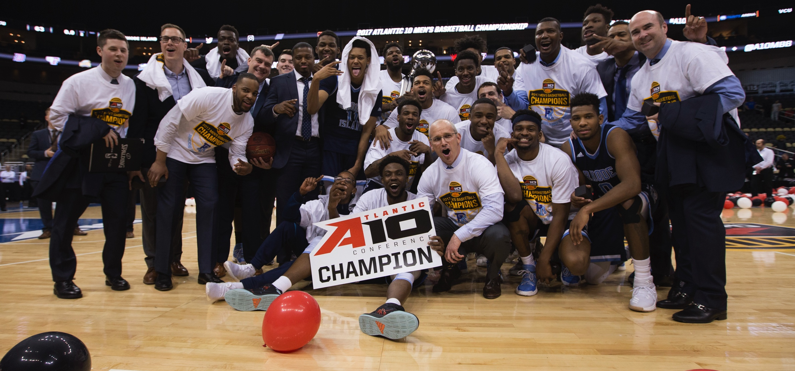
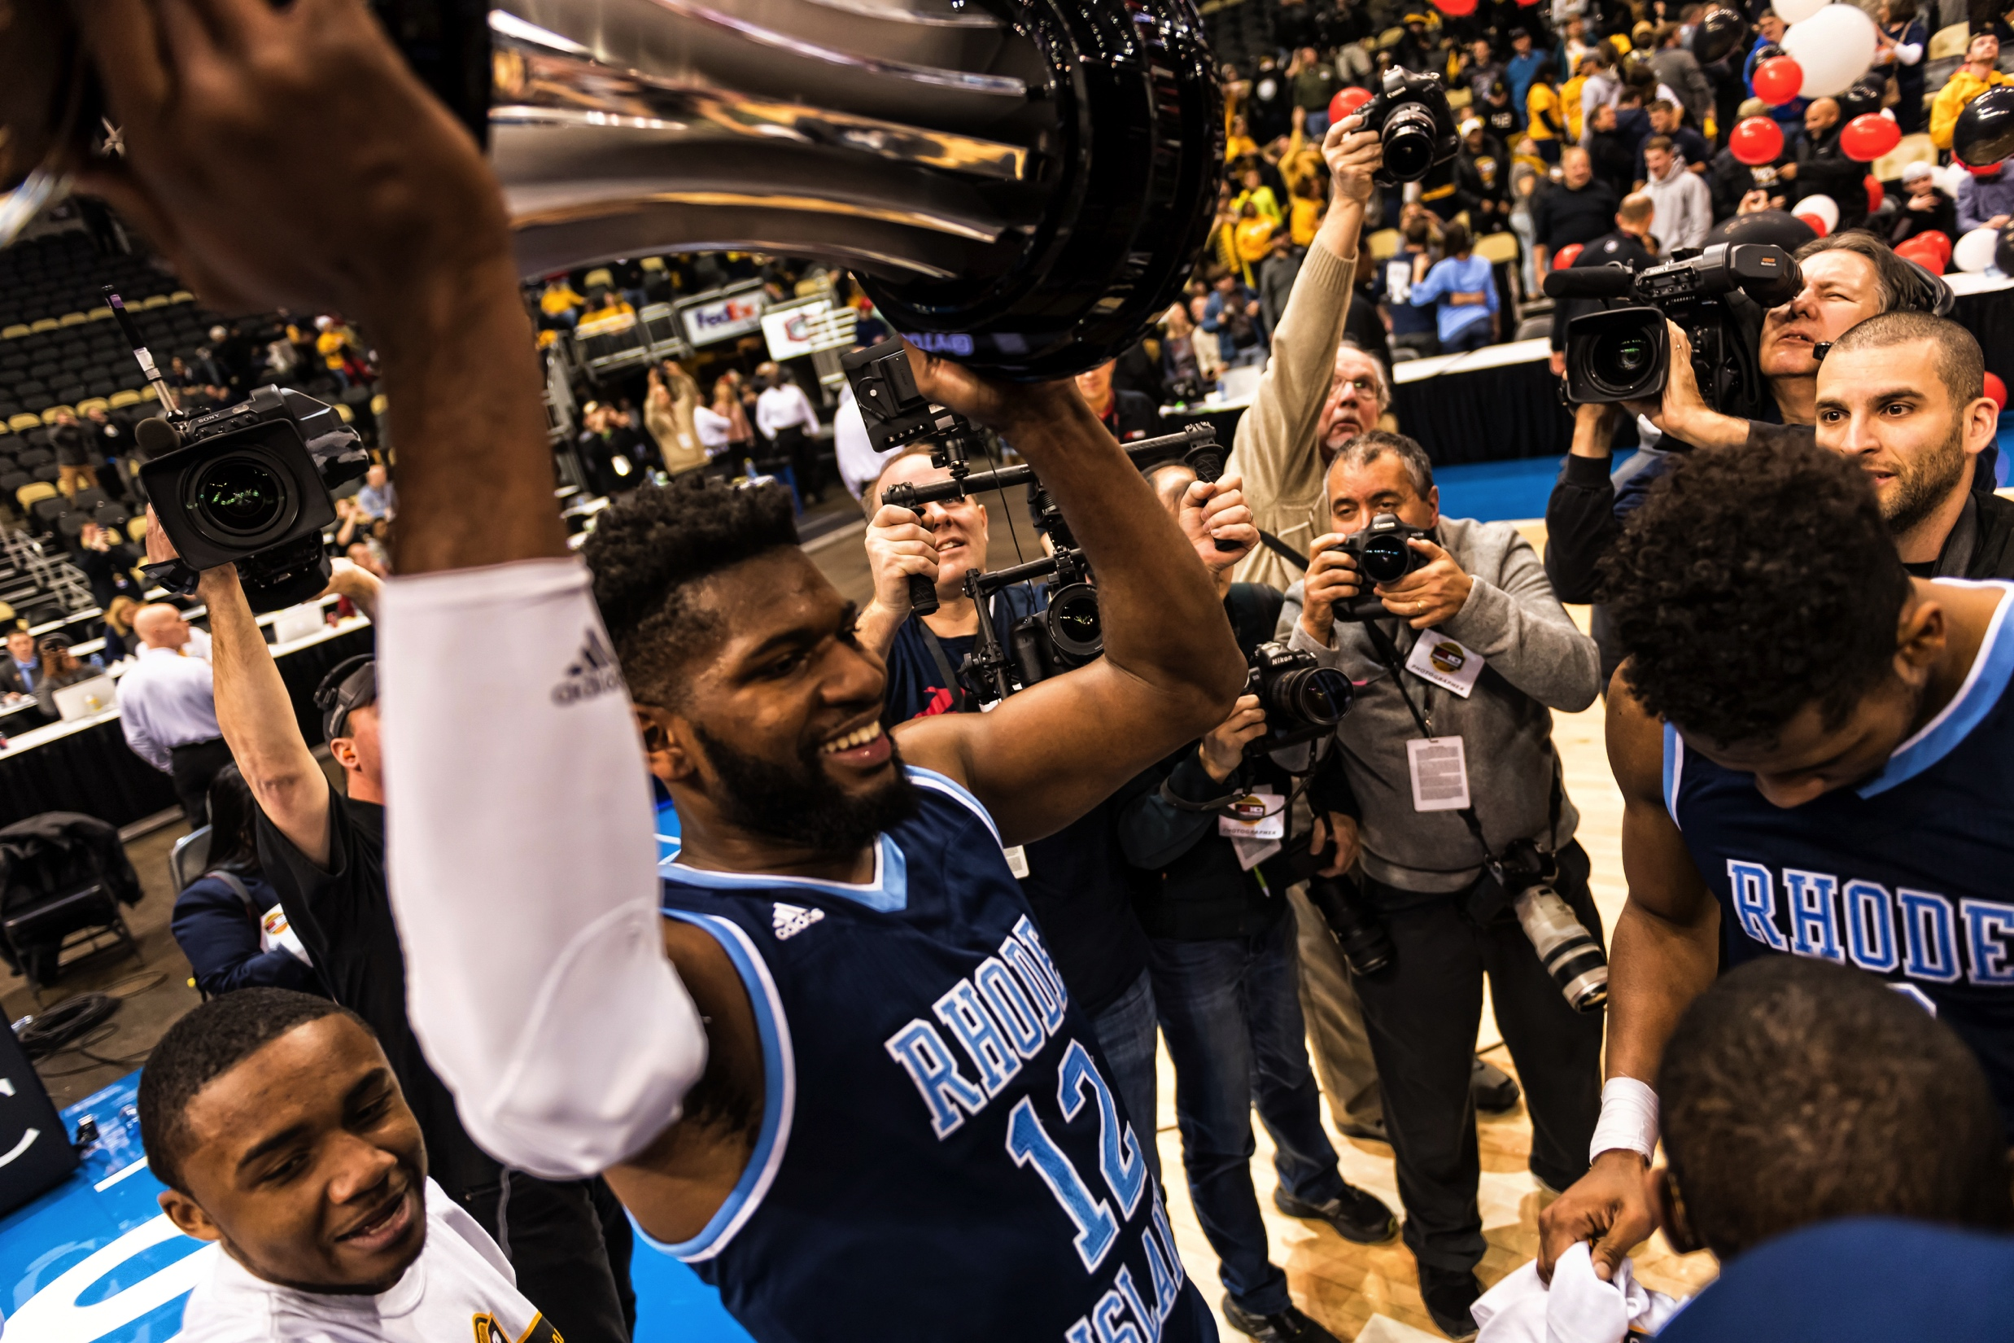
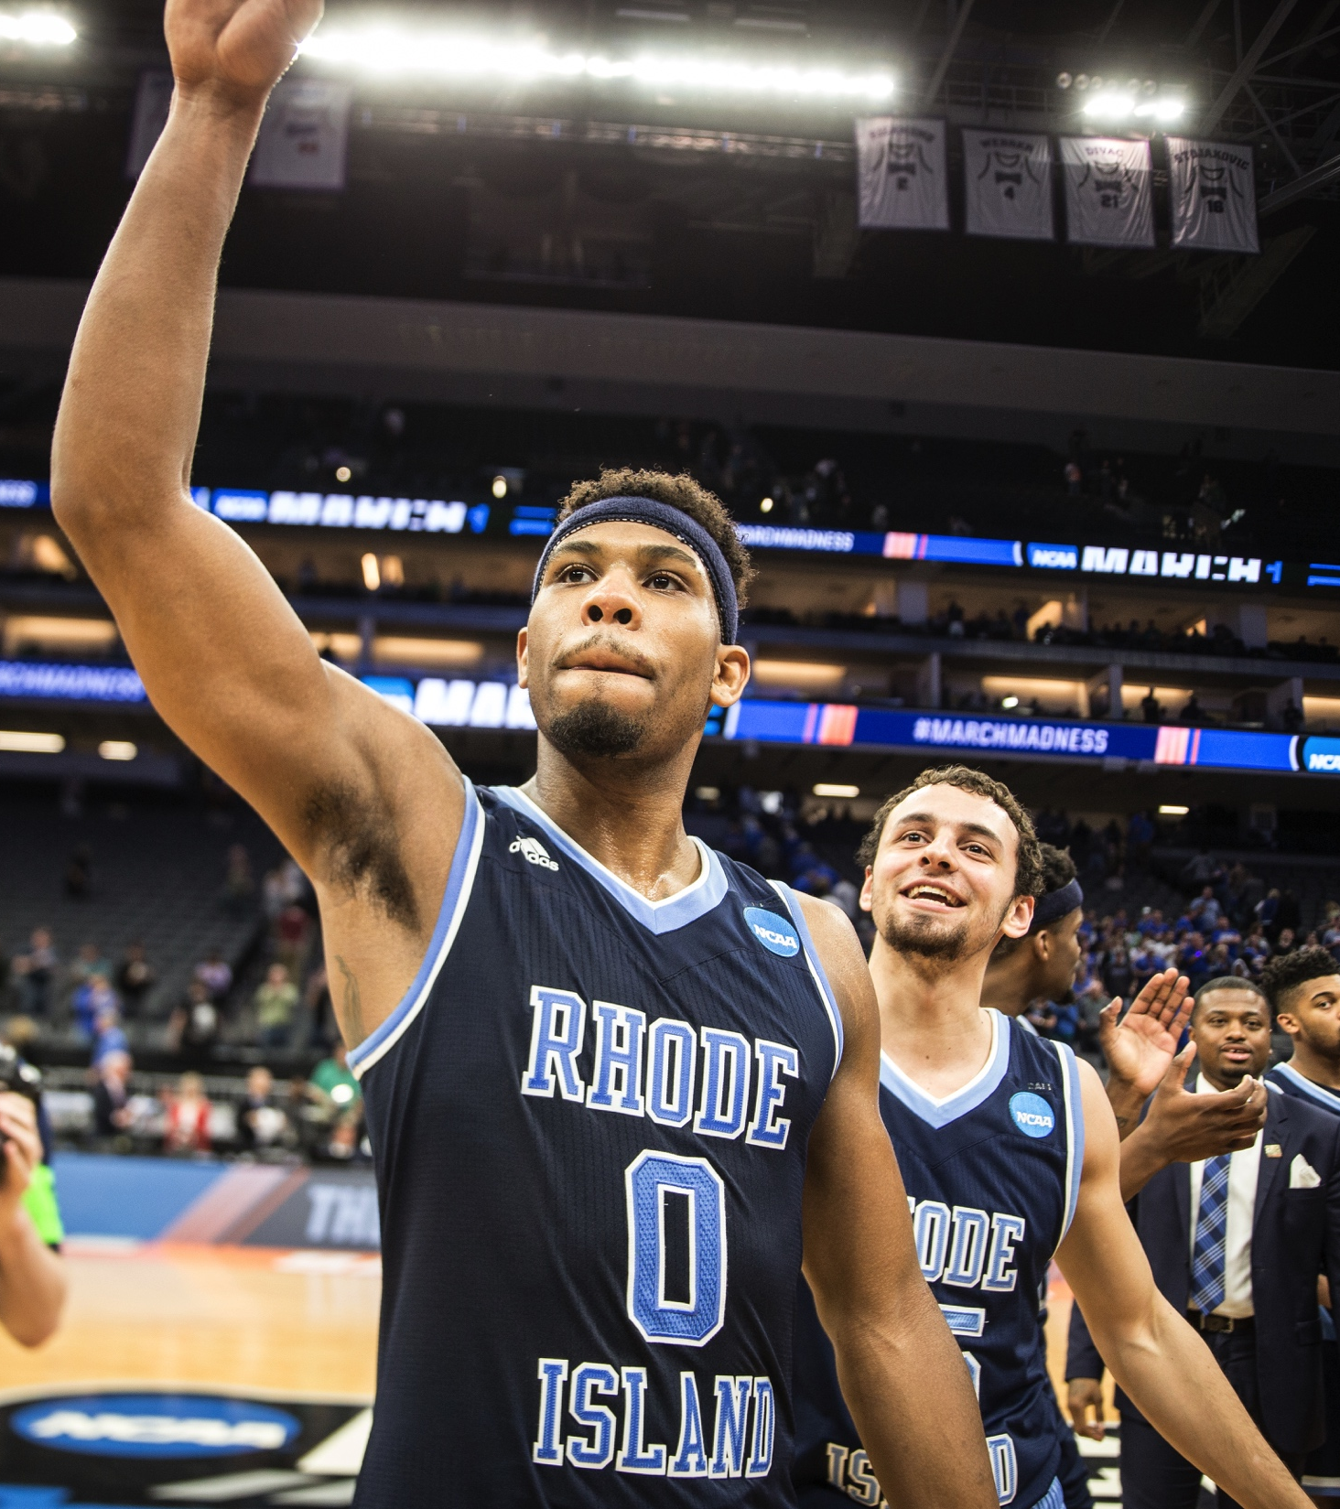
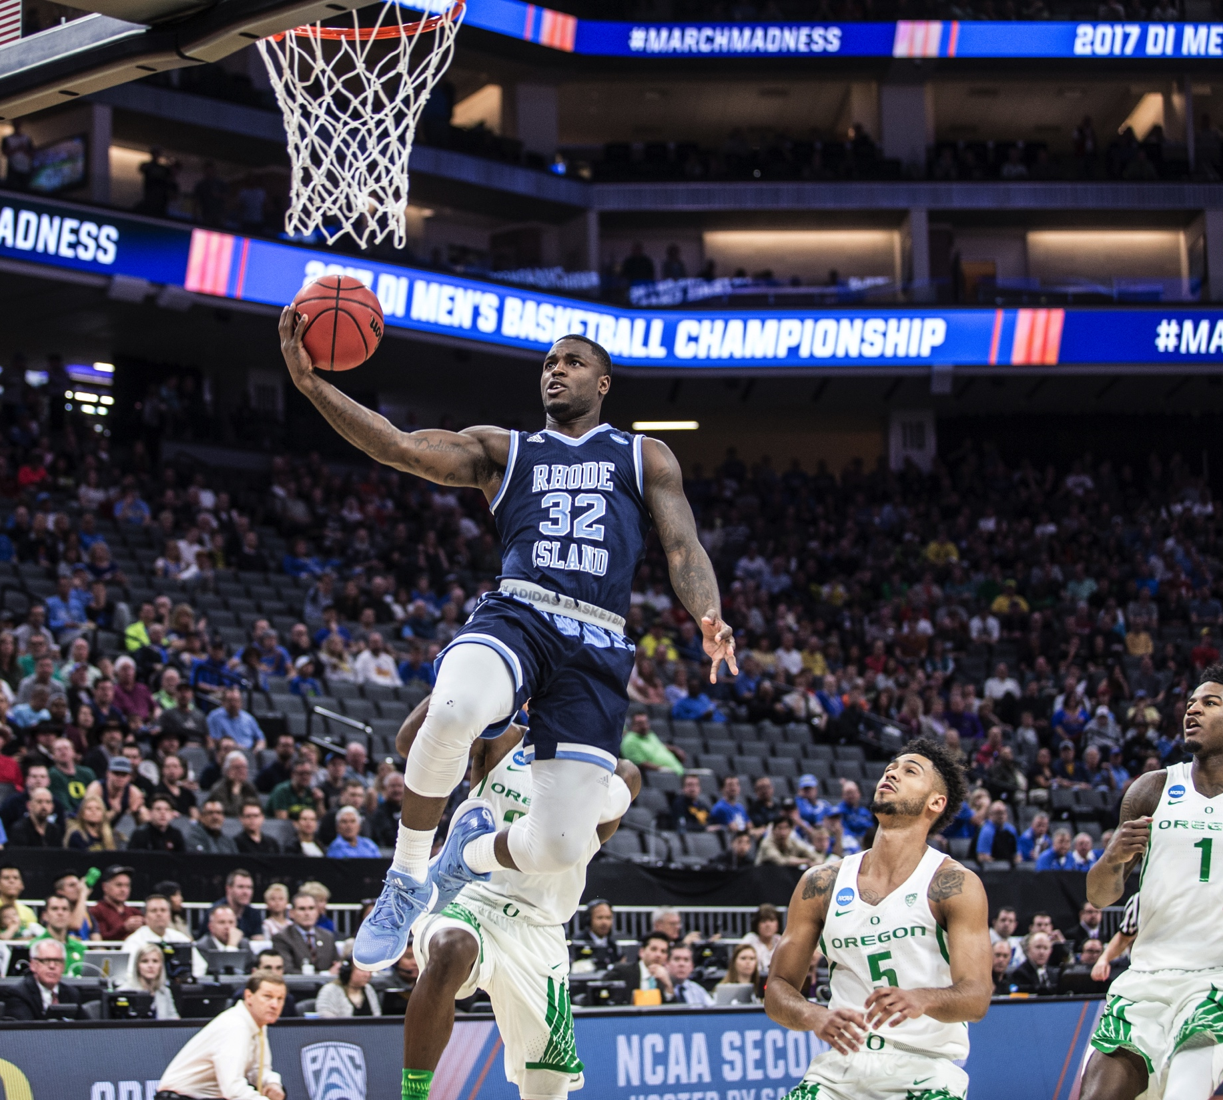
MEN’S BASKETBALL ATLANTIC 10 CHAMPS NCAA TOURNAMENT
2016-17 Rhode Island Athletics Highlights

Slide 8
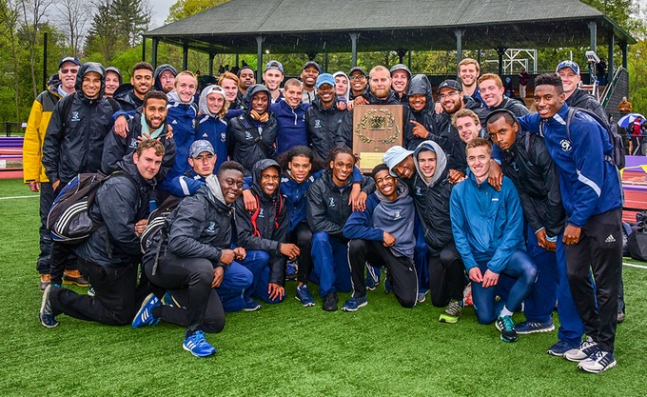
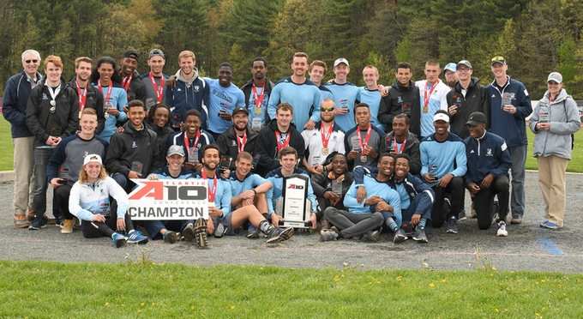
MEN’S OUTDOOR TRACK & FIELD ATLANTIC 10, NEW ENGLAND CHAMPIONS
2016-17 Rhode Island Athletics Highlights

